Slide 1

CHAPTER 1
ALL KIDNEY REPLACEMENT THERAPY IN MALAYSIA
Sunita Bavanandan
Hooi Lai Seong
Ong Loke Meng
Maisarah Jalalonmuhali
Choo Cheh Loo

Slide 2
Table 1.1.1: Stock and flow of New KRT Incidence, Malaysia 2016-2025
Year | 2025 | 2024 | 2023 | 2022 | 2021 | 2020 | 2019 | 2018 | 2017 | 2016
New Dialysis Patients | 9905 | 10056 | 10446 | 10087 | 9434 | 9492 | 9499 | 8554 | 8089 | 8110
New HD Patients | 8089 | 8249 | 8479 | 8170 | 7738 | 7923 | 8066 | 7324 | 6955 | 7104
New PD Patients | 1816 | 1807 | 1967 | 1917 | 1696 | 1569 | 1433 | 1230 | 1134 | 1006
New Transplant Patients | 277 | 258 | 283 | 215 | 80 | 152 | 160 | 99 | 112 | 92
New Dialysis Rate, pmp | 289 | 295 | 313 | 308 | 290 | 293 | 292 | 264 | 253 | 256
New HD Rate, pmp | 236 | 242 | 254 | 250 | 238 | 244 | 248 | 226 | 217 | 225
New PD Rate, pmp | 53 | 53 | 59 | 59 | 52 | 48 | 44 | 38 | 35 | 32
New Transplant Rate, pmp | 8 | 8 | 8 | 7 | 2 | 5 | 5 | 3 | 3 | 3
New HD, % | 79.4 | 80.0 | 79.0 | 79.3 | 81.3 | 82.2 | 83.5 | 84.6 | 84.8 | 86.6
New PD, % | 17.8 | 17.5 | 18.3 | 18.6 | 17.8 | 16.3 | 14.8 | 14.2 | 13.8 | 12.3
New Tx, % | 2.7 | 2.5 | 2.6 | 2.1 | 0.8 | 1.6 | 1.7 | 1.1 | 1.4 | 1.1

Slide 3
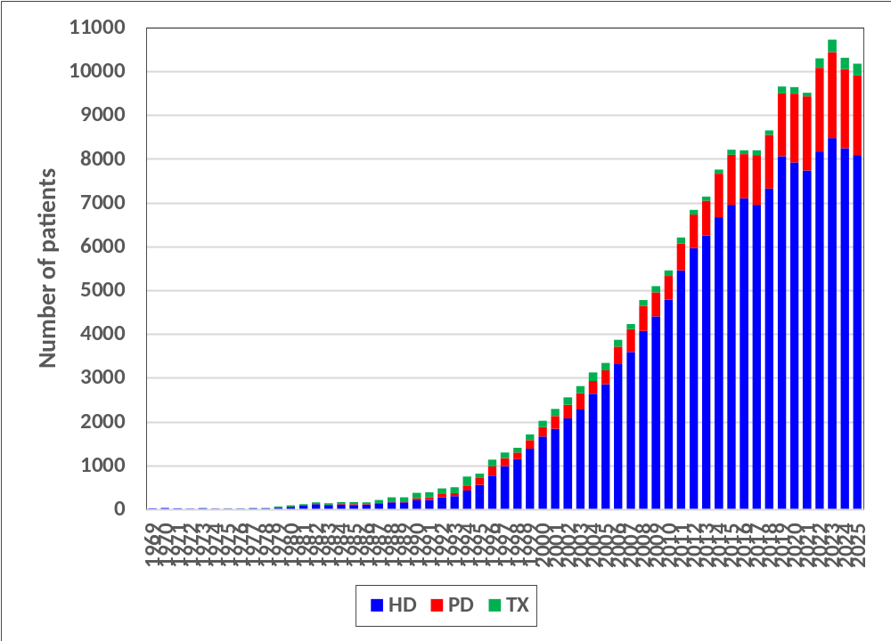
Figure 1.1.1(a): Number of new KRT patients by modality (New Dialysis and New Transplant), Malaysia 1969-2025

Slide 4
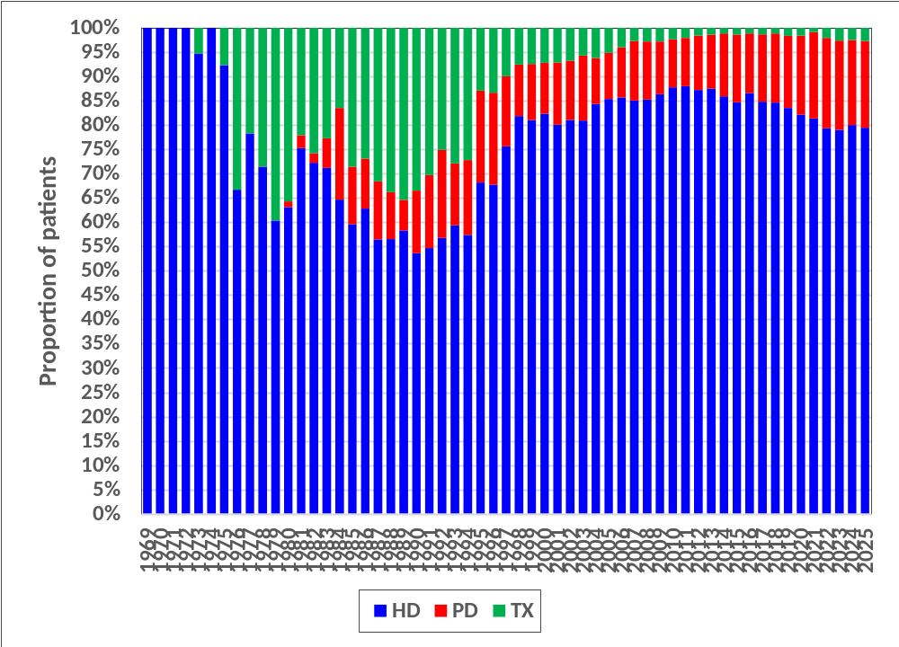
Figure 1.1.1(b): Proportion of new KRT patients by modality (New Dialysis and New Transplant), Malaysia 1969-2025

Slide 5
Table 1.1.2: Stock and flow of ESKD Patients on KRT at 31st Dec, Malaysia 2016-2025
Year | 2025 | 2024 | 2023 | 2022 | 2021 | 2020 | 2019 | 2018 | 2017 | 2016
Dialysis Patients | 57638 | 56149 | 54662 | 52221 | 50559 | 50412 | 47498 | 44758 | 42550 | 40603
HD Patients | 50833 | 49339 | 47979 | 45859 | 44633 | 44883 | 42516 | 40194 | 38264 | 36626
PD Patients | 6805 | 6810 | 6683 | 6362 | 5926 | 5529 | 4982 | 4564 | 4286 | 3977
Transplant Patients | 2441 | 2281 | 2138 | 1949 | 1862 | 1917 | 1885 | 1838 | 1860 | 1839
Dialysis Rate, pmp | 1684 | 1649 | 1636 | 1597 | 1552 | 1554 | 1460 | 1382 | 1329 | 1284
HD Rate, pmp | 1485 | 1449 | 1436 | 1402 | 1370 | 1383 | 1307 | 1241 | 1195 | 1158
PD Rate, pmp | 199 | 200 | 200 | 195 | 182 | 170 | 153 | 141 | 134 | 126
Transplant Rate, pmp | 71 | 67 | 64 | 60 | 57 | 59 | 58 | 57 | 58 | 58
HD, % | 84.6 | 84.4 | 84.5 | 84.7 | 85.1 | 85.8 | 86.1 | 86.3 | 86.2 | 86.3
PD, % | 11.3 | 11.7 | 11.8 | 11.7 | 11.3 | 10.6 | 10.1 | 9.8 | 9.7 | 9.4
Tx, % | 4.1 | 3.9 | 3.8 | 3.6 | 3.6 | 3.7 | 3.8 | 3.9 | 4.2 | 4.3

Slide 6
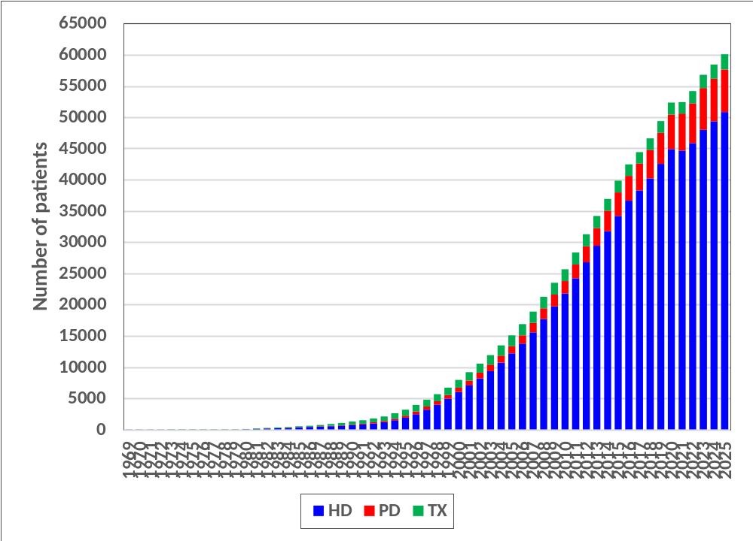
Figure 1.1.2(a): Prevalence of treated ESKD patients by modality (On KRT at 31st Dec), Malaysia 1969-2025

Slide 7
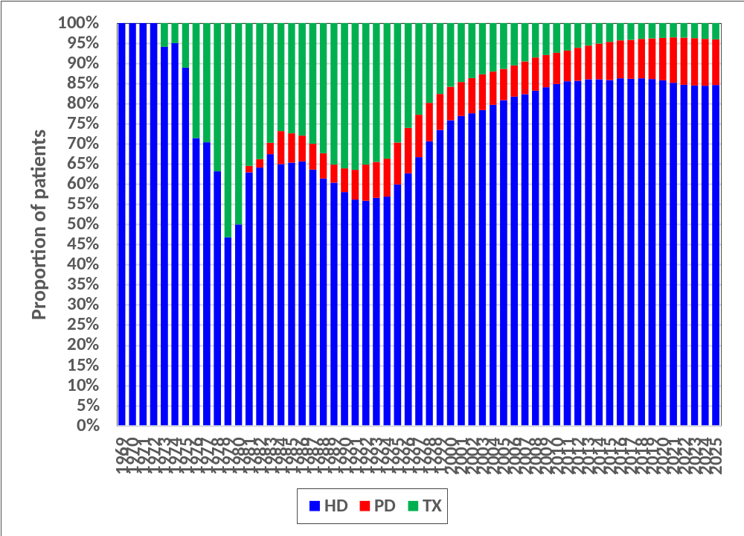
Figure 1.1.2(b): Proportion of treated prevalent ESKD patients by modality (On KRT at 31st Dec), Malaysia 1969-2025

Slide 8
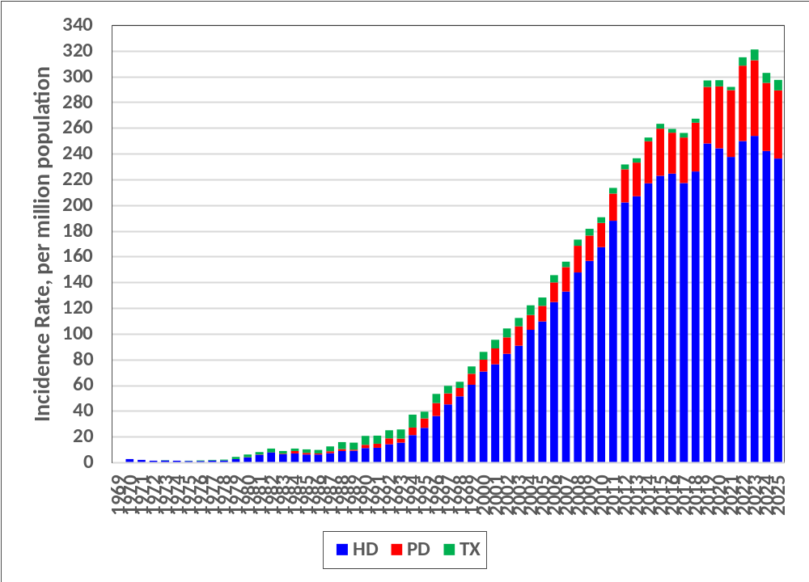
Figure 1.2.1: Incidence rate of newly treated ESKD patients (per million population) by modality (New Dialysis and New Transplant), Malaysia 1969-2025

Slide 9
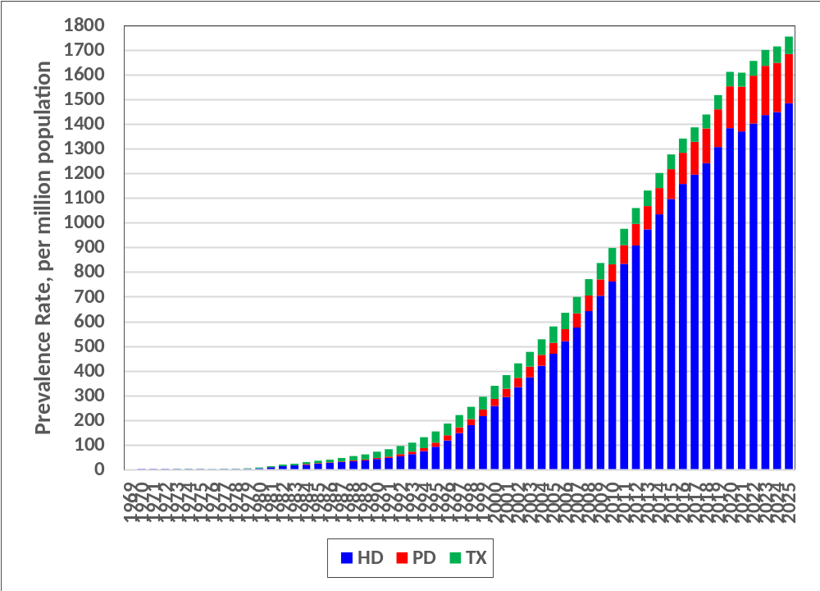
Figure 1.2.2: Prevalence rate of treated ESKD patients (per million population) by modality (On KRT at 31st Dec), Malaysia 1969-2025

Slide 10
Table 1.2.3: Kidney transplant rate per 1000 dialysis patients, 1969-2025
Year | Number of new transplant recipients | Number of prevalent dialysis patients | Kidney transplant rate per 1000 dialysis patients |  | Year | Number of new transplant recipients | Number of prevalent dialysis patients | Kidney transplant rate per 1000 dialysis patients
2025 | 277 | 57638 | 4.8 |  | 1996 | 151 | 2925 | 51.6
2024 | 258 | 56149 | 4.6 |  | 1995 | 105 | 2236 | 47.0
2023 | 283 | 54662 | 5.2 |  | 1994 | 203 | 1744 | 116.4
2022 | 215 | 52221 | 4.1 |  | 1993 | 140 | 1395 | 100.4
2021 | 80 | 50559 | 1.6 |  | 1992 | 119 | 1176 | 101.2
2020 | 152 | 50412 | 3.0 |  | 1991 | 117 | 965 | 121.2
2019 | 160 | 47498 | 3.4 |  | 1990 | 125 | 831 | 150.4
2018 | 99 | 44758 | 2.2 |  | 1989 | 96 | 696 | 137.9
2017 | 112 | 42550 | 2.6 |  | 1988 | 91 | 627 | 145.1
2016 | 92 | 40603 | 2.3 |  | 1987 | 66 | 536 | 123.1
2015 | 115 | 37968 | 3.0 |  | 1986 | 42 | 461 | 91.1
2014 | 91 | 35043 | 2.6 |  | 1985 | 46 | 402 | 114.4
2013 | 100 | 32274 | 3.1 |  | 1984 | 27 | 330 | 81.8
2012 | 108 | 29365 | 3.7 |  | 1983 | 30 | 248 | 121.0
2011 | 130 | 26416 | 4.9 |  | 1982 | 40 | 190 | 210.5
2010 | 128 | 23779 | 5.4 |  | 1981 | 25 | 120 | 208.3
2009 | 142 | 21638 | 6.6 |  | 1980 | 30 | 55 | 545.5
2008 | 133 | 19430 | 6.8 |  | 1979 | 23 | 29 | 793.1
2007 | 113 | 17112 | 6.6 |  | 1978 | 8 | 24 | 333.3
2006 | 153 | 15098 | 10.1 |  | 1977 | 5 | 19 | 263.2
2005 | 173 | 13369 | 12.9 |  | 1976 | 6 | 15 | 400.0
2004 | 194 | 11853 | 16.4 |  | 1975 | 1 | 16 | 62.5
2003 | 160 | 10421 | 15.4 |  | 1974 | 0 | 19 | 0.0
2002 | 172 | 9119 | 18.9 |  | 1973 | 1 | 16 | 62.5
2001 | 163 | 7844 | 20.8 |  | 1972 | 0 | 17 | 0.0
2000 | 145 | 6704 | 21.6 |  | 1971 | 0 | 15 | 0.0
1999 | 127 | 5555 | 22.9 |  | 1970 | 0 | 18 | 0.0
1998 | 106 | 4551 | 23.3 |  | 1969 | 0 | 12 | 0.0
1997 | 129 | 3708 | 34.8

Slide 11
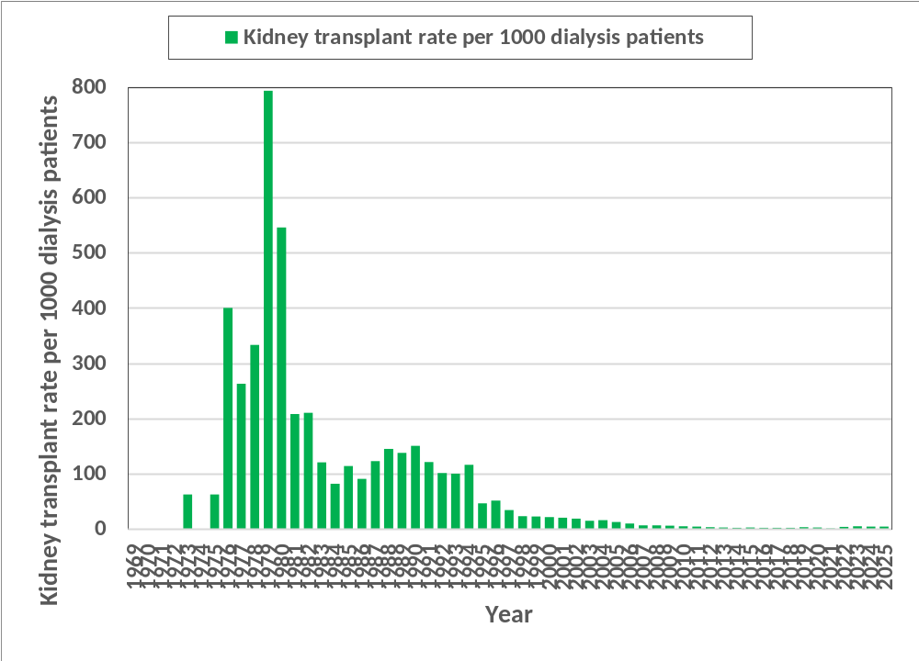
Figure 1.2.3(a): Kidney transplant rate per 1000 dialysis patients, Malaysia 1969-2025

Slide 12
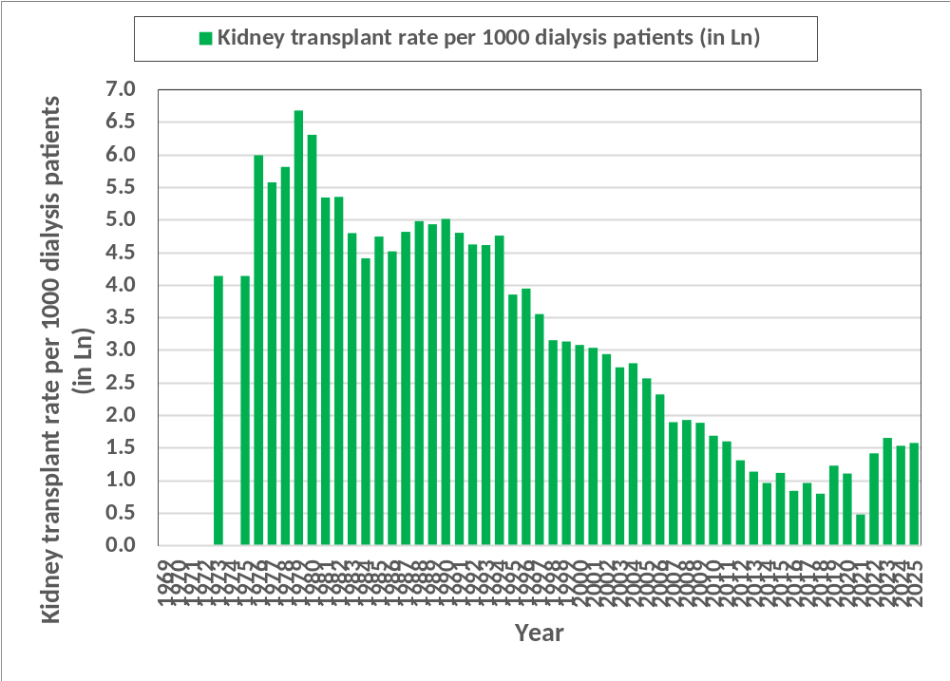
Figure 1.2.3(b): Kidney transplant rate per 1000 dialysis patients (in Ln), Malaysia 1969-2025

Slide 13
Table 1.3.1: HIV positive patients in the KRT population, 2023-2025
 | Haemodialysis |  | Peritoneal Dialysis |  | Kidney Transplant |  | Total
 | n | % | n | % | n | % | n | %
2025
MOH | 67 | 97.1 | 63 | 88.7 | 3 | 75.0 | 133 | 92.4
PRIVATE | 0 | 0.0 | 1 | 1.4 | 0 | 0.0 | 1 | 0.7
UNIVERSITY | 2 | 2.9 | 7 | 9.9 | 1 | 25.0 | 10 | 6.9
Total | 69 | 100 | 71 | 100 | 4 | 100 | 144 | 100
2024
MOH | 57 | 95.0 | 52 | 85.2 | 2 | 66.7 | 111 | 89.5
PRIVATE | 1 | 1.7 | 1 | 1.6 | 0 | 0.0 | 2 | 1.6
UNIVERSITY | 2 | 3.3 | 8 | 13.1 | 1 | 33.3 | 11 | 8.9
Total | 60 | 100 | 61 | 100 | 3 | 100 | 124 | 100
2023
MOH | 49 | 96.1 | 59 | 88.1 | 2 | 66.7 | 110 | 90.9
PRIVATE | 0 | 0.0 | 1 | 1.5 | 0 | 0.0 | 1 | 0.8
UNIVERSITY | 2 | 3.9 | 7 | 10.4 | 1 | 33.3 | 10 | 8.3
Total | 51 | 100 | 67 | 100 | 3 | 100 | 121 | 100
NGO = Non-governmental organisation
HIV = human immunodeficiency virus

Slide 14
Table 1.4.1: Work related rehabilitation in relation to modality, new dialysis patients 2016 - 2025
 | 2025 |  | 2024 |  | 2023 |  | 2022 |  | 2021
 | n | % | n | % | n | % | n | % | n | %
Working full or part time for pay | 1639 | 21.3 | 1718 | 22.5 | 1708 | 21.3 | 1582 | 20.4 | 1451 | 20.0
Home maker e.g. Housewife | 2085 | 27.1 | 2170 | 28.5 | 2006 | 25.0 | 2004 | 25.9 | 1861 | 25.6
Student (full-time) | 48 | 0.6 | 71 | 0.9 | 78 | 1.0 | 79 | 1.0 | 76 | 1.0
Not working for pay | 3914 | 50.9 | 3668 | 48.1 | 4231 | 52.7 | 4076 | 52.7 | 3872 | 53.3
Total | 7686 | 100 | 7627 | 100 | 8023 | 100 | 7741 | 100 | 7260 | 100
 | 2020 |  | 2019 |  | 2018 |  | 2017 |  | 2016
 | n | % | n | % | n | % | n | % | n | %
Working full or part time for pay | 1333 | 17.8 | 1326 | 18.4 | 1306 | 19.4 | 1269 | 20.8 | 1332 | 23.6
Home maker e.g. Housewife | 1903 | 25.4 | 1858 | 25.8 | 1679 | 24.9 | 1453 | 23.8 | 1114 | 19.8
Student (full-time) | 78 | 1.0 | 87 | 1.2 | 71 | 1.1 | 66 | 1.1 | 75 | 1.3
Not working for pay | 4171 | 55.7 | 3934 | 54.6 | 3682 | 54.6 | 3312 | 54.3 | 3115 | 55.3
Total | 7485 | 100 | 7205 | 100 | 6738 | 100 | 6100 | 100 | 5636 | 100
analysis based on new patient with available data (alive as of 31 December)

Slide 15
Table 1.4.2: Work related rehabilitation in relation to year of entry, new HD patients 2016 - 2025
 | 2025 |  | 2024 |  | 2023 |  | 2022 |  | 2021
 | n | % | n | % | n | % | n | % | n | %
Working full or part time for pay | 1216 | 19.2 | 1280 | 20.4 | 1302 | 19.9 | 1178 | 18.8 | 1094 | 18.5
Home maker e.g. Housewife | 1687 | 26.7 | 1796 | 28.6 | 1668 | 25.4 | 1615 | 25.8 | 1521 | 25.8
Student (full-time) | 15 | 0.2 | 20 | 0.3 | 23 | 0.4 | 28 | 0.4 | 26 | 0.4
Not working for pay | 3402 | 53.8 | 3173 | 50.6 | 3563 | 54.3 | 3444 | 55.0 | 3262 | 55.3
Total | 6320 | 100 | 6269 | 100 | 6556 | 100 | 6265 | 100 | 5903 | 100
 | 2020 |  | 2019 |  | 2018 |  | 2017 |  | 2016
 | n | % | n | % | n | % | n | % | n | %
Working full or part time for pay | 1046 | 16.7 | 1068 | 17.7 | 1051 | 18.4 | 1040 | 20.2 | 1147 | 23.6
Home maker e.g. Housewife | 1587 | 25.4 | 1576 | 26.1 | 1424 | 25.0 | 1224 | 23.7 | 951 | 19.6
Student (full-time) | 25 | 0.4 | 23 | 0.4 | 17 | 0.3 | 24 | 0.5 | 30 | 0.6
Not working for pay | 3593 | 57.5 | 3369 | 55.8 | 3208 | 56.3 | 2868 | 55.6 | 2736 | 56.3
Total | 6251 | 100 | 6036 | 100 | 5700 | 100 | 5156 | 100 | 4864 | 100
analysis based on new patient with available data (alive as of 31 December)

Slide 16
Table 1.4.3: Work related rehabilitation in relation to year of entry, new PD patients 2016 – 2025
 | 2025 |  | 2024 |  | 2023 |  | 2022 |  | 2021
 | n | % | n | % | n | % | n | % | n | %
Working full or part time for pay | 423 | 31.0 | 438 | 32.3 | 406 | 27.7 | 404 | 27.4 | 357 | 26.3
Home maker e.g. Housewife | 398 | 29.1 | 374 | 27.5 | 338 | 23.0 | 389 | 26.4 | 340 | 25.1
Student (full-time) | 33 | 2.4 | 51 | 3.8 | 55 | 3.7 | 51 | 3.5 | 50 | 3.7
Not working for pay | 512 | 37.5 | 495 | 36.5 | 668 | 45.5 | 632 | 42.8 | 610 | 45.0
Total | 1366 | 100 | 1358 | 100 | 1467 | 100 | 1476 | 100 | 1357 | 100
 | 2020 |  | 2019 |  | 2018 |  | 2017 |  | 2016
 | n | % | n | % | n | % | n | % | n | %
Working full or part time for pay | 287 | 23.3 | 258 | 22.1 | 255 | 24.6 | 229 | 24.3 | 185 | 24.0
Home maker e.g. Housewife | 316 | 25.6 | 282 | 24.1 | 255 | 24.6 | 229 | 24.3 | 163 | 21.1
Student (full-time) | 53 | 4.3 | 64 | 5.5 | 54 | 5.2 | 42 | 4.4 | 45 | 5.8
Not working for pay | 578 | 46.8 | 565 | 48.3 | 474 | 45.7 | 444 | 47.0 | 379 | 49.1
Total | 1234 | 100 | 1169 | 100 | 1038 | 100 | 944 | 100 | 772 | 100
analysis based on new patient with available data (alive as of 31 December)

Slide 17
Table 1.5.1: Characteristics of EQ-5D-5L respondents on dialysis, 2025
 | All Dialysis |  | Haemodialysis |  | Peritoneal Dialysis
 | n | % | n | % | n | %
Age
18-24 | 376 | 1.2 | 280 | 1.0 | 96 | 4.1
25-34 | 1799 | 5.7 | 1535 | 5.3 | 264 | 11.3
35-44 | 4082 | 12.9 | 3678 | 12.6 | 404 | 17.3
45-54 | 6426 | 20.4 | 5943 | 20.3 | 483 | 20.6
55-64 | 8866 | 28.1 | 8262 | 28.3 | 604 | 25.8
65-74 | 7429 | 23.5 | 7062 | 24.2 | 367 | 15.7
≥ 75 | 2579 | 8.2 | 2456 | 8.4 | 123 | 5.3
Total | 31557 | 100 | 29216 | 100 | 2341 | 100
Mean | 57.3 |  | 57.7 |  | 52.2
Standard Deviation | 13.6 |  | 13.4 |  | 15.0
Median | 58.8 |  | 59.2 |  | 53.7
Minimum | 18.0 |  | 18.0 |  | 18.1
Maximum | 98.0 |  | 98.0 |  | 94.3
Mode of administration
Self-complete | 14212 | 45.0 | 12955 | 44.3 | 1257 | 53.7
Proxy | 3352 | 10.6 | 3178 | 10.9 | 174 | 7.4
Interviewer | 13993 | 44.3 | 13083 | 44.8 | 910 | 38.9
Total | 31557 | 100 | 29216 | 100 | 2341 | 100
Language
Malay | 27878 | 88.3 | 25715 | 88.0 | 2163 | 92.4
Chinese | 1834 | 5.8 | 1724 | 5.9 | 110 | 4.7
Tamil | 627 | 2.0 | 616 | 2.1 | 11 | 0.5
English | 1218 | 3.9 | 1161 | 4.0 | 57 | 2.4
Total | 31557 | 100 | 29216 | 100 | 2341 | 100
Gender
Male | 16547 | 52.4 | 15376 | 52.6 | 1171 | 50.0
Female | 15010 | 47.6 | 13840 | 47.4 | 1170 | 50.0
Total | 31557 | 100 | 29216 | 100 | 2341 | 100

Slide 18
Table 1.5.2: Frequencies reported by dimension and level in dialysis patients, 2025
 | All Dialysis |  | Haemodialysis |  | Peritoneal Dialysis
 | n | % | n | % | n | %
Mobility
Lvl 1-No problems | 18913 | 59.9 | 17369 | 59.5 | 1544 | 66.0
Lvl 2-Slight problems | 5657 | 17.9 | 5235 | 17.9 | 422 | 18.0
Lvl 3-Moderate problems | 3336 | 10.6 | 3136 | 10.7 | 200 | 8.5
Lvl 4-Severe problems | 1460 | 4.6 | 1387 | 4.7 | 73 | 3.1
Lvl 5-Extreme problems/unable to do | 2191 | 6.9 | 2089 | 7.2 | 102 | 4.4
Total | 31557 | 100 | 29216 | 100 | 2341 | 100
Self-care
Lvl 1-No problems | 21228 | 67.3 | 19480 | 66.7 | 1748 | 74.7
Lvl 2-Slight problems | 4780 | 15.1 | 4455 | 15.2 | 325 | 13.9
Lvl 3-Moderate problems | 2984 | 9.5 | 2841 | 9.7 | 143 | 6.1
Lvl 4-Severe problems | 1138 | 3.6 | 1089 | 3.7 | 49 | 2.1
Lvl 5-Extreme problems/unable to do | 1427 | 4.5 | 1351 | 4.6 | 76 | 3.2
Total | 31557 | 100 | 29216 | 100 | 2341 | 100
Usual activities
Lvl 1-No problems | 18433 | 58.4 | 16883 | 57.8 | 1550 | 66.2
Lvl 2-Slight problems | 6726 | 21.3 | 6248 | 21.4 | 478 | 20.4
Lvl 3-Moderate problems | 3541 | 11.2 | 3355 | 11.5 | 186 | 7.9
Lvl 4-Severe problems | 1356 | 4.3 | 1299 | 4.4 | 57 | 2.4
Lvl 5-Extreme problems/unable to do | 1501 | 4.8 | 1431 | 4.9 | 70 | 3.0
Total | 31557 | 100 | 29216 | 100 | 2341 | 100

Slide 19
Table 1.5.2: Frequencies reported by dimension and level in dialysis patients, 2025 (cont.)
 | All Dialysis |  | Haemodialysis |  | Peritoneal Dialysis
 | n | % | n | % | n | %
Pain/discomfort
Lvl 1-No problems | 19531 | 61.9 | 17749 | 60.8 | 1782 | 76.1
Lvl 2-Slight problems | 8310 | 26.3 | 7862 | 26.9 | 448 | 19.1
Lvl 3-Moderate problems | 2689 | 8.5 | 2593 | 8.9 | 96 | 4.1
Lvl 4-Severe problems | 653 | 2.1 | 646 | 2.2 | 7 | 0.3
Lvl 5-Extreme problems/unable to do | 374 | 1.2 | 366 | 1.3 | 8 | 0.3
Total | 31557 | 100 | 29216 | 100 | 2341 | 100
Anxiety/depression
Lvl 1-No problems | 23360 | 74.0 | 21477 | 73.5 | 1883 | 80.4
Lvl 2-Slight problems | 5938 | 18.8 | 5577 | 19.1 | 361 | 15.4
Lvl 3-Moderate problems | 1603 | 5.1 | 1518 | 5.2 | 85 | 3.6
Lvl 4-Severe problems | 395 | 1.3 | 389 | 1.3 | 6 | 0.3
Lvl 5-Extreme problems/unable to do | 261 | 0.8 | 255 | 0.9 | 6 | 0.3
Total | 31557 | 100 | 29216 | 100 | 2341 | 100

Slide 20
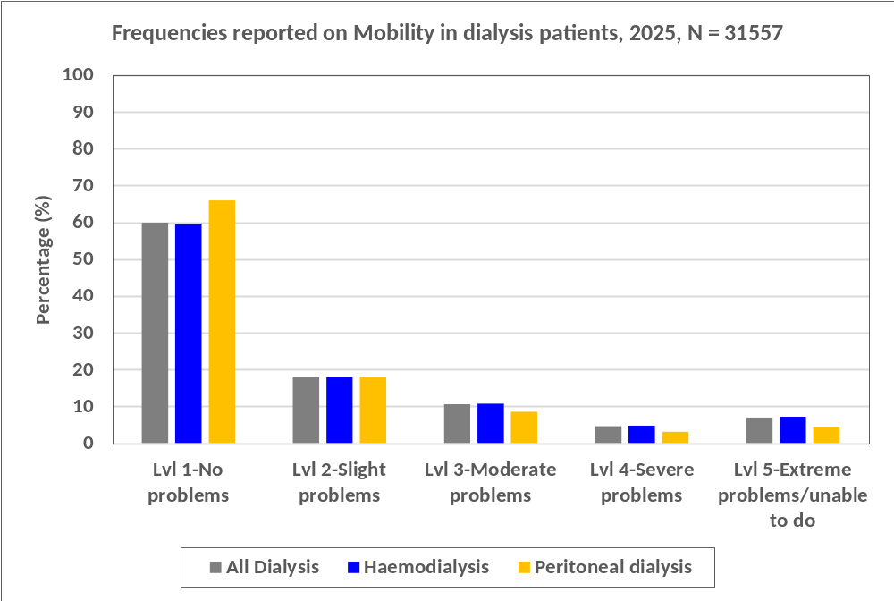
Figure 1.5.2 (a): Frequencies reported on Mobility in dialysis patients, 2025

Slide 21
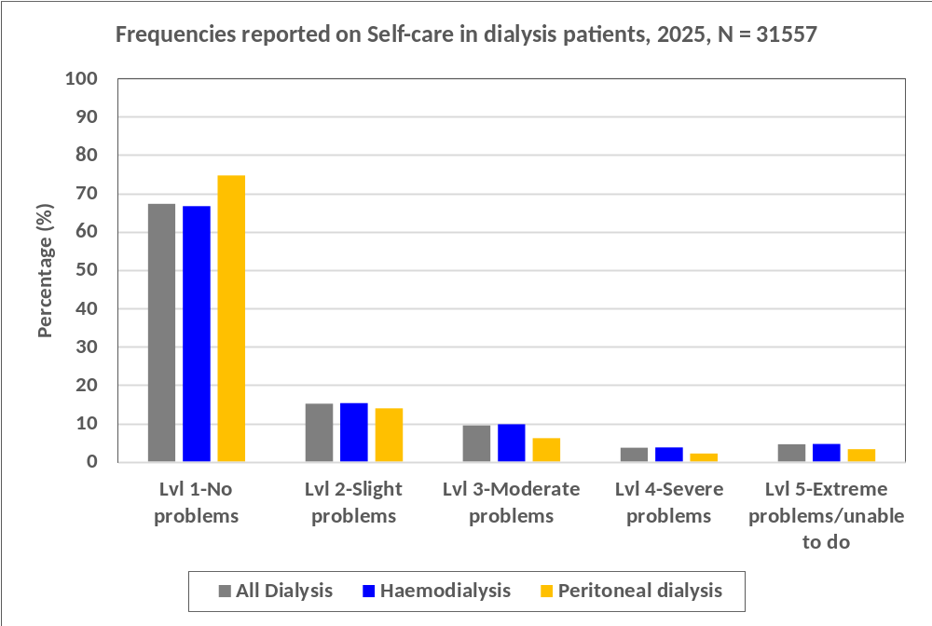
Figure 1.5.2 (b): Frequencies reported on Self-care in dialysis patients, 2025

Slide 22
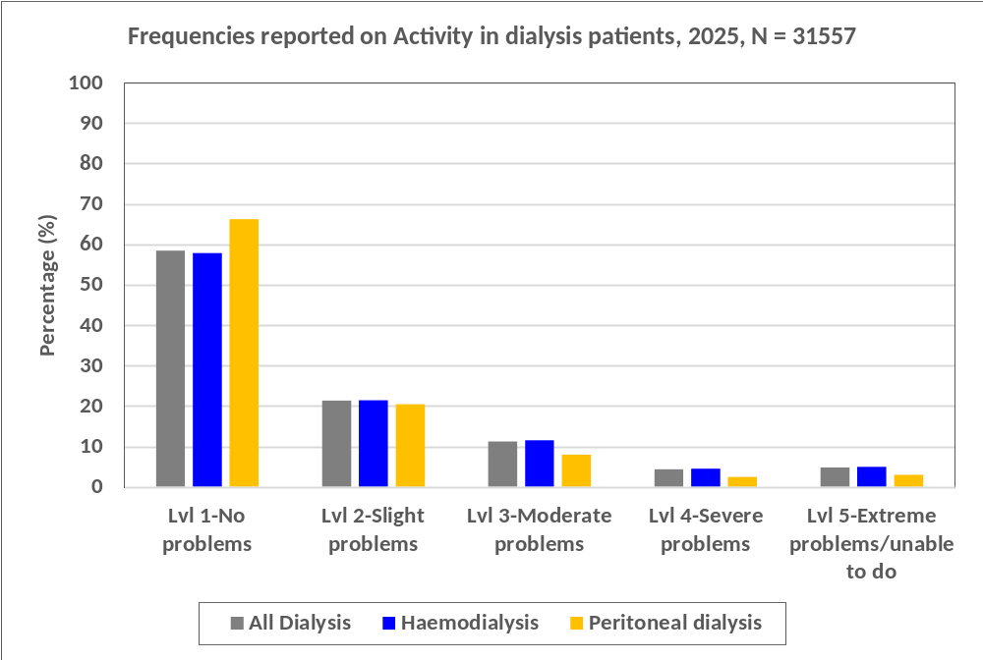
Figure 1.5.2 (c): Frequencies reported on Usual activities in dialysis patients, 2025

Slide 23
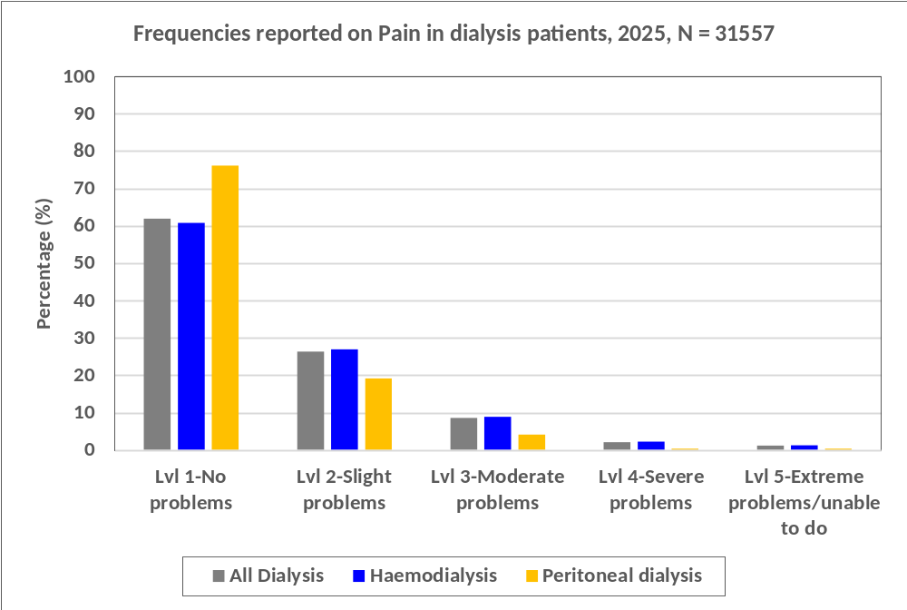
Figure 1.5.2 (d): Frequencies reported on Pain/discomfort in dialysis patients, 2025

Slide 24
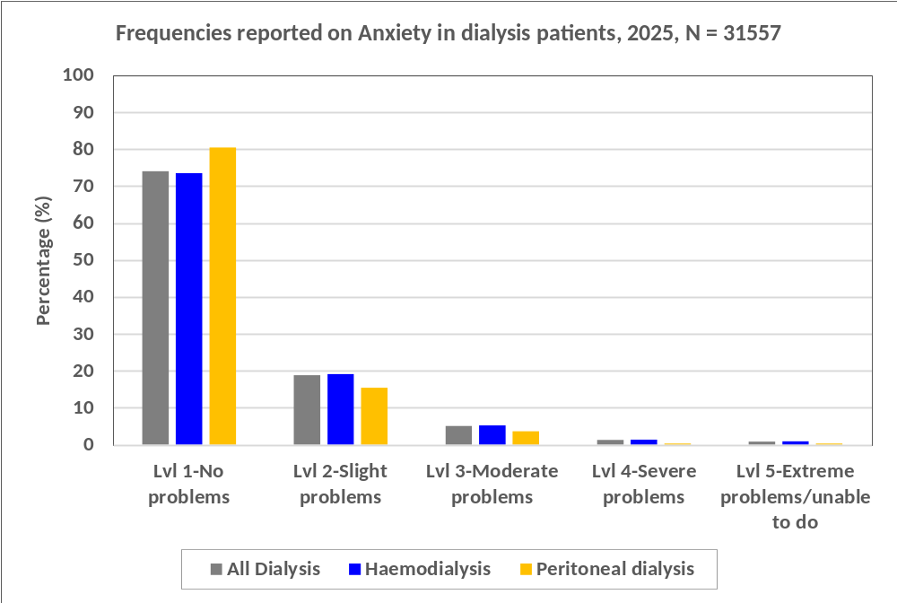
Figure 1.5.2 (e): Frequencies reported on Anxiety/depression in dialysis patients, 2025

Slide 25
Table 1.5.3: EQ-5D-5L index values in dialysis patients, 2025
 | All Dialysis (n: 31557) | Haemodialysis (n: 29216) | Peritoneal Dialysis (n: 2341)
 | EQ-5D-5L index value | EQ-5D-5L index values | EQ-5D-5L index values
Mean | 0.805 | 0.800 | 0.864
Standard Deviation | 0.281 | 0.284 | 0.221
Median | 0.919 | 0.919 | 1.000
Minimum | -0.441 | -0.441 | -0.441
Maximum | 1 | 1 | 1

Slide 26
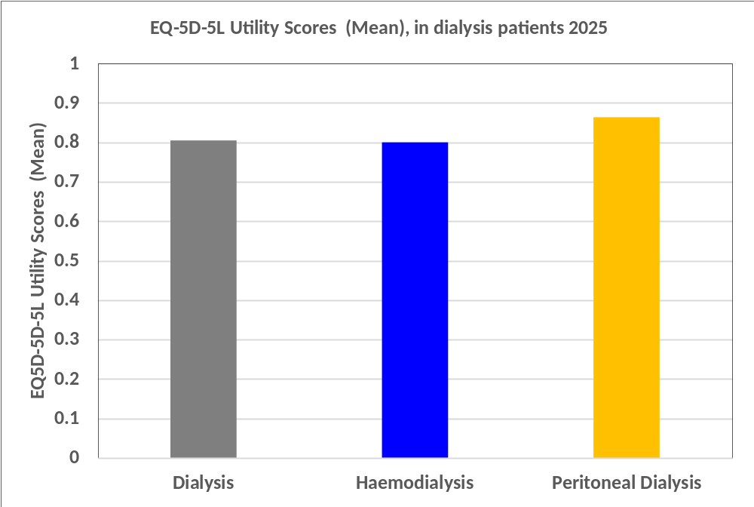
Figure 1.5.3: Mean EQ-5D-5L index values in dialysis patients, 2025

Slide 27
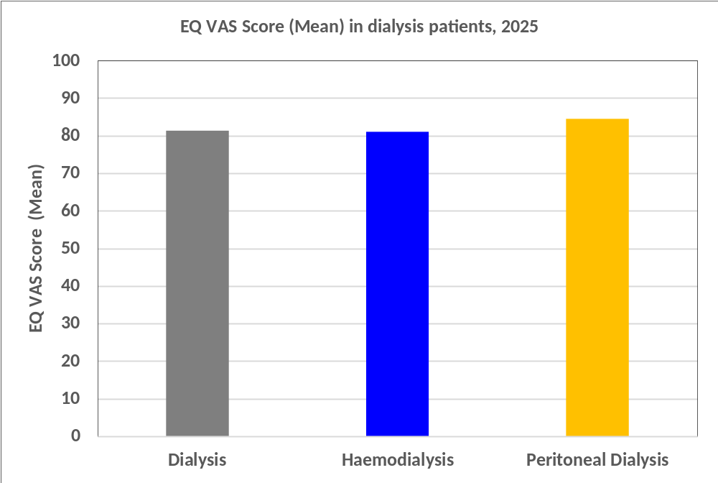
Figure 1.5.4: Mean EQ VAS Score in dialysis patients, 2025

Slide 28
Table 1.5.4: EQ VAS Score in dialysis patients, 2025
 | Health score on assessment day
 | 0 - 10 | 11 - 20 | 21 - 30 | 31 - 40 | 41 - 50 | 51 - 60 | 61 - 70 | 71 - 80 | 81 - 90 | 91 - 100 | Total
 | n | n | n | n | n | n | n | n | n | n | n
Dialysis
Age
18-24 | 8 | 0 | 0 | 1 | 5 | 3 | 18 | 50 | 121 | 170 | 376
25-34 | 54 | 7 | 1 | 3 | 40 | 51 | 95 | 263 | 498 | 787 | 1799
35-44 | 110 | 12 | 13 | 8 | 110 | 137 | 255 | 710 | 1121 | 1606 | 4082
45-54 | 175 | 14 | 22 | 34 | 265 | 241 | 480 | 1231 | 1707 | 2257 | 6426
55-64 | 247 | 32 | 43 | 46 | 439 | 410 | 901 | 1897 | 2213 | 2638 | 8866
65-74 | 212 | 24 | 36 | 79 | 503 | 410 | 885 | 1753 | 1696 | 1831 | 7429
≥ 75 | 71 | 15 | 30 | 50 | 240 | 238 | 375 | 595 | 508 | 457 | 2579
Total | 877 | 104 | 145 | 221 | 1602 | 1490 | 3009 | 6499 | 7864 | 9746 | 31557
Mean | 81.3
SD | 19.9
Median | 88.0
Min | 0
Max | 100

Slide 29
Table 1.5.4: EQ VAS Score in dialysis patients, 2025 (cont.)
 | Health score on assessment day
 | 0 - 10 | 11 - 20 | 21 - 30 | 31 - 40 | 41 - 50 | 51 - 60 | 61 - 70 | 71 - 80 | 81 - 90 | 91 - 100 | Total
 | n | n | n | n | n | n | n | n | n | n | n
HD
Age
18-24 | 7 | 0 | 0 | 1 | 5 | 3 | 16 | 41 | 75 | 132 | 280
25-34 | 47 | 7 | 1 | 3 | 37 | 48 | 86 | 232 | 406 | 668 | 1535
35-44 | 98 | 10 | 13 | 8 | 105 | 127 | 236 | 657 | 962 | 1462 | 3678
45-54 | 166 | 13 | 22 | 33 | 255 | 232 | 454 | 1143 | 1519 | 2106 | 5943
55-64 | 233 | 29 | 43 | 45 | 424 | 389 | 846 | 1771 | 1985 | 2497 | 8262
65-74 | 209 | 23 | 36 | 79 | 494 | 393 | 843 | 1671 | 1562 | 1752 | 7062
≥ 75 | 71 | 15 | 30 | 50 | 234 | 232 | 361 | 559 | 466 | 438 | 2456
Total | 831 | 97 | 145 | 219 | 1554 | 1424 | 2842 | 6074 | 6975 | 9055 | 29216
Mean | 81.0
SD | 20.2
Median | 85.0
Min | 0
Max | 100
PD
Age
18-24 | 1 | 0 | 0 | 0 | 0 | 0 | 2 | 9 | 46 | 38 | 96
25-34 | 7 | 0 | 0 | 0 | 3 | 3 | 9 | 31 | 92 | 119 | 264
35-44 | 12 | 2 | 0 | 0 | 5 | 10 | 19 | 53 | 159 | 144 | 404
45-54 | 9 | 1 | 0 | 1 | 10 | 9 | 26 | 88 | 188 | 151 | 483
55-64 | 14 | 3 | 0 | 1 | 15 | 21 | 55 | 126 | 228 | 141 | 604
65-74 | 3 | 1 | 0 | 0 | 9 | 17 | 42 | 82 | 134 | 79 | 367
≥ 75 | 0 | 0 | 0 | 0 | 6 | 6 | 14 | 36 | 42 | 19 | 123
Total | 46 | 7 | 0 | 2 | 48 | 66 | 167 | 425 | 889 | 691 | 2341
Mean | 84.5
SD | 16.2
Median | 90
Min | 0
Max | 100

