Slide 1

CHAPTER 2
DIALYSIS IN MALAYSIA
Ong Loke Meng
Sunita Bavanandan
Hooi Lai Seong
Choo Cheh Loo

Slide 2
Table 2.1.1(a): Stock and flow - Dialysis Patients, Malaysia 2016-2025
Year | 2025 | 2024 | 2023 | 2022 | 2021 | 2020 | 2019 | 2018 | 2017 | 2016
New Dialysis patients | 9905 | 10056 | 10446 | 10087 | 9434 | 9492 | 9499 | 8554 | 8089 | 8110
Died | 7994 | 7625 | 7558 | 8041 | 9104 | 6358 | 6496 | 6153 | 5949 | 5402
Transplanted | 234 | 222 | 244 | 178 | 64 | 143 | 125 | 72 | 84 | 66
Lost to Follow-up | 61 | 51 | 41 | 37 | 33 | 34 | 37 | 56 | 39 | 31
Dialysing at 31st December | 57638 | 56149 | 54662 | 52221 | 50559 | 50412 | 47498 | 44758 | 42550 | 40603

Slide 3
Table 2.1.1(b): Stock and flow - HD Patients, Malaysia 2016-2025
Year | 2025 | 2024 | 2023 | 2022 | 2021 | 2020 | 2019 | 2018 | 2017 | 2016
New HD patients | 8089 | 8249 | 8479 | 8170 | 7738 | 7923 | 8066 | 7324 | 6955 | 7104
Died | 6788 | 6470 | 6444 | 6857 | 7935 | 5476 | 5603 | 5334 | 5174 | 4671
Transplanted | 186 | 170 | 200 | 145 | 53 | 112 | 93 | 47 | 75 | 60
Lost to Follow-up | 56 | 47 | 34 | 34 | 26 | 31 | 34 | 49 | 37 | 29
Dialysing at 31st December | 50833 | 49339 | 47979 | 45859 | 44633 | 44883 | 42516 | 40194 | 38264 | 36626

Slide 4
Table 2.1.1(c): Stock and flow - PD Patients, Malaysia 2016-2025
Year | 2025 | 2024 | 2023 | 2022 | 2021 | 2020 | 2019 | 2018 | 2017 | 2016
New PD patients | 1816 | 1807 | 1967 | 1917 | 1696 | 1569 | 1433 | 1230 | 1134 | 1006
Died | 1206 | 1155 | 1114 | 1184 | 1169 | 882 | 893 | 819 | 775 | 731
Transplanted | 48 | 52 | 44 | 33 | 11 | 31 | 32 | 25 | 9 | 6
Lost to Follow-up | 5 | 4 | 7 | 3 | 7 | 3 | 3 | 7 | 2 | 2
Dialysing at 31st December | 6805 | 6810 | 6683 | 6362 | 5926 | 5529 | 4982 | 4564 | 4286 | 3977

Slide 5
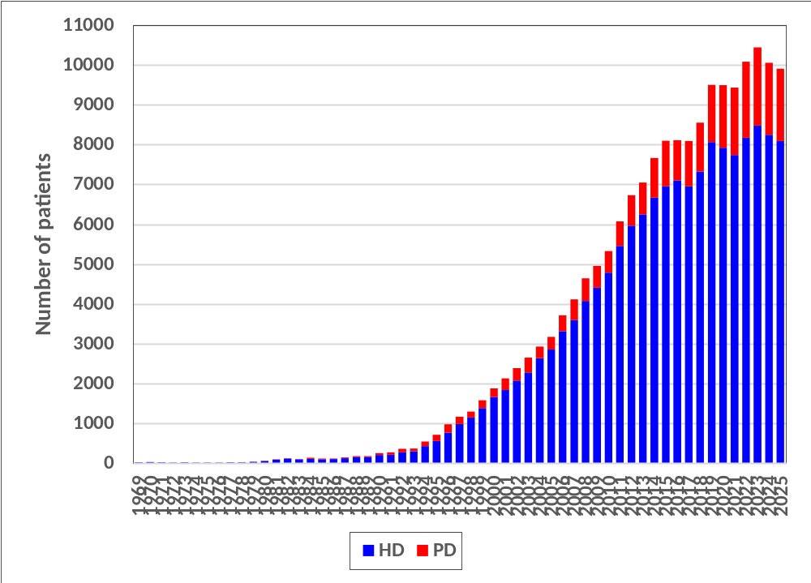
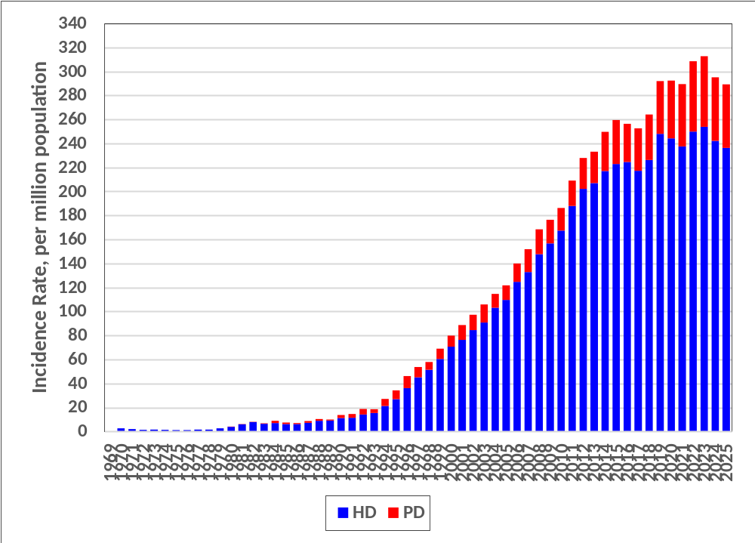
Figure 2.1.1: New Dialysis (Haemodialysis & Chronic PD) Incidence Rate per Million Population, Malaysia 1969-2025
(a) Number of New Dialysis Incidence, Malaysia 1969-2025
(b) New Dialysis Incidence Rates, Malaysia 1969-2025

Slide 6
Table 2.1.2(a): Dialysis Treatment Rate by State (New Dialysis), per million population 2016-2025
Year | 2025 | 2024 | 2023 | 2022 | 2021 | 2020 | 2019 | 2018 | 2017 | 2016
Johor | 313 | 330 | 342 | 355 | 337 | 343 | 362 | 333 | 342 | 340
Kedah | 355 | 326 | 380 | 299 | 346 | 301 | 317 | 294 | 284 | 276
Kelantan | 277 | 252 | 295 | 249 | 205 | 240 | 230 | 209 | 176 | 220
Melaka | 376 | 398 | 400 | 456 | 397 | 369 | 380 | 347 | 300 | 304
Negeri Sembilan | 367 | 394 | 388 | 373 | 399 | 361 | 412 | 394 | 365 | 358
Pahang | 289 | 320 | 306 | 331 | 316 | 271 | 279 | 237 | 227 | 226
Perak | 347 | 339 | 354 | 409 | 371 | 415 | 392 | 319 | 284 | 285
Perlis | 249 | 273 | 205 | 217 | 174 | 172 | 181 | 245 | 167 | 183
Pulau Pinang | 341 | 372 | 354 | 381 | 363 | 386 | 366 | 326 | 334 | 362
Sabah & WP Labuan | 150 | 152 | 166 | 161 | 143 | 131 | 139 | 113 | 115 | 128
Sarawak | 295 | 271 | 298 | 302 | 254 | 250 | 221 | 174 | 193 | 174
Selangor & WP Putrajaya | 265 | 264 | 290 | 264 | 241 | 256 | 269 | 256 | 220 | 216
Terengganu | 325 | 376 | 355 | 356 | 365 | 375 | 347 | 319 | 279 | 277
WP Kuala Lumpur | 302 | 345 | 385 | 372 | 352 | 373 | 375 | 377 | 422 | 448

Slide 7
Table 2.1.2(b): Dialysis Treatment Rate by State (Dialysis at 31st Dec), per million population 2016-2025
Year | 2025 | 2024 | 2023 | 2022 | 2021 | 2020 | 2019 | 2018 | 2017 | 2016
Johor | 2049 | 2024 | 2033 | 2022 | 1971 | 1967 | 1999 | 1921 | 1870 | 1785
Kedah | 1848 | 1768 | 1741 | 1639 | 1655 | 1624 | 1510 | 1429 | 1361 | 1301
Kelantan | 1296 | 1246 | 1202 | 1113 | 1075 | 1111 | 971 | 916 | 858 | 828
Melaka | 2202 | 2158 | 2087 | 2017 | 1889 | 1811 | 1807 | 1698 | 1597 | 1545
Negeri Sembilan | 2183 | 2133 | 2078 | 2046 | 2013 | 1973 | 1991 | 1857 | 1780 | 1724
Pahang | 1668 | 1654 | 1614 | 1583 | 1532 | 1469 | 1334 | 1267 | 1200 | 1174
Perak | 2081 | 2011 | 2075 | 2068 | 2016 | 2020 | 1846 | 1688 | 1605 | 1577
Perlis | 1131 | 1122 | 1075 | 1014 | 949 | 955 | 1024 | 1061 | 1044 | 988
Pulau Pinang | 2013 | 2034 | 2017 | 2020 | 1983 | 1993 | 1861 | 1803 | 1797 | 1780
Sabah & WP Labuan | 847 | 812 | 811 | 815 | 785 | 781 | 666 | 610 | 584 | 551
Sarawak | 1893 | 1821 | 1779 | 1676 | 1572 | 1518 | 1229 | 1144 | 1095 | 1019
Selangor & WP Putrajaya | 1474 | 1423 | 1403 | 1334 | 1286 | 1344 | 1362 | 1285 | 1230 | 1203
Terengganu | 1858 | 1880 | 1844 | 1849 | 1830 | 1795 | 1518 | 1384 | 1291 | 1206
WP Kuala Lumpur | 1841 | 1888 | 1893 | 1867 | 1839 | 1864 | 1981 | 1980 | 1941 | 1892

Slide 8
Table 2.1.3(a): Dialysis Treatment Rate by Gender, per million male or female population 2016-2025
Year | 2025 | 2024 | 2023 | 2022 | 2021 | 2020 | 2019 | 2018 | 2017 | 2016
ALL
Male | 304 | 305 | 321 | 323 | 297 | 300 | 312 | 280 | 266 | 273
Female | 274 | 284 | 303 | 292 | 282 | 284 | 271 | 248 | 238 | 238
HD
Male | 247 | 251 | 261 | 262 | 242 | 251 | 265 | 241 | 231 | 241
Female | 224 | 232 | 246 | 236 | 232 | 237 | 230 | 210 | 203 | 207
PD
Male | 56 | 54 | 60 | 61 | 54 | 49 | 47 | 38 | 36 | 32
Female | 50 | 52 | 57 | 56 | 49 | 47 | 41 | 38 | 35 | 32

Slide 9
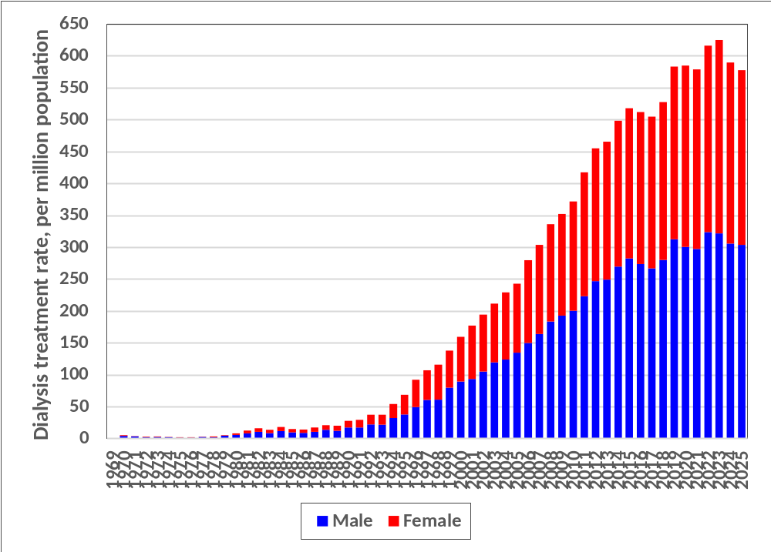
Figure 2.1.3(a) (i): Dialysis Treatment Rate by Gender 1969-2025

Slide 10
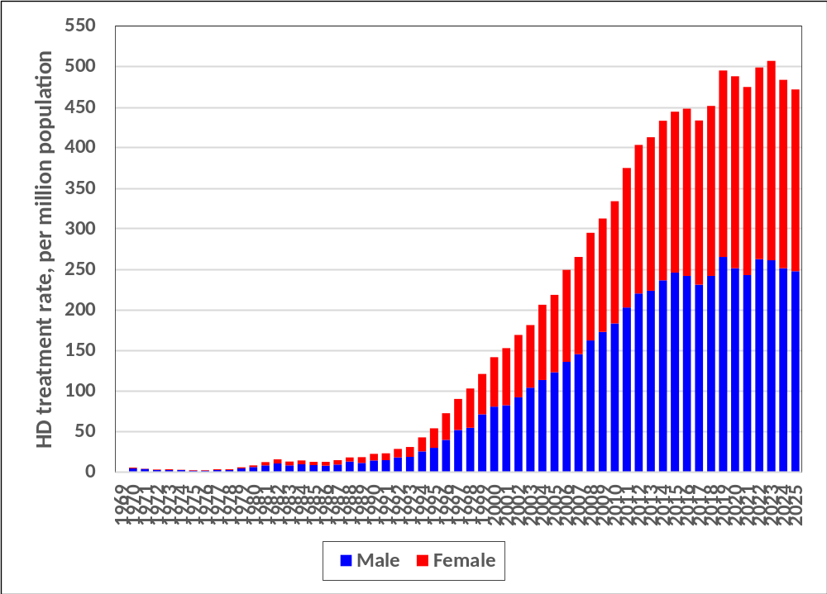
Figure 2.1.3(a) (ii): HD Treatment Rate by Gender 1969-2025

Slide 11
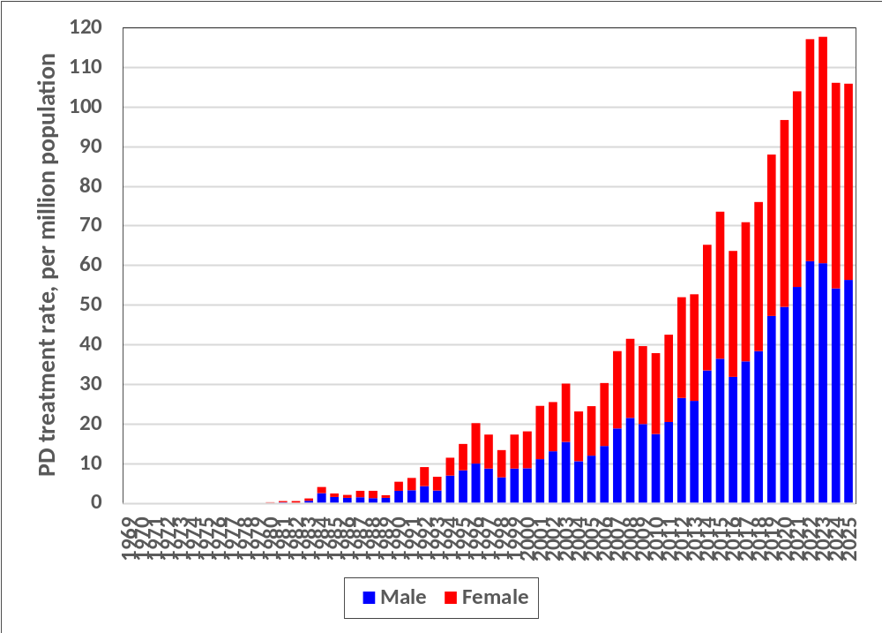
Figure 2.1.3(a) (iii): PD Treatment Rate by Gender 1980-2025

Slide 12
Table 2.1.3(b): Gender Distribution of Dialysis Patients 2016-2025
Year | 2025 | 2024 | 2023 | 2022 | 2021 | 2020 | 2019 | 2018 | 2017 | 2016
New Dialysis patients | 9905 | 10056 | 10446 | 10087 | 9434 | 9492 | 9499 | 8554 | 8089 | 8110
% Male | 55.0 | 54.3 | 53.8 | 54.6 | 53.5 | 53.7 | 55.1 | 54.7 | 54.5 | 55.1
% Female | 45.0 | 45.7 | 46.2 | 45.4 | 46.5 | 46.3 | 44.9 | 45.3 | 45.5 | 44.9
ESKD patients at 31st December | 57638 | 56149 | 54662 | 52221 | 50559 | 50412 | 47498 | 44758 | 42550 | 40603
% Male | 52.4 | 52.5 | 52.5 | 52.7 | 52.8 | 53.2 | 53.8 | 53.9 | 54.2 | 54.5
% Female | 47.6 | 47.5 | 47.5 | 47.3 | 47.2 | 46.8 | 46.2 | 46.1 | 45.8 | 45.5
New HD patients | 8089 | 8249 | 8479 | 8170 | 7738 | 7923 | 8066 | 7324 | 6955 | 7104
% Male | 54.9 | 54.4 | 53.8 | 54.7 | 53.3 | 53.7 | 55.1 | 55.1 | 54.9 | 55.5
% Female | 45.1 | 45.6 | 46.2 | 45.3 | 46.7 | 46.3 | 44.9 | 44.9 | 45.1 | 44.5
HD patients at 31st December | 50833 | 49339 | 47979 | 45859 | 44633 | 44883 | 42516 | 40194 | 38264 | 36626
% Male | 52.6 | 52.6 | 52.7 | 52.9 | 53.1 | 53.5 | 54.1 | 54.4 | 54.7 | 55.1
% Female | 47.4 | 47.4 | 47.3 | 47.1 | 46.9 | 46.5 | 45.9 | 45.6 | 45.3 | 44.9
New PD patients | 1816 | 1807 | 1967 | 1917 | 1696 | 1569 | 1433 | 1230 | 1134 | 1006
% Male | 55.6 | 53.6 | 53.7 | 54.2 | 54.6 | 53.5 | 55.2 | 52.0 | 52.0 | 51.7
% Female | 44.4 | 46.4 | 46.3 | 45.8 | 45.4 | 46.5 | 44.8 | 48.0 | 48.0 | 48.3
PD patients at 31st December | 6805 | 6810 | 6683 | 6362 | 5926 | 5529 | 4982 | 4564 | 4286 | 3977
% Male | 51.6 | 51.5 | 51.4 | 50.9 | 50.7 | 50.8 | 50.9 | 49.8 | 50.0 | 49.5
% Female | 48.4 | 48.5 | 48.6 | 49.1 | 49.3 | 49.2 | 49.1 | 50.2 | 50.0 | 50.5

Slide 13
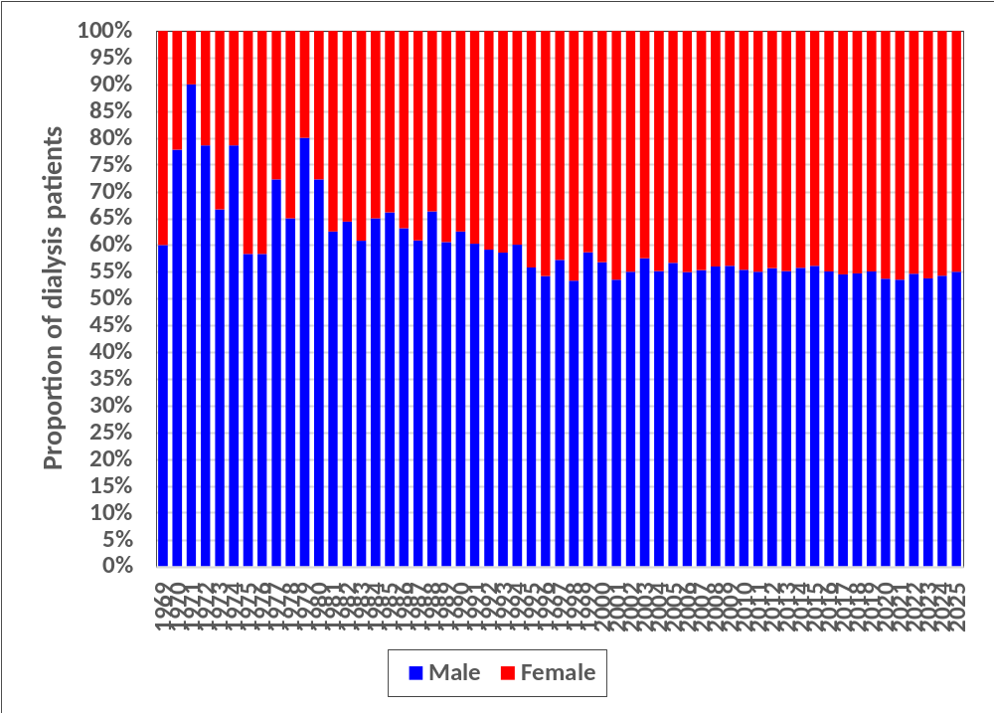
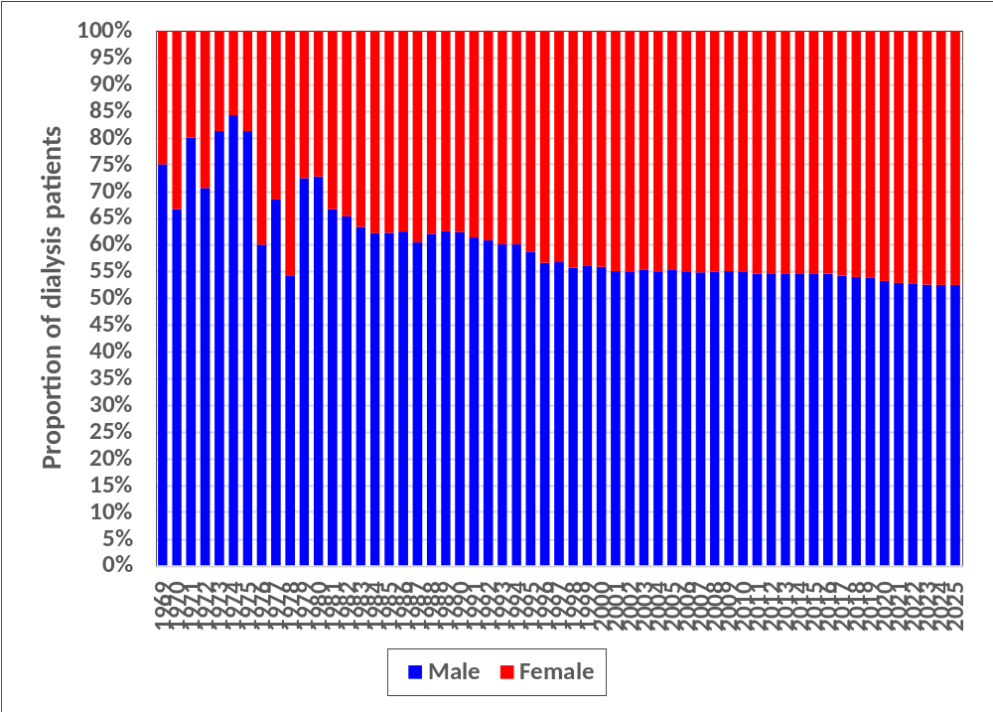
Figure 2.1.3(b) (i): Gender Distribution of Dialysis Patients 1969-2025
(i) New Dialysis patients
(ii) ESKD Patients at 31st December

Slide 14

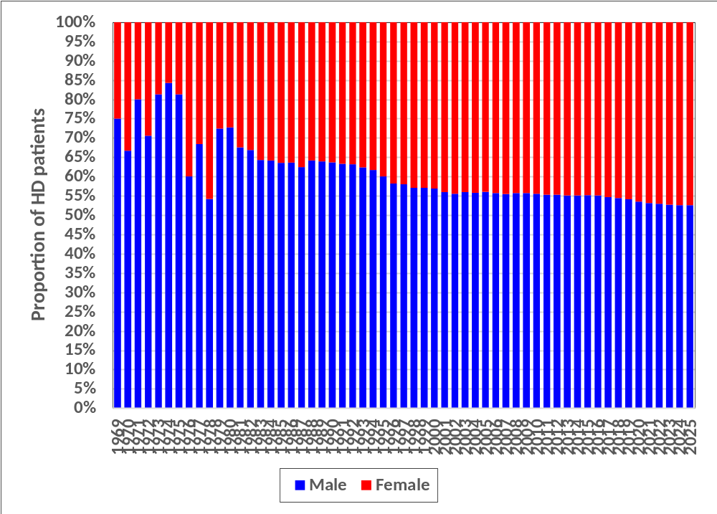
Figure 2.1.3(b) (ii): Gender Distribution of HD Patients 1969-2025
(i) New PD patients
(ii) PD Patients at 31st December

Slide 15
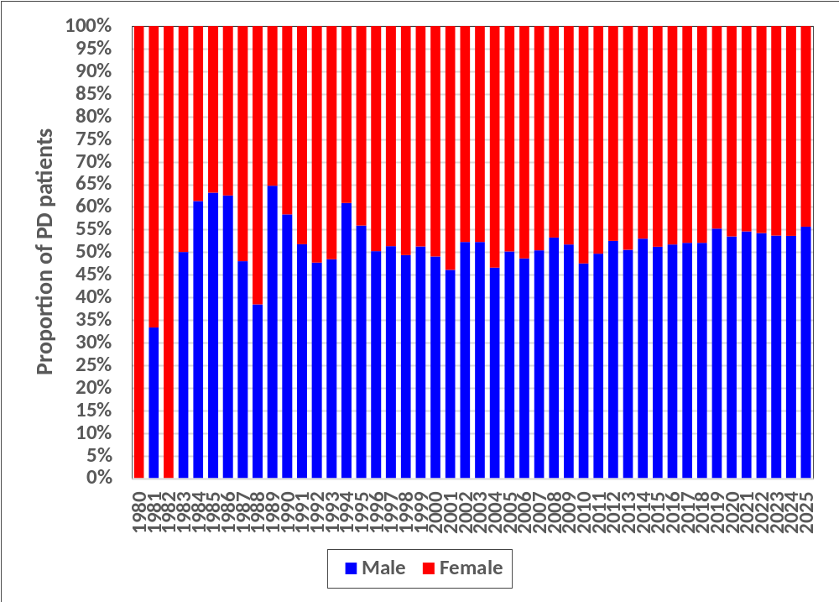
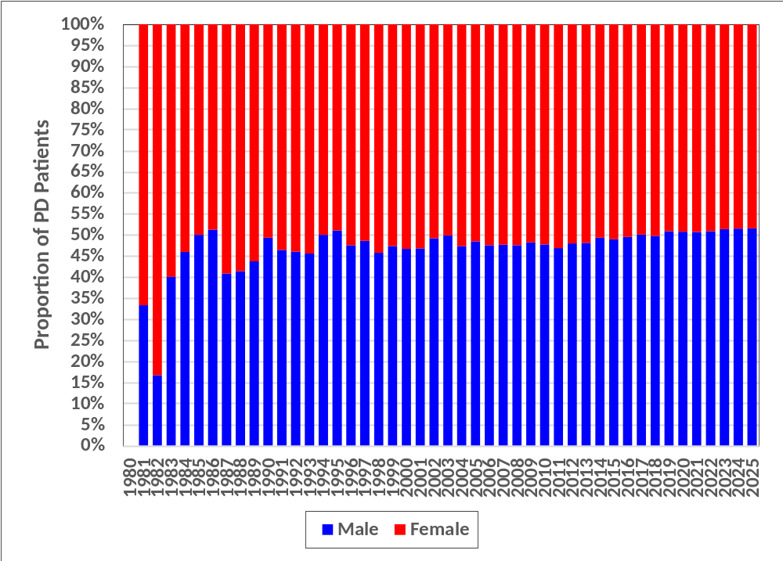
Figure 2.1.3(b) (iii): Gender Distribution of PD Patients 1980-2025
(i) New HD patients
(ii) HD Patients at 31st December

Slide 16
Table 2.1.4(a): Dialysis Treatment Rate by Age Group, per million age group population 2016-2025
Year | 2025 | 2024 | 2023 | 2022 | 2021 | 2020 | 2019 | 2018 | 2017 | 2016
New Dialysis patients | 9905 | 10056 | 10446 | 10087 | 9434 | 9492 | 9499 | 8554 | 8089 | 8110
≤14 | 6 | 7 | 8 | 7 | 7 | 7 | 9 | 7 | 7 | 6
15-24 | 32 | 31 | 35 | 38 | 39 | 36 | 37 | 32 | 31 | 32
25-34 | 112 | 105 | 113 | 118 | 100 | 102 | 92 | 89 | 81 | 81
35-44 | 246 | 255 | 261 | 253 | 232 | 231 | 250 | 216 | 209 | 212
45-54 | 559 | 576 | 621 | 609 | 553 | 598 | 600 | 563 | 541 | 574
55-64 | 946 | 1039 | 1111 | 1079 | 1110 | 1122 | 1132 | 1046 | 1027 | 1085
65-74 | 1140 | 1174 | 1265 | 1285 | 1245 | 1306 | 1302 | 1194 | 1212 | 1194
≥75 | 737 | 752 | 824 | 919 | 787 | 800 | 829 | 808 | 726 | 762
Overall Mean age (yrs) | 55.6 | 55.6 | 55.6 | 55.6 | 55.8 | 55.8 | 55.7 | 55.7 | 55.7 | 55.5
Overall SD age | 14.2 | 14.0 | 14.1 | 14.3 | 14.1 | 13.9 | 14.1 | 14.0 | 13.9 | 13.8
Overall Median age (yrs) | 57.3 | 57.3 | 57.4 | 57.3 | 57.8 | 57.6 | 57.5 | 57.5 | 57.3 | 57.1
New HD patients | 8089 | 8249 | 8479 | 8170 | 7738 | 7923 | 8066 | 7324 | 6955 | 7104
≤14 | 1 | 2 | 1 | 2 | 1 | 2 | 2 | 2 | 2 | 3
15-24 | 18 | 15 | 19 | 21 | 21 | 18 | 22 | 21 | 19 | 21
25-34 | 76 | 71 | 78 | 81 | 69 | 71 | 70 | 69 | 63 | 64
35-44 | 189 | 202 | 202 | 191 | 180 | 188 | 207 | 180 | 173 | 182
45-54 | 460 | 473 | 504 | 491 | 455 | 510 | 512 | 486 | 471 | 511
55-64 | 793 | 873 | 923 | 901 | 942 | 956 | 975 | 911 | 910 | 967
65-74 | 989 | 1016 | 1098 | 1109 | 1077 | 1136 | 1162 | 1059 | 1078 | 1073
≥75 | 670 | 694 | 729 | 831 | 713 | 735 | 766 | 742 | 653 | 695
HD Mean age (yrs) | 56.9 | 56.7 | 56.8 | 56.9 | 57.0 | 56.8 | 56.7 | 56.5 | 56.6 | 56.2
HD SD age | 13.5 | 13.3 | 13.3 | 13.6 | 13.2 | 13.1 | 13.4 | 13.4 | 13.1 | 13.2
HD Median age (yrs) | 58.3 | 58.2 | 58.1 | 58.2 | 58.5 | 58.3 | 58.1 | 57.9 | 57.9 | 57.3
New PD patients | 1816 | 1807 | 1967 | 1917 | 1696 | 1569 | 1433 | 1230 | 1134 | 1006
≤14 | 5 | 5 | 7 | 5 | 6 | 5 | 7 | 5 | 5 | 3
15-24 | 14 | 16 | 16 | 17 | 18 | 18 | 15 | 11 | 12 | 11
25-34 | 36 | 34 | 35 | 37 | 31 | 31 | 23 | 20 | 19 | 17
35-44 | 57 | 53 | 59 | 62 | 52 | 43 | 43 | 36 | 37 | 30
45-54 | 99 | 103 | 116 | 117 | 98 | 88 | 88 | 76 | 69 | 63
55-64 | 153 | 166 | 188 | 178 | 168 | 166 | 157 | 135 | 117 | 118
65-74 | 151 | 158 | 167 | 176 | 168 | 170 | 140 | 136 | 134 | 121
≥75 | 68 | 58 | 95 | 88 | 73 | 65 | 62 | 66 | 73 | 68
PD Mean age (yrs) | 50.2 | 50.4 | 50.5 | 50.4 | 50.3 | 50.5 | 50.2 | 50.8 | 50.3 | 50.9
PD SD age | 15.8 | 15.8 | 16.1 | 15.9 | 16.4 | 16.4 | 16.6 | 16.5 | 17.0 | 16.6
PD Median age (yrs) | 51.6 | 52.3 | 52.8 | 52.6 | 53.0 | 54.0 | 53.4 | 54.0 | 53.3 | 54.0

Slide 17
Table 2.1.4(a): Dialysis Treatment Rate by Age Group, per million age group population 2016-2025 (cont.)
Year | 2025 | 2024 | 2023 | 2022 | 2021 | 2020 | 2019 | 2018 | 2017 | 2016
Dialysis patients at 31st December | 57638 | 56149 | 54662 | 52221 | 50559 | 50412 | 47498 | 44758 | 42550 | 40603
≤14 | 22 | 23 | 24 | 23 | 23 | 22 | 24 | 21 | 20 | 20
15-24 | 149 | 153 | 158 | 163 | 160 | 162 | 147 | 141 | 143 | 141
25-34 | 574 | 565 | 570 | 575 | 551 | 538 | 492 | 469 | 451 | 442
35-44 | 1367 | 1337 | 1328 | 1301 | 1252 | 1229 | 1256 | 1180 | 1146 | 1120
45-54 | 3066 | 3043 | 3042 | 2977 | 2880 | 2946 | 2821 | 2747 | 2680 | 2639
55-64 | 5570 | 5702 | 5733 | 5672 | 5725 | 5926 | 5614 | 5420 | 5379 | 5284
65-74 | 7141 | 7049 | 7151 | 7009 | 6985 | 7210 | 6837 | 6598 | 6461 | 6369
≥75 | 5129 | 5279 | 5198 | 5234 | 5132 | 5323 | 4748 | 4722 | 4442 | 4365
Overall Mean age (yrs) | 56.7 | 56.6 | 56.5 | 56.4 | 56.4 | 56.5 | 56.4 | 56.3 | 56.1 | 56.0
Overall SD age | 14.0 | 14.0 | 14.0 | 14.1 | 14.0 | 14.0 | 14.0 | 14.0 | 14.0 | 14.0
Overall Median age (yrs) | 58.4 | 58.4 | 58.3 | 58.2 | 58.3 | 58.3 | 58.1 | 58 | 57.8 | 57.5
HD patients at 31st December | 50833 | 49339 | 47979 | 45859 | 44633 | 44883 | 42516 | 40194 | 38264 | 36626
≤14 | 7 | 7 | 6 | 6 | 6 | 7 | 9 | 8 | 8 | 7
15-24 | 89 | 93 | 95 | 99 | 98 | 101 | 95 | 94 | 97 | 96
25-34 | 442 | 436 | 440 | 444 | 432 | 433 | 403 | 385 | 371 | 370
35-44 | 1155 | 1131 | 1125 | 1108 | 1077 | 1075 | 1106 | 1042 | 1015 | 999
45-54 | 2701 | 2671 | 2684 | 2621 | 2560 | 2648 | 2545 | 2482 | 2430 | 2397
55-64 | 5012 | 5102 | 5115 | 5082 | 5139 | 5335 | 5088 | 4949 | 4933 | 4859
65-74 | 6551 | 6447 | 6522 | 6378 | 6354 | 6596 | 6288 | 6081 | 5933 | 5859
≥75 | 4816 | 4942 | 4867 | 4903 | 4845 | 5023 | 4453 | 4395 | 4120 | 4046
HD Mean age (yrs) | 57.6 | 57.4 | 57.3 | 57.2 | 57.2 | 57.2 | 57.0 | 56.9 | 56.7 | 56.5
HD SD age | 13.5 | 13.5 | 13.5 | 13.5 | 13.5 | 13.5 | 13.5 | 13.5 | 13.5 | 13.5
HD Median age (yrs) | 59.0 | 59.0 | 58.9 | 58.8 | 58.8 | 58.8 | 58.6 | 58.4 | 58.1 | 57.9
PD patients at 31st December | 6805 | 6810 | 6683 | 6362 | 5926 | 5529 | 4982 | 4564 | 4286 | 3977
≤14 | 15 | 17 | 18 | 17 | 16 | 14 | 15 | 12 | 13 | 12
15-24 | 60 | 60 | 63 | 64 | 62 | 62 | 52 | 47 | 45 | 45
25-34 | 132 | 129 | 130 | 131 | 120 | 104 | 88 | 84 | 80 | 72
35-44 | 212 | 205 | 202 | 193 | 174 | 154 | 150 | 139 | 131 | 121
45-54 | 365 | 372 | 358 | 357 | 320 | 298 | 276 | 265 | 250 | 242
55-64 | 558 | 600 | 619 | 590 | 587 | 590 | 527 | 471 | 446 | 425
65-74 | 590 | 602 | 629 | 631 | 631 | 614 | 548 | 517 | 528 | 510
≥75 | 313 | 337 | 331 | 332 | 287 | 300 | 296 | 327 | 322 | 319
PD Mean age (yrs) | 50.6 | 50.7 | 50.6 | 50.5 | 50.6 | 51.0 | 51.0 | 51.0 | 50.8 | 50.9
PD SD age | 15.9 | 16.0 | 16.1 | 16.3 | 16.4 | 16.4 | 16.6 | 16.7 | 16.8 | 16.9
PD Median age (yrs) | 52.3 | 52.6 | 53.0 | 52.9 | 53.5 | 54.3 | 54.2 | 54.1 | 53.8 | 53.9

Slide 18
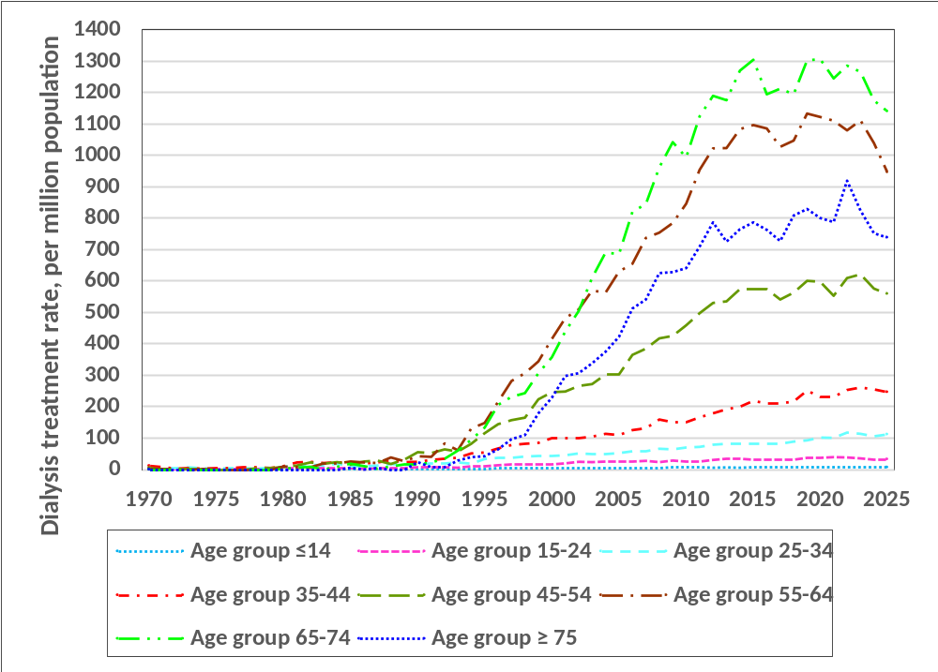
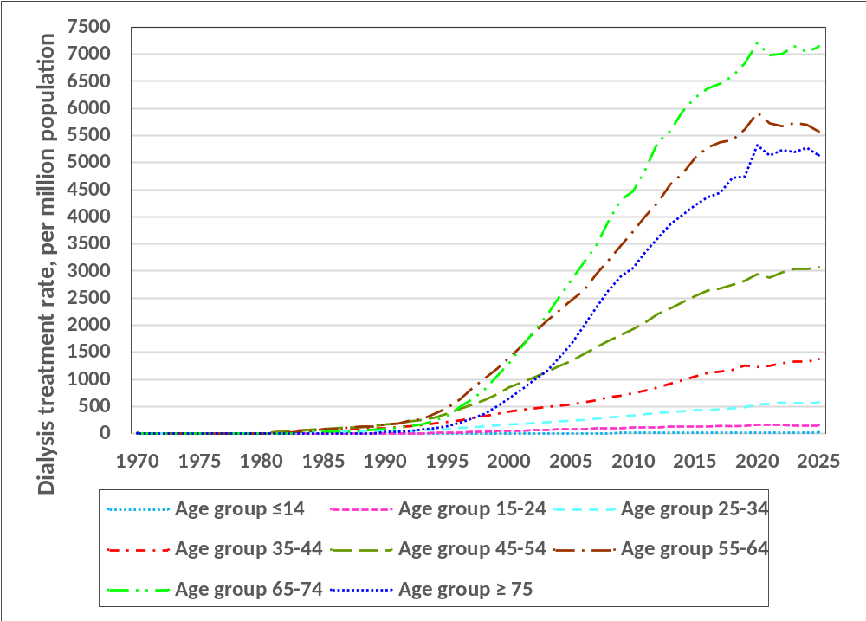
Figure 2.1.4(a) (i): New Dialysis Treatment Rate by Age Group 1969-2025
(i) New Dialysis Patients
(ii) ESKD Patients at 31st December

Slide 19
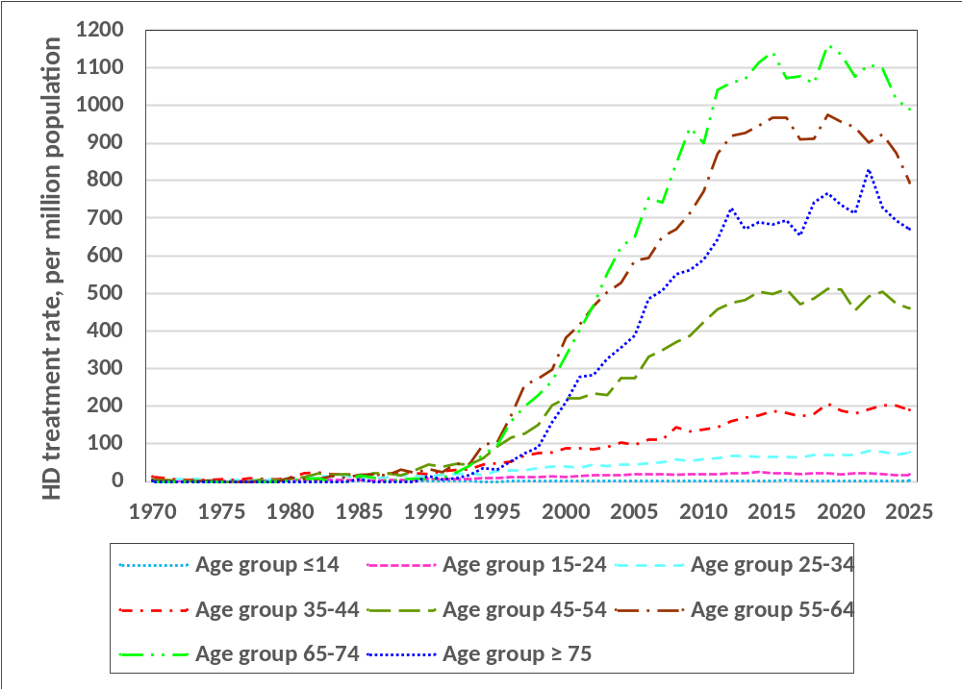
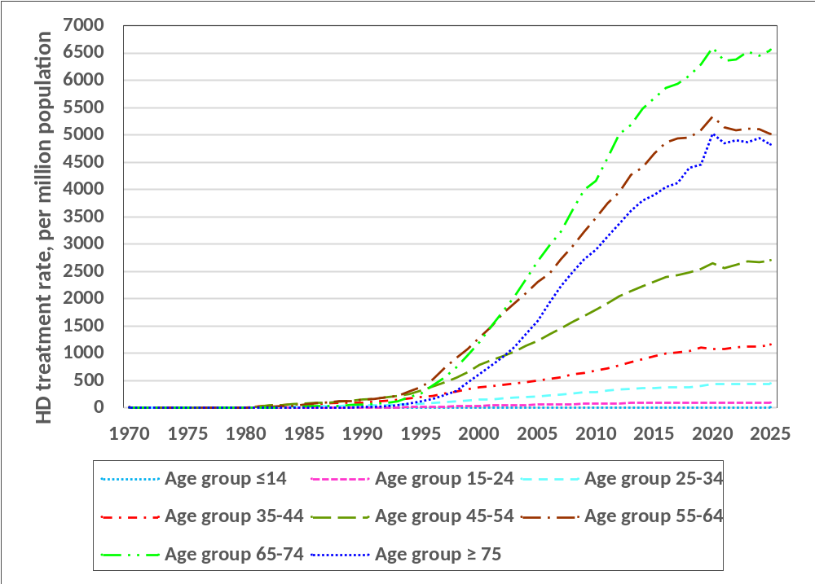
Figure 2.1.4(a) (ii): HD Treatment Rate by Age Group 1969-2025
(i) New HD Patients
(ii) HD Patients at 31st December

Slide 20
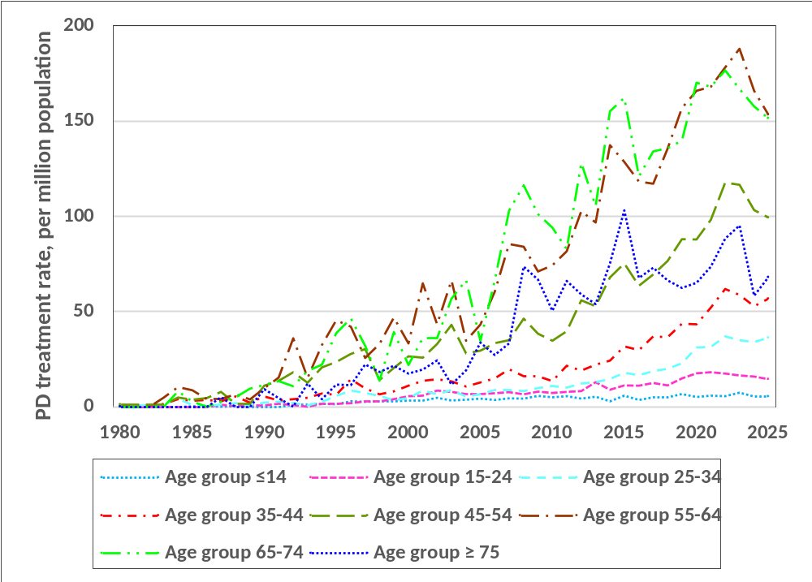
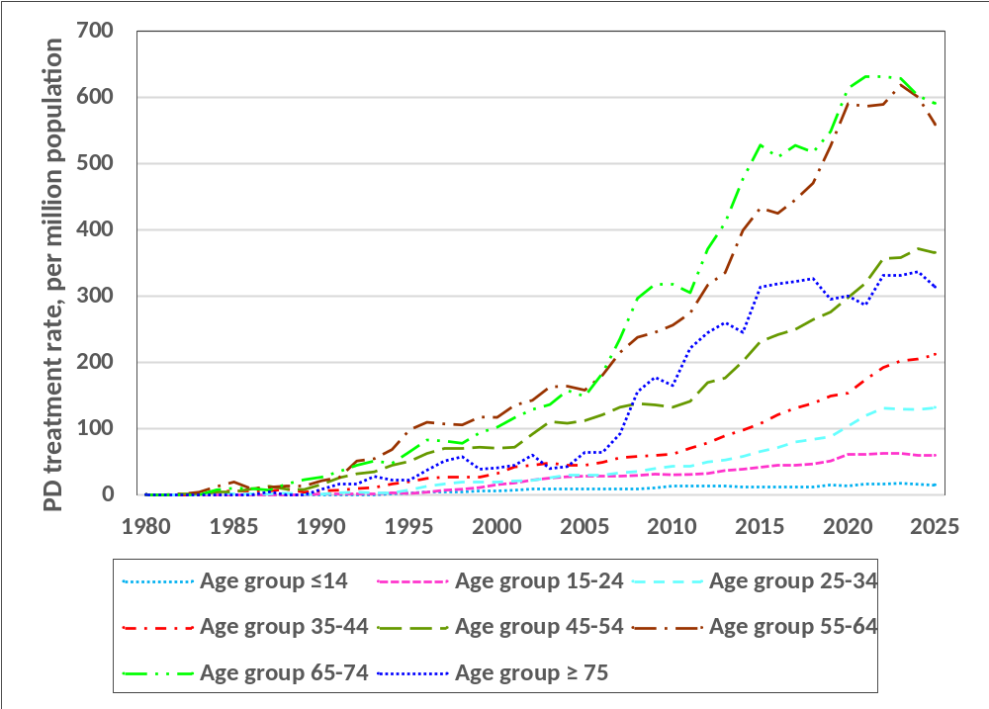
Figure 2.1.4(a) (iii): PD Treatment Rate by Age Group 1980-2025
(i) New PD Patients
(ii) PD Patients at 31st December

Slide 21
Table 2.1.4(b): Percentage Age Distribution of Dialysis Patients 2016-2025
Year | 2025 | 2024 | 2023 | 2022 | 2021 | 2020 | 2019 | 2018 | 2017 | 2016
New Dialysis patients | 9905 | 10056 | 10446 | 10087 | 9434 | 9492 | 9499 | 8554 | 8089 | 8110
% ≤24 | 2.4 | 2.3 | 2.6 | 2.7 | 2.9 | 2.7 | 3.1 | 2.9 | 3.0 | 3.0
% 25-34 | 6.7 | 6.3 | 6.3 | 6.6 | 6.1 | 6.2 | 6.0 | 6.4 | 6.1 | 6.0
% 35-44 | 13.7 | 13.8 | 13.3 | 12.9 | 12.4 | 12.0 | 11.8 | 11.1 | 11.1 | 10.8
% 45-54 | 21.8 | 21.4 | 21.6 | 21.3 | 20.4 | 21.6 | 21.5 | 22.3 | 22.5 | 23.6
% 55-64 | 27.4 | 29.1 | 29.4 | 28.9 | 31.4 | 30.9 | 31.2 | 31.2 | 31.3 | 31.9
% 65-74 | 21.5 | 21.0 | 20.9 | 21.0 | 21.1 | 21.0 | 20.3 | 19.8 | 20.1 | 18.8
% ≥75 | 6.5 | 6.0 | 6.0 | 6.5 | 5.8 | 5.6 | 6.2 | 6.4 | 5.9 | 6.0
New HD patients | 8089 | 8249 | 8479 | 8170 | 7738 | 7923 | 8066 | 7324 | 6955 | 7104
% ≤24 | 1.4 | 1.2 | 1.4 | 1.6 | 1.7 | 1.5 | 1.9 | 1.9 | 1.9 | 2.1
% 25-34 | 5.6 | 5.2 | 5.4 | 5.6 | 5.1 | 5.2 | 5.3 | 5.8 | 5.5 | 5.4
% 35-44 | 12.9 | 13.4 | 12.7 | 12.0 | 11.7 | 11.7 | 11.5 | 10.8 | 10.6 | 10.6
% 45-54 | 21.9 | 21.4 | 21.6 | 21.2 | 20.4 | 22.1 | 21.6 | 22.5 | 22.8 | 23.9
% 55-64 | 28.1 | 29.8 | 30.1 | 29.8 | 32.5 | 31.5 | 31.6 | 31.7 | 32.3 | 32.5
% 65-74 | 22.9 | 22.2 | 22.4 | 22.4 | 22.2 | 21.9 | 21.4 | 20.5 | 20.8 | 19.3
% ≥75 | 7.2 | 6.8 | 6.5 | 7.3 | 6.4 | 6.1 | 6.7 | 6.9 | 6.2 | 6.2
New PD patients | 1816 | 1807 | 1967 | 1917 | 1696 | 1569 | 1433 | 1230 | 1134 | 1006
% ≤24 | 6.8 | 7.4 | 7.6 | 7.3 | 8.7 | 8.9 | 9.7 | 8.7 | 10.1 | 9.3
% 25-34 | 11.9 | 11.2 | 10.3 | 10.9 | 10.6 | 11.5 | 9.7 | 9.9 | 10.0 | 9.8
% 35-44 | 17.2 | 15.9 | 15.9 | 16.5 | 15.4 | 13.6 | 13.6 | 13.0 | 13.8 | 12.2
% 45-54 | 21.1 | 21.4 | 21.5 | 21.6 | 20.1 | 19.2 | 20.9 | 21.1 | 20.5 | 21.0
% 55-64 | 24.2 | 25.8 | 26.4 | 25.1 | 26.4 | 27.6 | 28.6 | 28.0 | 25.5 | 28.0
% 65-74 | 15.6 | 15.7 | 14.6 | 15.2 | 15.8 | 16.6 | 14.4 | 15.6 | 15.9 | 15.3
% ≥75 | 3.2 | 2.6 | 3.7 | 3.3 | 3.0 | 2.7 | 3.1 | 3.7 | 4.2 | 4.3

Slide 22
Table 2.1.4(b): Percentage Age Distribution of Dialysis Patients 2016-2025 (cont.)
ESKD patients at 31st December | 57638 | 56149 | 54662 | 52221 | 50559 | 50412 | 47498 | 44758 | 42550 | 40603
% ≤24 | 1.8 | 1.9 | 2.0 | 2.1 | 2.1 | 2.2 | 2.2 | 2.3 | 2.4 | 2.5
% 25-34 | 5.9 | 6.0 | 6.1 | 6.3 | 6.2 | 6.2 | 6.4 | 6.4 | 6.4 | 6.5
% 35-44 | 13.1 | 13.0 | 12.9 | 12.8 | 12.5 | 12.0 | 11.9 | 11.6 | 11.5 | 11.5
% 45-54 | 20.5 | 20.3 | 20.2 | 20.1 | 19.8 | 20.0 | 20.2 | 20.8 | 21.2 | 21.6
% 55-64 | 27.8 | 28.6 | 29.0 | 29.4 | 30.2 | 30.7 | 30.9 | 30.9 | 31.2 | 31.1
% 65-74 | 23.2 | 22.6 | 22.6 | 22.1 | 22.1 | 21.9 | 21.3 | 20.9 | 20.4 | 20.0
% ≥75 | 7.7 | 7.6 | 7.2 | 7.2 | 7.0 | 7.0 | 7.1 | 7.2 | 6.9 | 6.8
HD patients at 31st December | 50833 | 49339 | 47979 | 45859 | 44633 | 44883 | 42516 | 40194 | 38264 | 36626
% ≤24 | 1.1 | 1.2 | 1.2 | 1.3 | 1.4 | 1.4 | 1.5 | 1.6 | 1.7 | 1.8
% 25-34 | 5.2 | 5.3 | 5.3 | 5.5 | 5.5 | 5.6 | 5.8 | 5.9 | 5.9 | 6.1
% 35-44 | 12.5 | 12.5 | 12.5 | 12.4 | 12.2 | 11.8 | 11.7 | 11.4 | 11.3 | 11.3
% 45-54 | 20.5 | 20.3 | 20.3 | 20.2 | 19.9 | 20.2 | 20.4 | 20.9 | 21.3 | 21.8
% 55-64 | 28.3 | 29.1 | 29.5 | 30.0 | 30.7 | 31.0 | 31.3 | 31.4 | 31.8 | 31.7
% 65-74 | 24.1 | 23.5 | 23.5 | 22.9 | 22.7 | 22.5 | 21.9 | 21.4 | 20.8 | 20.4
% ≥75 | 8.2 | 8.1 | 7.7 | 7.6 | 7.5 | 7.4 | 7.4 | 7.4 | 7.1 | 7.0
PD patients at 31st December | 6805 | 6810 | 6683 | 6362 | 5926 | 5529 | 4982 | 4564 | 4286 | 3977
% ≤24 | 6.8 | 7.0 | 7.5 | 7.7 | 8.0 | 8.3 | 8.6 | 8.4 | 8.8 | 9.3
% 25-34 | 11.6 | 11.4 | 11.3 | 11.7 | 11.6 | 10.9 | 10.9 | 11.3 | 11.4 | 10.8
% 35-44 | 17.1 | 16.5 | 16.1 | 15.6 | 14.8 | 13.8 | 13.5 | 13.4 | 13.1 | 12.7
% 45-54 | 20.7 | 20.4 | 19.5 | 19.8 | 18.8 | 18.5 | 18.8 | 19.7 | 19.6 | 20.2
% 55-64 | 23.6 | 24.8 | 25.6 | 25.1 | 26.4 | 27.9 | 27.7 | 26.3 | 25.7 | 25.5
% 65-74 | 16.2 | 15.9 | 16.3 | 16.4 | 17.0 | 17.0 | 16.3 | 16.0 | 16.5 | 16.3
% ≥75 | 4.0 | 4.0 | 3.8 | 3.7 | 3.4 | 3.6 | 4.2 | 4.9 | 4.9 | 5.1

Slide 23
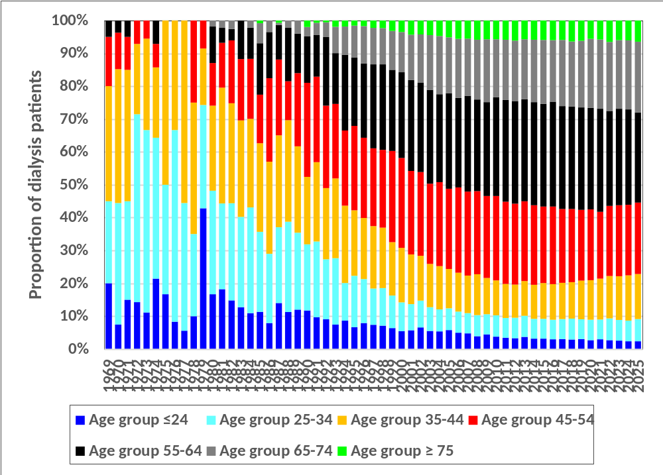
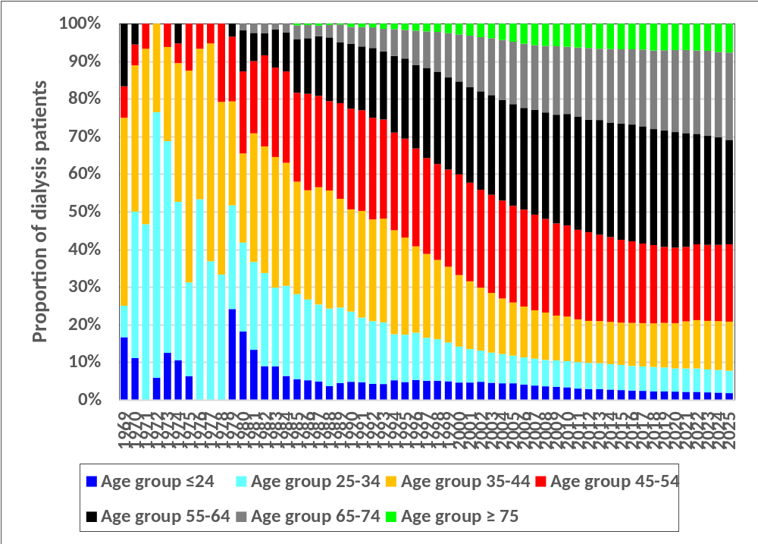
Figure 2.1.4(b) (i): Age Distribution of Dialysis Patients 1969-2025
(i) New Dialysis Patients
(ii) ESKD Patients at 31st December

Slide 24
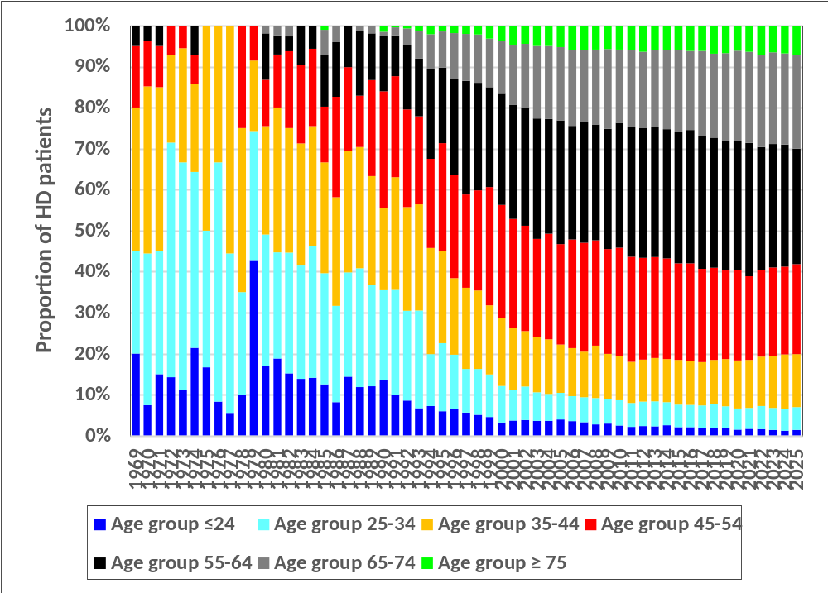
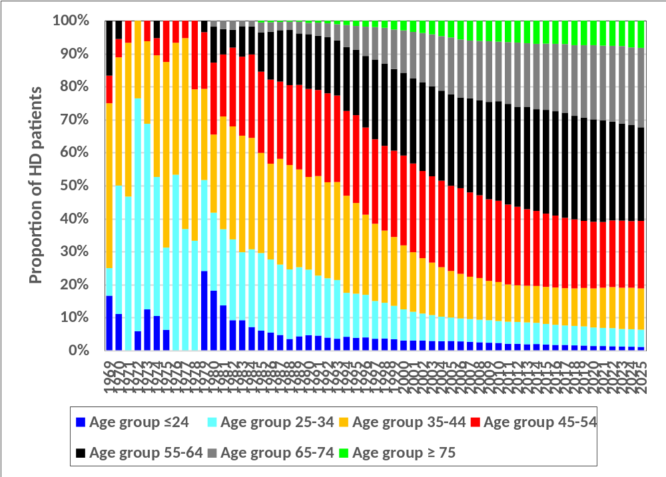
Figure 2.1.4(b) (ii): Age Distribution of HD Patients 1969-2025
(i) New HD patients
(ii) HD Patients at 31st December

Slide 25
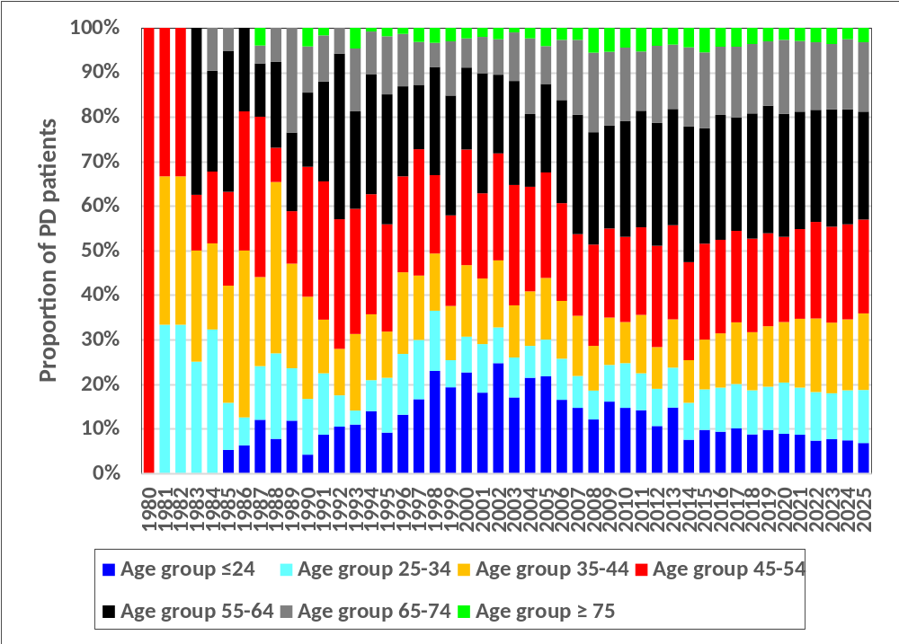
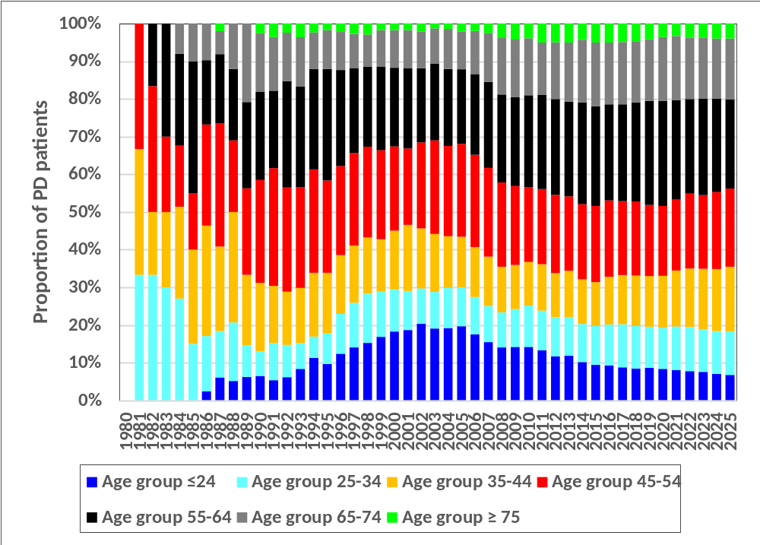
Figure 2.1.4(b) (iii): Age Distribution of PD Patients 1980-2025
(i) New PD Patients
(ii) PD Patients at 31st December

Slide 26
Table 2.1.5: Method and Location of Dialysis Patients 2016-2025
Year | 2025 | 2024 | 2023 | 2022 | 2021 | 2020 | 2019 | 2018 | 2017 | 2016
New Dialysis patients | 9905 | 10056 | 10446 | 10087 | 9434 | 9492 | 9499 | 8554 | 8089 | 8110
% Centre HD | 81.5 | 81.8 | 81.0 | 80.8 | 82.0 | 83.4 | 84.8 | 85.5 | 85.4 | 86.7
% Home and office HD | 0.2 | 0.2 | 0.1 | 0.2 | 0.1 | 0.1 | 0.1 | 0.1 | 0.5 | 0.3
% PD | 18.3 | 18.0 | 18.8 | 19.0 | 18.0 | 16.5 | 15.1 | 14.4 | 14.0 | 12.4
% Unknown | 0.0 | 0.0 | 0.0 | 0.0 | 0.0 | 0.0 | 0.0 | 0.0 | 0.0 | 0.6
ESKD patients at 31st December | 57638 | 56149 | 54662 | 52221 | 50559 | 50412 | 47498 | 44758 | 42550 | 40603
% Centre HD | 88.1 | 87.7 | 87.6 | 87.6 | 88.1 | 88.9 | 89.4 | 89.6 | 89.8 | 90.0
% Home and office HD | 0.1 | 0.1 | 0.2 | 0.2 | 0.2 | 0.1 | 0.1 | 0.2 | 0.1 | 0.2
% PD | 11.8 | 12.1 | 12.2 | 12.2 | 11.7 | 11.0 | 10.5 | 10.2 | 10.1 | 9.8
% Unknown | 0.0 | 0.0 | 0.0 | 0.0 | 0.0 | 0.0 | 0.0 | 0.0 | 0.0 | 0.0

Slide 27
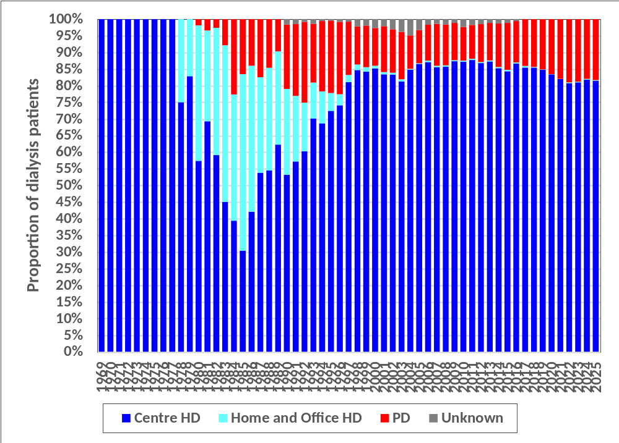
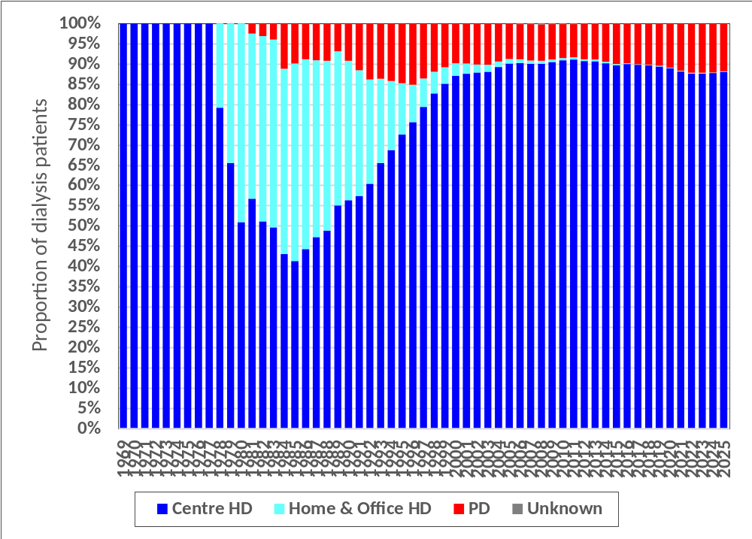
Figure 2.1.5: Method and Location of Dialysis Patients 1969-2025
(i) New Dialysis Patients
(ii) ESKD Patients at 31st December

Slide 28
Table 2.1.6: Funding for Dialysis Treatment 2016-2025
Year | 2025 | 2024 | 2023 | 2022 | 2021 | 2020 | 2019 | 2018 | 2017 | 2016
New Dialysis
% Government funded | 43.1 | 45.9 | 46.7 | 48.6 | 48.0 | 47.0 | 48.5 | 47.1 | 47.9 | 54.0
% SOCSO | 21.8 | 20.0 | 19.5 | 19.1 | 17.3 | 17.8 | 17.0 | 16.0 | 16.5 | 15.3
% Zakat/Baitumal | 13.5 | 12.9 | 12.5 | 9.9 | 10.4 | 10.5 | 9.0 | 10.0 | 9.4 | 6.1
% NGO/Charity | 1.7 | 1.9 | 1.6 | 1.4 | 1.4 | 1.8 | 2.2 | 2.0 | 2.5 | 4.5
% Self funded | 16.9 | 16.2 | 16.6 | 18.8 | 20.7 | 18.7 | 19.4 | 20.9 | 19.2 | 16.3
% Employer subsidised | 1.4 | 1.7 | 1.4 | 1.1 | 1.3 | 3.1 | 2.5 | 2.9 | 3.6 | 2.9
% Insurance | 1.6 | 1.5 | 1.6 | 1.1 | 0.8 | 0.7 | 0.7 | 0.8 | 0.8 | 0.8
% Others | 0.0 | 0.0 | 0.0 | 0.0 | 0.0 | 0.2 | 0.6 | 0.3 | 0.2 | 0.0
Dialysing at 31st December
% Government funded | 48.7 | 50.5 | 51.4 | 52.2 | 53.4 | 52.4 | 53.9 | 56.0 | 55.8 | 56.3
% SOCSO | 27.3 | 26.1 | 25.7 | 25.0 | 24.0 | 23.5 | 22.0 | 21.7 | 20.9 | 19.7
% Zakat/Baitumal | 12.0 | 11.4 | 11.0 | 10.5 | 10.5 | 10.6 | 9.9 | 9.5 | 9.7 | 7.5
% NGO/Charity | 1.3 | 1.4 | 1.1 | 1.0 | 1.2 | 1.3 | 1.8 | 2.0 | 2.3 | 4.8
% Self funded | 8.5 | 8.3 | 8.6 | 9.3 | 8.9 | 8.5 | 8.9 | 7.3 | 7.5 | 8.2
% Employer subsidised | 1.3 | 1.3 | 1.3 | 1.4 | 1.4 | 3.1 | 2.8 | 2.9 | 3.4 | 3.1
% Insurance | 0.9 | 0.9 | 0.8 | 0.6 | 0.5 | 0.5 | 0.5 | 0.5 | 0.4 | 0.4
% Others | 0.0 | 0.0 | 0.0 | 0.0 | 0.0 | 0.1 | 0.2 | 0.1 | 0.0 | 0.0

Slide 29
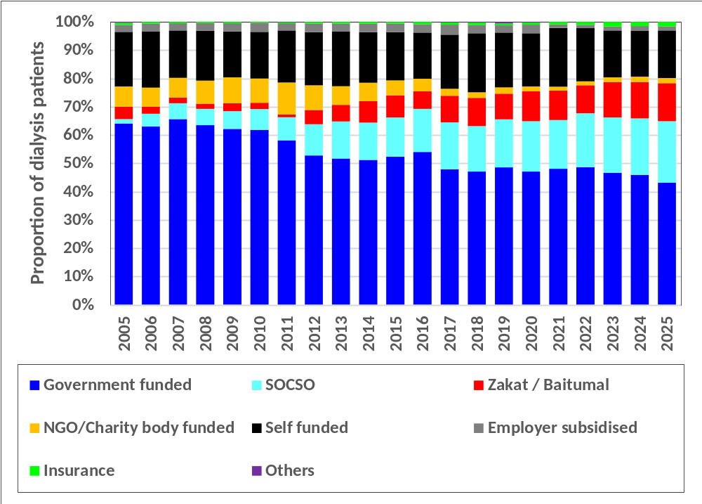
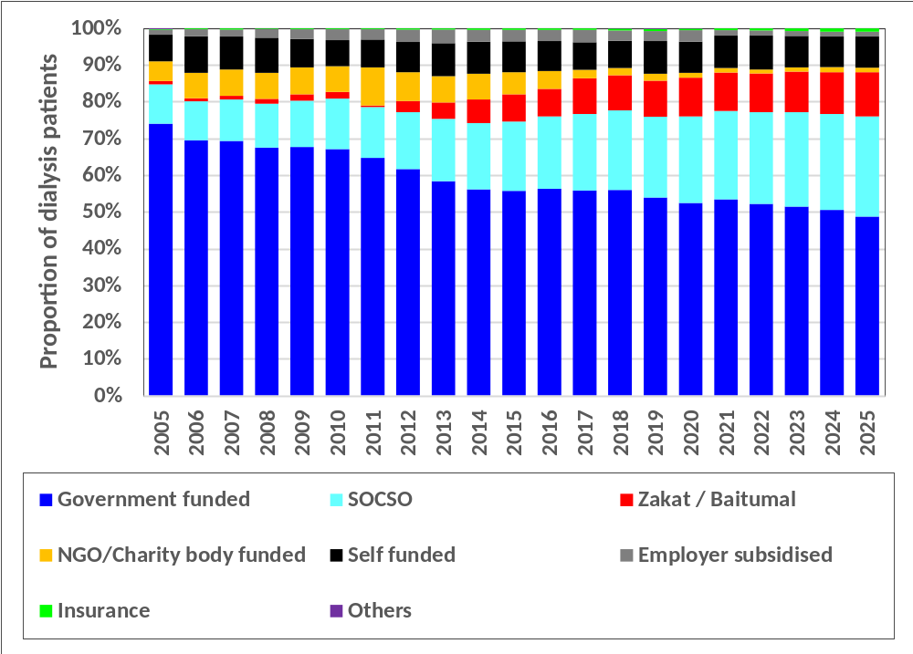
Figure 2.1.6: Funding for Dialysis Treatment 2005-2025
(i) New Dialysis Patients
(ii) Dialysis Patients at 31st December

Slide 30
Table 2.1.7: Distribution of Dialysis Patients by Sector 2016-2025
Year | 2025 | 2024 | 2023 | 2022 | 2021 | 2020 | 2019 | 2018 | 2017 | 2016
New Dialysis patients | 9905 | 10056 | 10446 | 10087 | 9434 | 9492 | 9499 | 8554 | 8089 | 8110
% Public centre | 25.7 | 26.4 | 27.4 | 28.7 | 26.6 | 26.6 | 28.1 | 26.5 | 28.1 | 31.2
% NGO centre | 11.4 | 11.1 | 11.6 | 11.5 | 11.7 | 13.8 | 14.9 | 16.1 | 15.9 | 16.3
% Private centre | 62.9 | 62.4 | 61.0 | 59.8 | 61.7 | 59.6 | 57.0 | 57.4 | 56.1 | 52.6
ESKD patients at 31st December | 57638 | 56149 | 54662 | 52221 | 50559 | 50412 | 47498 | 44758 | 42550 | 40603
% Public centre | 26.9 | 28.1 | 28.6 | 29.2 | 29.3 | 29.5 | 29.8 | 29.8 | 30.1 | 30.2
% NGO centre | 14.9 | 15.3 | 15.8 | 16.4 | 17.2 | 18.1 | 18.8 | 19.5 | 20.3 | 20.8
% Private centre | 58.2 | 56.6 | 55.7 | 54.4 | 53.4 | 52.5 | 51.4 | 50.7 | 49.7 | 48.9

Slide 31
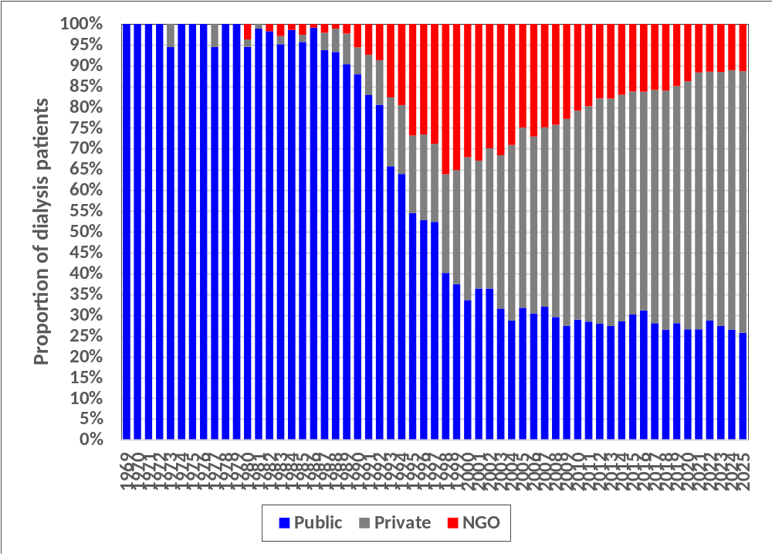
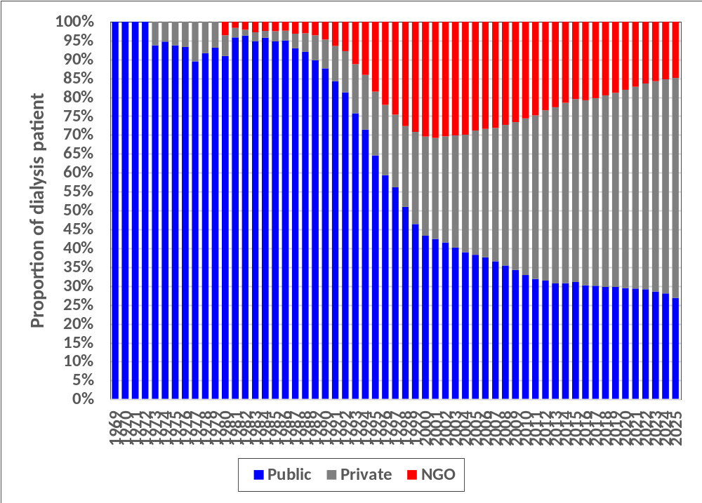
Figure 2.1.7: Distribution of Dialysis Patients by Sector 1969-2025
(i) New Dialysis Patients
(ii) Dialysis Patients at 31st December

Slide 32
Table 2.1.7(a): Distribution of Dialysis Patients by Modality and Sector 2016-2025
Year | 2025 | 2024 | 2023 | 2022 | 2021 | 2020 | 2019 | 2018 | 2017 | 2016
New dialysis patients | 9905 | 10056 | 10446 | 10087 | 9434 | 9492 | 9499 | 8554 | 8089 | 8110
% Public Centre | 25.7 | 26.4 | 27.4 | 28.7 | 26.6 | 26.6 | 28.1 | 26.5 | 28.1 | 31.2
% HD Public Centre | 7.5 | 8.7 | 8.7 | 9.9 | 8.8 | 10.2 | 13.1 | 12.4 | 14.3 | 18.9
% PD Public Centre | 18.2 | 17.7 | 18.6 | 18.8 | 17.8 | 16.4 | 15.0 | 14.1 | 13.8 | 12.3
% NGO | 11.4 | 11.1 | 11.6 | 11.5 | 11.7 | 13.8 | 14.9 | 16.1 | 15.9 | 16.3
% Private Centre | 62.9 | 62.4 | 61.0 | 59.8 | 61.7 | 59.6 | 57.0 | 57.4 | 56.1 | 52.6
% HD Private Centre | 62.7 | 62.2 | 60.9 | 59.6 | 61.6 | 59.5 | 56.9 | 57.2 | 55.8 | 52.4
% PD Private Centre | 0.1 | 0.2 | 0.2 | 0.2 | 0.2 | 0.1 | 0.1 | 0.2 | 0.2 | 0.1
ESKD patients at 31st December | 57638 | 56149 | 54662 | 52221 | 50559 | 50412 | 47498 | 44758 | 42550 | 40603
% Public Centre | 26.9 | 28.1 | 28.6 | 29.2 | 29.3 | 29.5 | 29.8 | 29.8 | 30.1 | 30.2
% HD Public Centre | 15.2 | 16.1 | 16.4 | 17.1 | 17.7 | 18.6 | 19.4 | 19.7 | 20.1 | 20.6
% PD Public Centre | 11.7 | 12.0 | 12.1 | 12.1 | 11.6 | 10.9 | 10.4 | 10.1 | 10.0 | 9.7
% NGO | 14.9 | 15.3 | 15.8 | 16.4 | 17.2 | 18.1 | 18.8 | 19.5 | 20.3 | 20.8
% Private Centre | 58.2 | 56.6 | 55.7 | 54.4 | 53.4 | 52.5 | 51.4 | 50.7 | 49.7 | 48.9
% HD Private Centre | 58.1 | 56.5 | 55.6 | 54.3 | 53.4 | 52.4 | 51.3 | 50.6 | 49.6 | 48.8
% PD Private Centre | 0.1 | 0.1 | 0.1 | 0.1 | 0.1 | 0.1 | 0.1 | 0.1 | 0.1 | 0.1

Slide 33
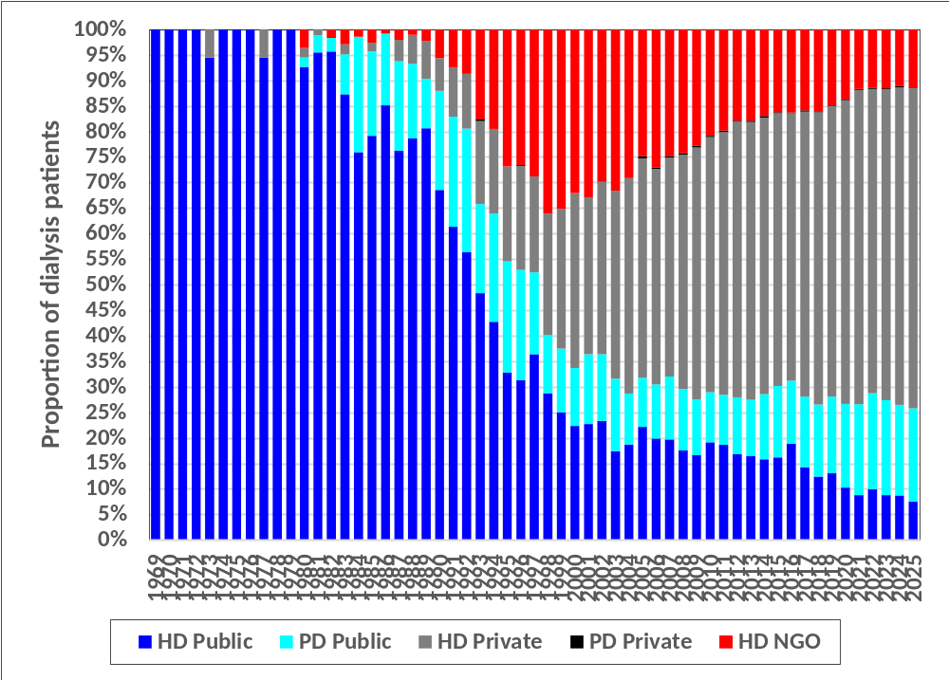
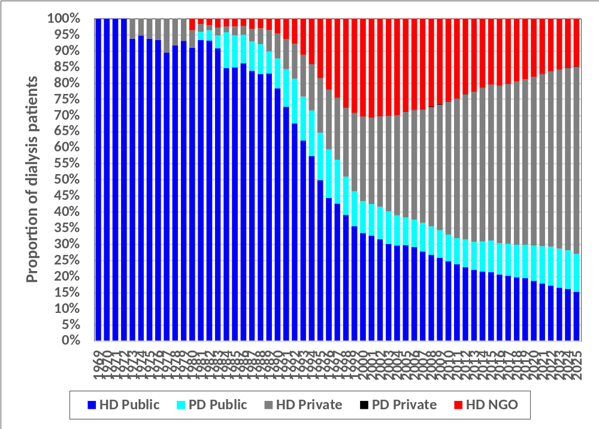
Figure 2.1.7(a): Distribution of Dialysis Patients by Modality and Sector 1969-2025
(i) New Dialysis Patients
(ii) Dialysis Patients at 31st December

Slide 34
Table 2.1.8: Primary Renal Diseases for New Dialysis Patients 2016-2025
Year | 2025 | 2024 | 2023 | 2022 | 2021 | 2020 | 2019 | 2018 | 2017 | 2016
New dialysis patients | 9905 | 10056 | 10446 | 10087 | 9434 | 9492 | 9499 | 8554 | 8089 | 8110
% Unknown cause | 5.6 | 5.4 | 5.5 | 4.5 | 4.4 | 2.7 | 3.1 | 3.1 | 5.2 | 9.0
% Diabetes Mellitus | 53.9 | 55.1 | 56.8 | 52.1 | 52.2 | 56.0 | 57.9 | 64.2 | 65.6 | 66.4
% GN/SLE | 2.2 | 2.1 | 2.1 | 2.1 | 1.9 | 1.9 | 2.2 | 2.6 | 3.1 | 3.8
% Polycystic kidney | 0.6 | 0.5 | 0.6 | 0.5 | 0.4 | 0.6 | 0.4 | 0.6 | 0.5 | 0.5
% Obstructive Nephropathy | 0.9 | 1.0 | 0.9 | 1.0 | 0.9 | 0.9 | 1.1 | 1.2 | 1.4 | 1.5
% Toxic Nephropathy | 0.4 | 0.5 | 0.4 | 0.4 | 0.4 | 0.5 | 0.8 | 0.9 | 1.0 | 0.8
% Hypertension | 31.7 | 31.0 | 29.5 | 34.4 | 34.3 | 33.3 | 30.4 | 24.3 | 21.0 | 16.6
% Others | 4.7 | 4.3 | 4.1 | 5.0 | 5.6 | 4.2 | 4.1 | 3.2 | 2.2 | 1.5

Slide 35
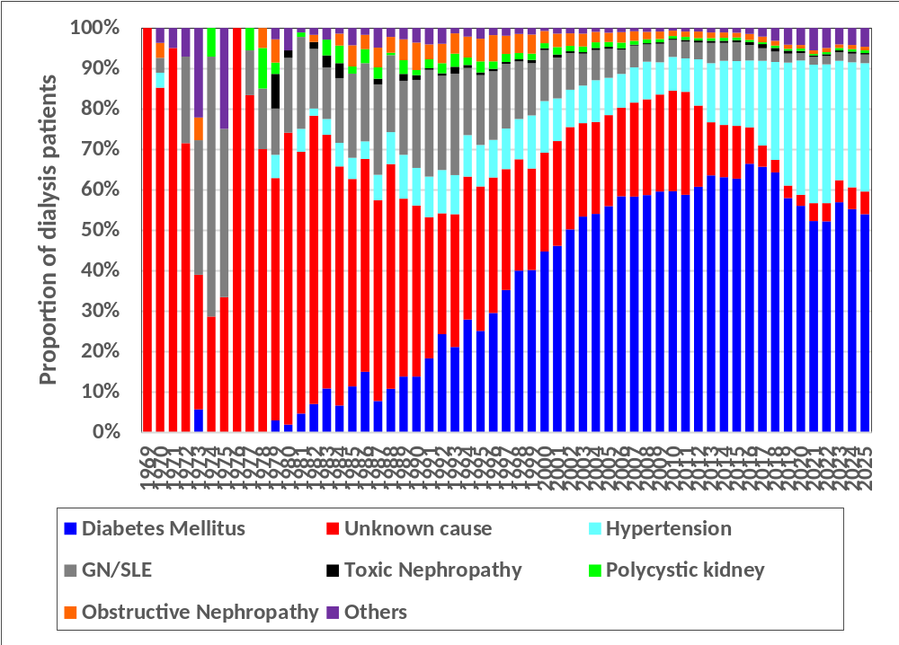
Figure 2.1.8: Primary Renal Diseases for New Dialysis Patients 1969-2025

Slide 36
Table 2.2.1: Number of Dialysis, HD and PD Centres in Malaysia by Sector, Year 2016-2025
Year | 2025 | 2024 | 2023 | 2022 | 2021 | 2020 | 2019 | 2018 | 2017 | 2016
Dialysis Centres | 1186 | 1120 | 1055 | 996 | 934 | 880 | 877 | 859 | 833 | 812
Public Centres | 242 | 238 | 237 | 230 | 228 | 221 | 219 | 210 | 209 | 208
NGO Centres | 171 | 167 | 168 | 164 | 161 | 159 | 175 | 167 | 161 | 162
Private Centres | 773 | 715 | 650 | 602 | 545 | 500 | 483 | 482 | 463 | 442
HD Centres | 1112 | 1047 | 985 | 931 | 875 | 827 | 824 | 807 | 783 | 762
Public HD Centres | 182 | 178 | 178 | 176 | 178 | 175 | 174 | 168 | 169 | 168
NGO HD Centres | 171 | 167 | 168 | 164 | 161 | 159 | 175 | 167 | 161 | 162
Private HD Centres | 759 | 702 | 639 | 591 | 536 | 493 | 475 | 472 | 453 | 432
PD Centres | 74 | 73 | 70 | 65 | 59 | 53 | 53 | 52 | 50 | 50
Public PD Centres | 60 | 60 | 59 | 54 | 50 | 46 | 45 | 42 | 40 | 40
NGO PD Centres | 0 | 0 | 0 | 0 | 0 | 0 | 0 | 0 | 0 | 0
Private PD Centres | 14 | 13 | 11 | 11 | 9 | 7 | 8 | 10 | 10 | 10

Slide 37
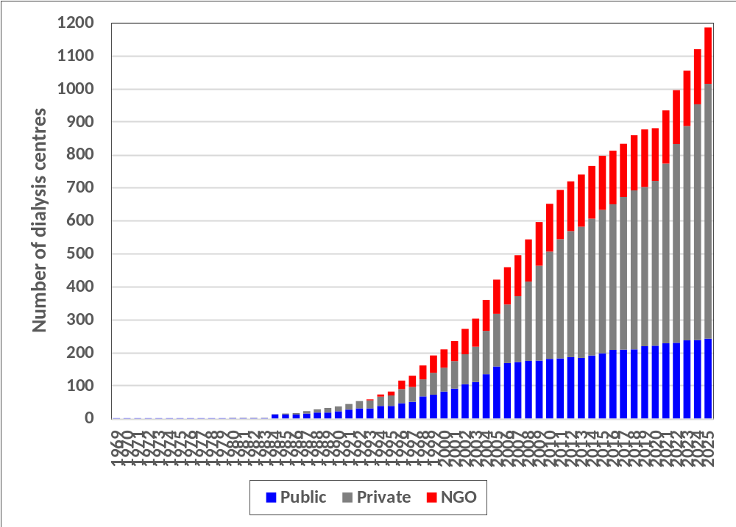
Figure 2.2.1(a): Number of Dialysis Centre in Malaysia by Sector, 1969-2025

Slide 38
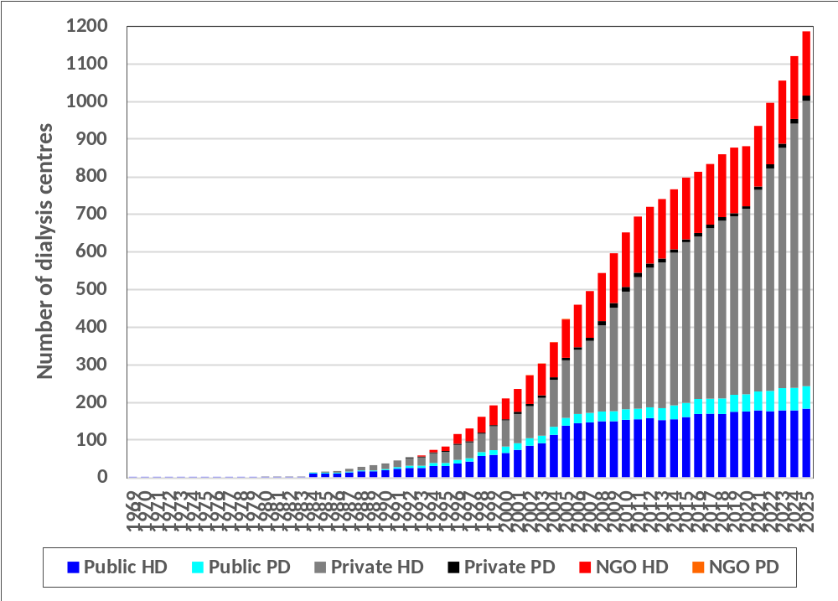
Figure 2.2.1(b): Number of HD and PD Centre in Malaysia by Sector, 1969-2025

Slide 39
Table 2.2.2: Prevalence Rate of Dialysis (HD+PD), HD and PD Patients in Malaysia by Sector, 2016-2025
Year | 2025 | 2024 | 2023 | 2022 | 2021 | 2020 | 2019 | 2018 | 2017 | 2016
Dialysis patients, pmp | 1684 | 1649 | 1636 | 1597 | 1552 | 1554 | 1460 | 1382 | 1329 | 1284
Public, pmp | 453 | 463 | 467 | 466 | 455 | 458 | 435 | 412 | 400 | 388
NGO, pmp | 250 | 252 | 258 | 262 | 267 | 281 | 275 | 270 | 269 | 267
Private, pmp | 981 | 934 | 911 | 869 | 829 | 815 | 750 | 701 | 660 | 628
HD patients, pmp | 1485 | 1449 | 1436 | 1402 | 1370 | 1383 | 1307 | 1241 | 1195 | 1158
Public, pmp | 256 | 265 | 269 | 273 | 275 | 289 | 283 | 272 | 267 | 264
NGO, pmp | 250 | 252 | 258 | 262 | 267 | 281 | 275 | 270 | 269 | 267
Private, pmp | 978 | 932 | 909 | 868 | 828 | 814 | 749 | 699 | 658 | 627
PD patients, pmp | 199 | 200 | 200 | 195 | 182 | 170 | 153 | 141 | 134 | 126
Public, pmp | 197 | 198 | 198 | 193 | 180 | 169 | 152 | 140 | 132 | 124
NGO, pmp | 0 | 0 | 0 | 0 | 0 | 0 | 0 | 0 | 0 | 0
Private, pmp | 2 | 2 | 2 | 2 | 1 | 1 | 1 | 1 | 1 | 1

Slide 40
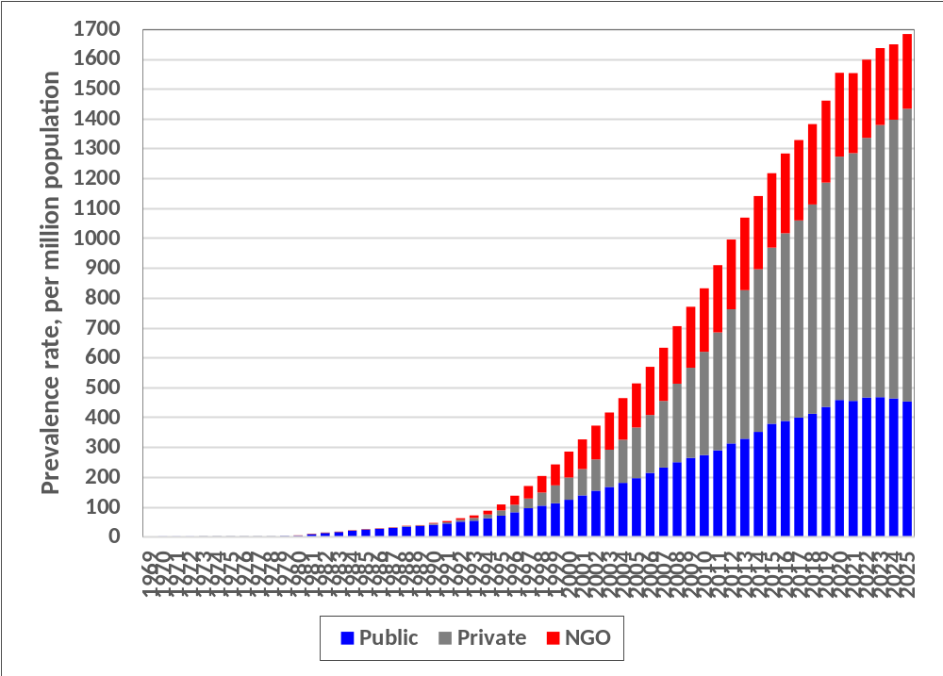
Figure 2.2.2(a): Prevalence Rate of Dialysis Patient (HD+PD) Malaysia by Sector, 1969-2025

Slide 41
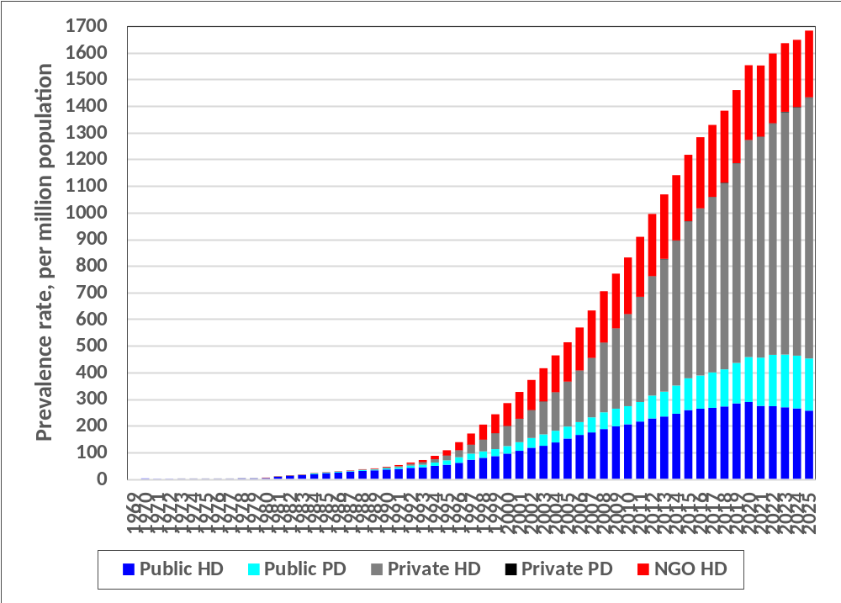
Figure 2.2.2(b): Prevalence Rate of HD and PD Patient in Malaysia by Sector, 1969-2025

Slide 42
Table 2.2.3: Distribution of Dialysis Patients by Modality and Region 2016-2025
Year | 2025 | 2024 | 2023 | 2022 | 2021 | 2020 | 2019 | 2018 | 2017 | 2016
New Dialysis patients | 9905 | 10056 | 10446 | 10087 | 9434 | 9492 | 9499 | 8554 | 8089 | 8110
% West Coast | 72.3 | 72.8 | 72.8 | 73.0 | 74.2 | 75.1 | 73.6 | 75.3 | 75.0 | 74.5
% East Coast | 14.3 | 14.6 | 14.2 | 14.0 | 13.8 | 13.6 | 14.0 | 13.7 | 12.8 | 13.4
% East Msia | 13.4 | 12.6 | 13.0 | 13.0 | 12.0 | 11.3 | 12.4 | 11.0 | 12.2 | 12.0
New HD patients | 8089 | 8249 | 8479 | 8170 | 7738 | 7923 | 8066 | 7324 | 6955 | 7104
% West Coast | 74.3 | 75.3 | 74.8 | 74.8 | 76.4 | 76.9 | 74.4 | 75.5 | 75.6 | 75.3
% East Coast | 14.6 | 14.8 | 14.5 | 14.0 | 13.3 | 13.0 | 12.9 | 13.4 | 12.0 | 12.6
% East Msia | 11.1 | 9.9 | 10.7 | 11.1 | 10.3 | 10.1 | 12.7 | 11.1 | 12.4 | 12.1
New PD patients | 1816 | 1807 | 1967 | 1917 | 1696 | 1569 | 1433 | 1230 | 1134 | 1006
% West Coast | 63.3 | 61.0 | 64.2 | 65.2 | 64.2 | 65.7 | 68.9 | 73.9 | 71.4 | 69.6
% East Coast | 13.1 | 13.8 | 12.9 | 13.9 | 16.3 | 16.8 | 20.5 | 15.7 | 17.6 | 19.4
% East Msia | 23.7 | 25.1 | 23.0 | 21.0 | 19.5 | 17.5 | 10.6 | 10.4 | 10.9 | 11.0
Dialysing at 31st Dec | 57638 | 56149 | 54662 | 52221 | 50559 | 50412 | 47498 | 44758 | 42550 | 40603
% West Coast | 72.9 | 73.0 | 73.4 | 73.6 | 73.9 | 74.5 | 74.6 | 75.1 | 75.5 | 76.0
% East Coast | 13.2 | 13.2 | 13.0 | 13.0 | 12.9 | 12.7 | 12.5 | 12.3 | 12.0 | 11.9
% East Msia | 14.0 | 13.7 | 13.6 | 13.4 | 13.1 | 12.8 | 12.9 | 12.6 | 12.5 | 12.2
HD patients at 31st Dec | 50833 | 49339 | 47979 | 45859 | 44633 | 44883 | 42516 | 40194 | 38264 | 36626
% West Coast | 73.9 | 74.0 | 74.3 | 74.4 | 74.6 | 74.9 | 74.8 | 75.3 | 75.6 | 76.1
% East Coast | 13.2 | 13.3 | 12.9 | 12.7 | 12.5 | 12.2 | 12.1 | 11.9 | 11.5 | 11.4
% East Msia | 12.9 | 12.7 | 12.8 | 12.9 | 12.9 | 12.9 | 13.1 | 12.8 | 12.8 | 12.4
PD patients at 31st Dec | 6805 | 6810 | 6683 | 6362 | 5926 | 5529 | 4982 | 4564 | 4286 | 3977
% West Coast | 65.4 | 66.0 | 66.8 | 67.5 | 68.6 | 70.9 | 73.1 | 73.6 | 73.8 | 74.3
% East Coast | 12.9 | 13.1 | 13.8 | 15.2 | 16.5 | 16.6 | 16.3 | 15.8 | 16.2 | 16.2
% East Msia | 21.7 | 20.9 | 19.3 | 17.3 | 14.9 | 12.5 | 10.6 | 10.6 | 10.0 | 9.6

Slide 43
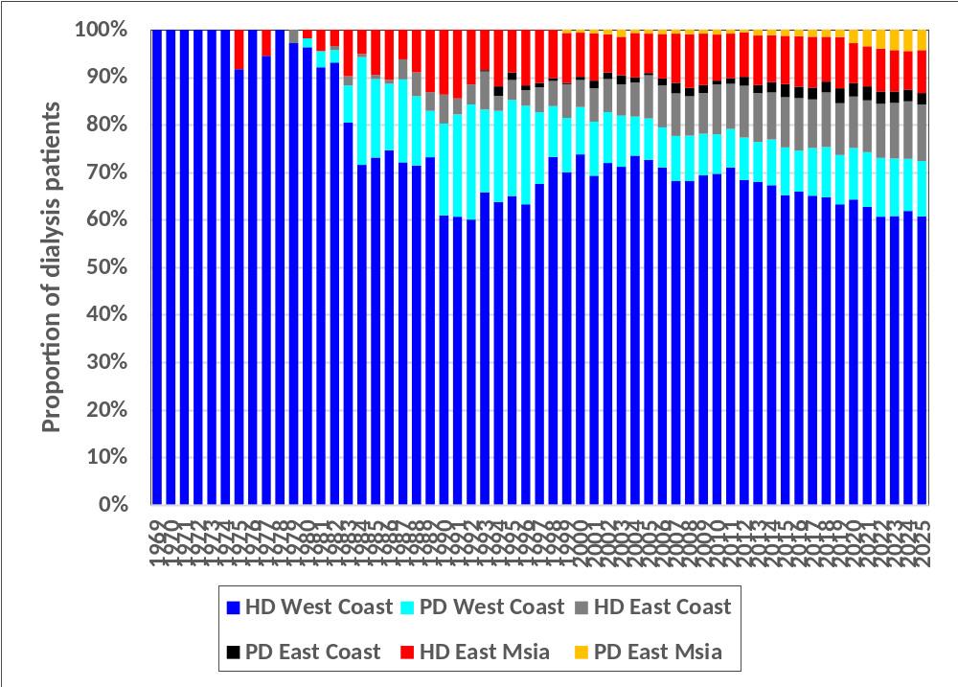
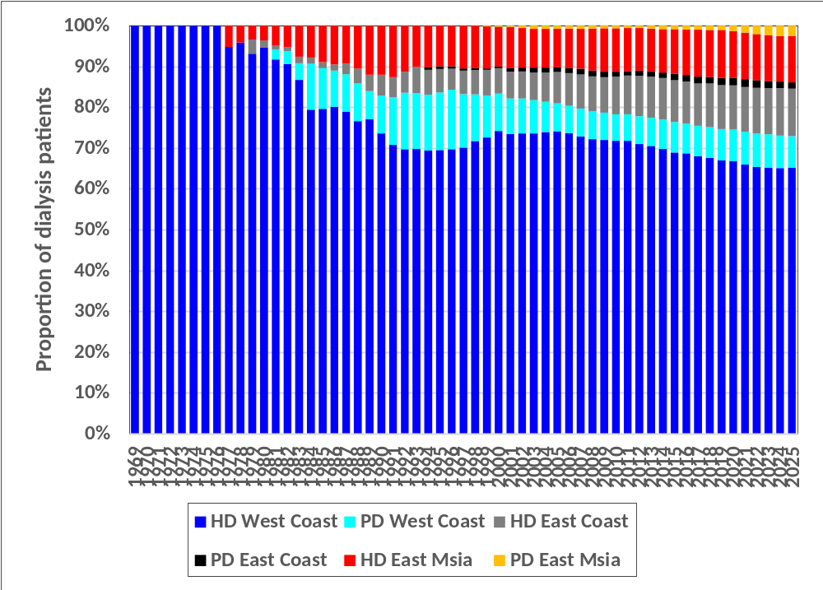
Figure 2.2.3: Distribution of Dialysis Patients by Modality and Region 1969-2025
(i) New Dialysis Patients
(ii) ESKD Patients at 31st December

Slide 44
Table 2.2.4: Number and Prevalence Rate of Dialysis Patients (HD & PD) in Malaysia by State and Sector, 2021-2025
State | Sector | 2025 |  | 2024 |  | 2023 |  | 2022 |  | 2021
 |  | n | PMP | n | PMP | n | PMP | n | PMP | n | PMP
Malaysia | Public | 15500 | 453 | 15763 | 463 | 15613 | 467 | 15233 | 466 | 14830 | 455
 | Private | 33566 | 981 | 31808 | 934 | 30425 | 911 | 28427 | 869 | 27022 | 829
 | NGO | 8572 | 250 | 8578 | 252 | 8624 | 258 | 8561 | 262 | 8707 | 267
 | Total | 57638 | 1684 | 56149 | 1649 | 54662 | 1636 | 52221 | 1597 | 50559 | 1552
Johor | Public | 1320 | 314 | 1471 | 351 | 1455 | 354 | 1387 | 344 | 1317 | 328
 | Private | 5844 | 1390 | 5513 | 1317 | 5337 | 1299 | 5156 | 1280 | 4938 | 1228
 | NGO | 1451 | 345 | 1489 | 356 | 1559 | 380 | 1601 | 397 | 1670 | 415
 | Total | 8615 | 2049 | 8473 | 2024 | 8351 | 2033 | 8144 | 2022 | 7925 | 1971
Kedah | Public | 1030 | 462 | 1066 | 481 | 1107 | 506 | 1106 | 511 | 1103 | 513
 | Private | 2708 | 1216 | 2488 | 1122 | 2335 | 1067 | 2058 | 951 | 2048 | 952
 | NGO | 377 | 169 | 366 | 165 | 369 | 169 | 382 | 177 | 410 | 191
 | Total | 4115 | 1848 | 3920 | 1768 | 3811 | 1741 | 3546 | 1639 | 3561 | 1655
Kelantan | Public | 943 | 495 | 942 | 499 | 938 | 504 | 922 | 504 | 912 | 503
 | Private | 1276 | 669 | 1155 | 612 | 1052 | 566 | 890 | 486 | 813 | 449
 | NGO | 252 | 132 | 256 | 136 | 246 | 132 | 226 | 123 | 224 | 124
 | Total | 2471 | 1296 | 2353 | 1246 | 2236 | 1202 | 2038 | 1113 | 1949 | 1075
Melaka | Public | 448 | 426 | 416 | 397 | 396 | 385 | 388 | 385 | 391 | 389
 | Private | 1656 | 1574 | 1626 | 1553 | 1474 | 1433 | 1382 | 1370 | 1240 | 1234
 | NGO | 212 | 202 | 218 | 208 | 276 | 268 | 264 | 262 | 266 | 265
 | Total | 2316 | 2202 | 2260 | 2158 | 2146 | 2087 | 2034 | 2017 | 1897 | 1889
Negeri Sembilan | Public | 725 | 583 | 773 | 623 | 804 | 656 | 780 | 646 | 772 | 641
 | Private | 1395 | 1121 | 1322 | 1066 | 1186 | 968 | 1084 | 897 | 1029 | 855
 | NGO | 596 | 479 | 550 | 444 | 555 | 453 | 607 | 503 | 623 | 517
 | Total | 2716 | 2183 | 2645 | 2133 | 2545 | 2078 | 2471 | 2046 | 2424 | 2013
Pahang | Public | 927 | 553 | 991 | 594 | 971 | 591 | 1010 | 626 | 994 | 621
 | Private | 1541 | 919 | 1453 | 871 | 1367 | 832 | 1205 | 746 | 1112 | 694
 | NGO | 329 | 196 | 315 | 189 | 314 | 191 | 341 | 211 | 348 | 217
 | Total | 2797 | 1668 | 2759 | 1654 | 2652 | 1614 | 2556 | 1583 | 2454 | 1532
Perak | Public | 1330 | 517 | 1313 | 511 | 1307 | 514 | 1227 | 488 | 1204 | 479
 | Private | 3378 | 1312 | 3199 | 1245 | 3299 | 1298 | 3323 | 1322 | 3212 | 1277
 | NGO | 647 | 251 | 656 | 255 | 666 | 262 | 649 | 258 | 655 | 260
 | Total | 5355 | 2081 | 5168 | 2011 | 5272 | 2075 | 5199 | 2068 | 5071 | 2016
Perlis | Public | 119 | 401 | 122 | 411 | 131 | 447 | 124 | 428 | 100 | 348
 | Private | 166 | 559 | 165 | 556 | 146 | 498 | 131 | 452 | 132 | 459
 | NGO | 51 | 172 | 46 | 155 | 38 | 130 | 39 | 135 | 41 | 143
 | Total | 336 | 1131 | 333 | 1122 | 315 | 1075 | 294 | 1014 | 273 | 949
State | Sector | 2025 |  | 2024 |  | 2023 |  | 2022 |  | 2021
 |  | n | PMP | n | PMP | n | PMP | n | PMP | n | PMP
Pulau Pinang | Public | 422 | 234 | 452 | 251 | 465 | 262 | 465 | 267 | 465 | 267
 | Private | 2369 | 1313 | 2342 | 1301 | 2268 | 1279 | 2185 | 1255 | 2063 | 1186
 | NGO | 841 | 466 | 868 | 482 | 843 | 476 | 867 | 498 | 922 | 530
 | Total | 3632 | 2013 | 3662 | 2034 | 3576 | 2017 | 3517 | 2020 | 3450 | 1983
Sabah | Public | 2093 | 557 | 2033 | 543 | 1958 | 544 | 1863 | 546 | 1761 | 516
 | Private | 682 | 182 | 645 | 172 | 617 | 172 | 597 | 175 | 590 | 173
 | NGO | 368 | 98 | 328 | 88 | 305 | 85 | 290 | 85 | 289 | 85
 | Total | 3143 | 837 | 3006 | 803 | 2880 | 801 | 2750 | 805 | 2640 | 774
Sarawak | Public | 2034 | 804 | 1992 | 791 | 1942 | 776 | 1840 | 744 | 1709 | 693
 | Private | 1442 | 570 | 1306 | 519 | 1238 | 495 | 1142 | 462 | 1063 | 431
 | NGO | 1310 | 518 | 1287 | 511 | 1272 | 508 | 1164 | 471 | 1105 | 448
 | Total | 4786 | 1893 | 4585 | 1821 | 4452 | 1779 | 4146 | 1676 | 3877 | 1572
Selangor | Public | 1949 | 263 | 1935 | 263 | 1901 | 264 | 1891 | 268 | 1853 | 264
 | Private | 7819 | 1055 | 7390 | 1004 | 7074 | 981 | 6426 | 911 | 6055 | 863
 | NGO | 1174 | 158 | 1180 | 160 | 1192 | 165 | 1155 | 164 | 1189 | 170
 | Total | 10942 | 1477 | 10505 | 1427 | 10167 | 1410 | 9472 | 1343 | 9097 | 1297
Terengganu | Public | 1036 | 832 | 1074 | 872 | 1119 | 925 | 1157 | 975 | 1192 | 1018
 | Private | 1015 | 815 | 941 | 764 | 828 | 684 | 758 | 639 | 670 | 572
 | NGO | 264 | 212 | 301 | 244 | 284 | 235 | 279 | 235 | 280 | 239
 | Total | 2315 | 1858 | 2316 | 1880 | 2231 | 1844 | 2194 | 1849 | 2142 | 1830
W.P. Labuan | Public | 121 | 1199 | 116 | 1151 | 116 | 1172 | 113 | 1166 | 115 | 1198
 | Private | 0 | 0 | 0 | 0 | 0 | 0 | 0 | 0 | 0 | 0
 | NGO | 0 | 0 | 0 | 0 | 0 | 0 | 0 | 0 | 0 | 0
 | Total | 121 | 1199 | 116 | 1151 | 116 | 1172 | 113 | 1166 | 115 | 1198
W.P. Putrajaya | Public | 130 | 1077 | 116 | 964 | 80 | 673 | 53 | 453 | 40 | 347
 | Private | 28 | 232 | 29 | 241 | 35 | 295 | 33 | 282 | 33 | 286
 | NGO | 0 | 0 | 0 | 0 | 0 | 0 | 0 | 0 | 0 | 0
 | Total | 158 | 1309 | 145 | 1205 | 115 | 968 | 86 | 735 | 73 | 634
W.P. Kuala Lumpur | Public | 873 | 421 | 951 | 460 | 923 | 460 | 907 | 462 | 902 | 459
 | Private | 2247 | 1083 | 2234 | 1081 | 2169 | 1081 | 2057 | 1049 | 2024 | 1031
 | NGO | 700 | 337 | 718 | 347 | 705 | 351 | 697 | 355 | 685 | 349
 | Total | 3820 | 1841 | 3903 | 1888 | 3797 | 1893 | 3661 | 1867 | 3611 | 1839

Slide 45
Data Definition for Diabetes as the Primary Renal Disease
Prior to 2017 when data was submitted in paper form, primary and secondary causes of renal disease were allowed. The National Renal Registry (NRR) office adjudicated discrepancies in the data submitted to determine the primary renal disease (PRD). If the PRD was recorded as unknown and patient has diabetes as the secondary cause or diabetes was included as a co-morbidity, the PRD was amended to diabetes. If there was a discrepancy in PRD reported between centres, one as unknown and the other as diabetes, the PRD was amended to diabetes In 2017 data collection migrated to eNRR, an online electronic form. From 2017 and 1st February 2021, the system allowed more than one PRD. The determination of PRD was based on the following algorithm:: If both unknown and diabetes were selected as PRD, diabetes was recorded as the PRD If the PRD was recorded as unknown and diabetes was included as a co-morbidity, the PRD was amended to diabetes. If there was a discrepancy in PRD reported between centres, the PRD at first notification was used If multiple PRDs were entered, the order for PRD determination is as follows: 1 ADPKD 2 Hereditary nephritis, specify 3 Glomerulonephritis, specify 4 Obstructive uropathy, specify 5 Drugs / toxic nephropathy 6 Diabetes Mellitus 7 Hypertension 8 Others, specify 9 Unknown Examples: If ‘Unknown’ & ‘diabetes’ were selected as PRD then PRD is diabetes If ‘diabetes’ & ‘ADPKD’ were selected as PRD then PRD is ADPKD If ‘Unknown’ was selected as PRD and Comorbidities include diabetes then PRD is diabetes If ‘Unknown’ was selected as PRD and Comorbidities include hypertension then PRD is hypertension Change in PRD is permitted with written request and documentation from the source data providers to NRR

Slide 46
Data Definition for Diabetes as the Primary Renal Disease (Cont.)
From 2nd February 2021 onwards Only a single entry for PRD is permitted If there was a discrepancy in PRD reported between centres, the PRD at first notification was used If PRD is unknown and diabetes is included in comorbidity at notification, “Unknown” PRD is maintained Change in PRD is permitted with written request and documentation from the source data providers to NRR

