Slide 1

CHAPTER 3
DEATH AND SURVIVAL ON DIALYSIS
Loh Chek Loong
Liu Wen Jiun
Wong Koh Wei

Slide 2
Table 3.1.1: Deaths on dialysis 2015-2024
Year | 2024 | 2023 | 2022 | 2021 | 2020 | 2019 | 2018 | 2017 | 2016 | 2015
Number of dialysis patients at risk | 55448 | 54173 | 51823 | 50209 | 50206 | 47425 | 44769 | 42600 | 40626 | 38042
Dialysis deaths | 7608 | 7553 | 8039 | 9103 | 6358 | 6496 | 6155 | 5949 | 5402 | 5004
Dialysis death rate % | 13 | 13 | 15 | 17 | 12 | 13 | 13 | 13 | 13 | 13
Number of HD patients at risk | 48806 | 47789 | 45953 | 44679 | 44898 | 42527 | 40222 | 38318 | 36568 | 34165
HD deaths | 6457 | 6438 | 6855 | 7934 | 5476 | 5603 | 5336 | 5174 | 4671 | 4373
HD death rate % | 12 | 13 | 14 | 16 | 12 | 13 | 13 | 13 | 12 | 12
Number of PD patients at risk | 6642 | 6384 | 5870 | 5530 | 5308 | 4898 | 4547 | 4282 | 4058 | 3877
PD deaths | 1151 | 1115 | 1184 | 1169 | 882 | 893 | 819 | 775 | 731 | 631
PD death rate % | 16 | 17 | 19 | 19 | 16 | 18 | 17 | 17 | 17 | 16

Slide 3
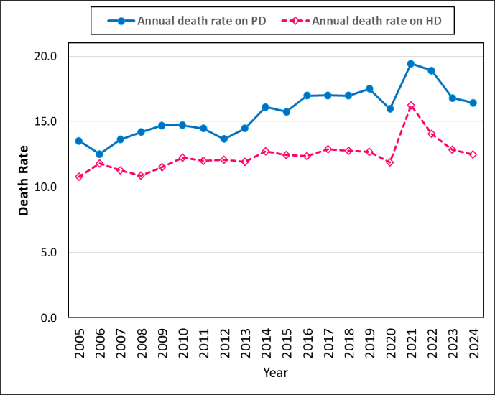
Figure 3.1.1: Death rates on dialysis 2005-2024

Slide 4
Table 3.1.2: Causes of death on dialysis 2015-2024
Year | 2024 |  | 2023 |  | 2022 |  | 2021 |  | 2020 |  | 2019 |  | 2018 |  | 2017 |  | 2016 |  | 2015
Causes of Death (Dialysis) | n | % | n | % | n | % | n | % | n | % | n | % | n | % | n | % | n | % | n | %
Cardiovascular | 1843 | 24.2 | 1772 | 23.5 | 1746 | 21.7 | 1893 | 20.8 | 1741 | 27.4 | 1837 | 28.3 | 1706 | 27.7 | 1730 | 29.1 | 1644 | 30.4 | 1561 | 31.2
Died at home | 760 | 10.0 | 788 | 10.4 | 920 | 11.4 | 982 | 10.8 | 802 | 12.6 | 1016 | 15.6 | 1019 | 16.6 | 965 | 16.2 | 774 | 14.3 | 724 | 14.5
Infection | 2302 | 30.3 | 2354 | 31.2 | 2917 | 36.3 | 3375 | 37.1 | 1600 | 25.2 | 1448 | 22.3 | 1545 | 25.1 | 1475 | 24.8 | 1502 | 27.8 | 1287 | 25.7
CRBSI | 378 | 5.0 | 177 | 2.3 | 181 | 2.3 | 125 | 1.4 | 105 | 1.7 | 102 | 1.6 | 94 | 1.5 | 87 | 1.5 | 55 | 1.0 | 58 | 1.2
PD peritonitis | 207 | 2.7 | 204 | 2.7 | 98 | 1.2 | 82 | 0.9 | 74 | 1.2 | 70 | 1.1 | 69 | 1.1 | 77 | 1.3 | 57 | 1.1 | 49 | 1.0
GIT bleed | 111 | 1.5 | 105 | 1.4 | 117 | 1.5 | 113 | 1.2 | 90 | 1.4 | 98 | 1.5 | 107 | 1.7 | 94 | 1.6 | 91 | 1.7 | 86 | 1.7
Cancer | 169 | 2.2 | 183 | 2.4 | 180 | 2.2 | 160 | 1.8 | 140 | 2.2 | 166 | 2.6 | 154 | 2.5 | 168 | 2.8 | 156 | 2.9 | 123 | 2.5
Liver disease | 25 | 0.3 | 19 | 0.3 | 16 | 0.2 | 23 | 0.3 | 36 | 0.6 | 21 | 0.3 | 23 | 0.4 | 24 | 0.4 | 27 | 0.5 | 24 | 0.5
Withdrawal | 140 | 1.8 | 185 | 2.5 | 52 | 0.7 | 87 | 1.0 | 67 | 1.1 | 99 | 1.5 | 52 | 0.8 | 76 | 1.3 | 66 | 1.2 | 59 | 1.2
Accidental Death | 66 | 0.9 | 54 | 0.7 | 57 | 0.7 | 51 | 0.6 | 48 | 0.8 | 62 | 1.0 | 52 | 0.8 | 55 | 0.9 | 50 | 0.9 | 41 | 0.8
Pulmonary Causes | 204 | 2.7 | 195 | 2.6 | 223 | 2.8 | 488 | 5.4 | 426 | 6.7 | 561 | 8.6 | 446 | 7.3 | 276 | 4.6 | 146 | 2.7 | 124 | 2.5
Others | 541 | 7.1 | 641 | 8.5 | 564 | 7.0 | 633 | 7.0 | 508 | 8.0 | 420 | 6.5 | 408 | 6.6 | 353 | 5.9 | 226 | 4.2 | 204 | 4.1
Unknown | 862 | 11.3 | 876 | 11.6 | 968 | 12.0 | 1091 | 12.0 | 721 | 11.3 | 596 | 9.2 | 480 | 7.8 | 569 | 9.6 | 608 | 11.3 | 664 | 13.3
Total | 7608 | 100 | 7553 | 100 | 8039 | 100 | 9103 | 100 | 6358 | 100 | 6496 | 100 | 6155 | 100 | 5949 | 100 | 5402 | 100 | 5004 | 100

Slide 5
Table 3.1.2: Causes of death on dialysis 2015-2024 (Cont. HD)
Year | 2024 |  | 2023 |  | 2022 |  | 2021 |  | 2020 |  | 2019 |  | 2018 |  | 2017 |  | 2016 |  | 2015
Causes of Death (HD) | n | % | n | % | n | % | n | % | n | % | n | % | n | % | n | % | n | % | n | %
Cardiovascular | 1627 | 25.2 | 1559 | 24.2 | 1503 | 21.9 | 1702 | 21.5 | 1528 | 27.9 | 1642 | 29.3 | 1520 | 28.5 | 1558 | 30.1 | 1491 | 31.9 | 1409 | 32.2
Died at home | 548 | 8.5 | 609 | 9.5 | 701 | 10.2 | 699 | 8.8 | 584 | 10.7 | 745 | 13.3 | 790 | 14.8 | 729 | 14.1 | 560 | 12.0 | 540 | 12.4
Infection | 1952 | 30.2 | 2046 | 31.8 | 2518 | 36.7 | 2955 | 37.2 | 1377 | 25.2 | 1255 | 22.4 | 1335 | 25.0 | 1300 | 25.1 | 1289 | 27.6 | 1139 | 26.1
CRBSI | 378 | 5.9 | 177 | 2.8 | 181 | 2.6 | 125 | 1.6 | 105 | 1.9 | 102 | 1.8 | 94 | 1.8 | 87 | 1.7 | 55 | 1.2 | 58 | 1.3
GIT bleed | 97 | 1.5 | 96 | 1.5 | 100 | 1.5 | 99 | 1.3 | 81 | 1.5 | 81 | 1.5 | 95 | 1.8 | 82 | 1.6 | 83 | 1.8 | 75 | 1.7
Cancer | 163 | 2.5 | 172 | 2.7 | 167 | 2.4 | 150 | 1.9 | 135 | 2.5 | 157 | 2.8 | 148 | 2.8 | 161 | 3.1 | 151 | 3.2 | 117 | 2.7
Liver disease | 24 | 0.4 | 19 | 0.3 | 16 | 0.2 | 23 | 0.3 | 33 | 0.6 | 21 | 0.4 | 23 | 0.4 | 23 | 0.4 | 27 | 0.6 | 24 | 0.6
Withdrawal | 130 | 2.0 | 172 | 2.7 | 45 | 0.7 | 83 | 1.1 | 66 | 1.2 | 88 | 1.6 | 48 | 0.9 | 58 | 1.1 | 56 | 1.2 | 53 | 1.2
Accidental Death | 64 | 1.0 | 52 | 0.8 | 48 | 0.7 | 45 | 0.6 | 45 | 0.8 | 57 | 1.0 | 50 | 0.9 | 53 | 1.0 | 47 | 1.0 | 40 | 0.9
Pulmonary Causes | 180 | 2.8 | 168 | 2.6 | 194 | 2.8 | 445 | 5.6 | 402 | 7.3 | 534 | 9.5 | 419 | 7.9 | 262 | 5.1 | 129 | 2.8 | 116 | 2.7
Others | 516 | 8.0 | 598 | 9.3 | 529 | 7.7 | 606 | 7.6 | 478 | 8.7 | 379 | 6.8 | 377 | 7.1 | 332 | 6.4 | 213 | 4.6 | 191 | 4.4
Unknown | 778 | 12.1 | 770 | 12.0 | 853 | 12.4 | 1002 | 12.6 | 642 | 11.7 | 542 | 9.7 | 437 | 8.2 | 529 | 10.2 | 570 | 12.2 | 611 | 14.0
Total | 6457 | 100 | 6438 | 100 | 6855 | 100 | 7934 | 100 | 5476 | 100 | 5603 | 100 | 5336 | 100 | 5174 | 100 | 4671 | 100 | 4373 | 100

Slide 6
Table 3.1.2: Causes of death on dialysis 2015-2024 (Cont. PD)
Year | 2024 |  | 2023 |  | 2022 |  | 2021 |  | 2020 |  | 2019 |  | 2018 |  | 2017 |  | 2016 |  | 2015
Causes of Death (PD) | n | % | n | % | n | % | n | % | n | % | n | % | n | % | n | % | n | % | n | %
Cardiovascular | 216 | 18.8 | 213 | 19.1 | 243 | 20.5 | 191 | 16.3 | 213 | 24.2 | 195 | 21.8 | 186 | 22.7 | 172 | 22.2 | 153 | 20.9 | 152 | 24.1
Died at home | 212 | 18.4 | 179 | 16.1 | 219 | 18.5 | 283 | 24.2 | 218 | 24.7 | 271 | 30.4 | 229 | 28.0 | 236 | 30.5 | 214 | 29.3 | 184 | 29.2
Infection | 350 | 30.4 | 308 | 27.6 | 399 | 33.7 | 420 | 35.9 | 223 | 25.3 | 193 | 21.6 | 210 | 25.6 | 175 | 22.6 | 213 | 29.1 | 148 | 23.5
PD peritonitis | 207 | 18.0 | 204 | 18.3 | 98 | 8.3 | 82 | 7.0 | 74 | 8.4 | 70 | 7.8 | 69 | 8.4 | 77 | 9.9 | 57 | 7.8 | 49 | 7.8
GIT bleed | 14 | 1.2 | 9 | 0.8 | 17 | 1.4 | 14 | 1.2 | 9 | 1.0 | 17 | 1.9 | 12 | 1.5 | 12 | 1.6 | 8 | 1.1 | 11 | 1.7
Cancer | 6 | 0.5 | 11 | 1.0 | 13 | 1.1 | 10 | 0.9 | 5 | 0.6 | 9 | 1.0 | 6 | 0.7 | 7 | 0.9 | 5 | 0.7 | 6 | 1.0
Liver disease | 1 | 0.1 | 0 | 0.0 | 0 | 0.0 | 0 | 0.0 | 3 | 0.3 | 0 | 0.0 | 0 | 0.0 | 1 | 0.1 | 0 | 0.0 | 0 | 0.0
Withdrawal | 10 | 0.9 | 13 | 1.2 | 7 | 0.6 | 4 | 0.3 | 1 | 0.1 | 11 | 1.2 | 4 | 0.5 | 18 | 2.3 | 10 | 1.4 | 6 | 1.0
Accidental Death | 2 | 0.2 | 2 | 0.2 | 9 | 0.8 | 6 | 0.5 | 3 | 0.3 | 5 | 0.6 | 2 | 0.2 | 2 | 0.3 | 3 | 0.4 | 1 | 0.2
Pulmonary Causes | 24 | 2.1 | 27 | 2.4 | 29 | 2.5 | 43 | 3.7 | 24 | 2.7 | 27 | 3.0 | 27 | 3.3 | 14 | 1.8 | 17 | 2.3 | 8 | 1.3
Others | 25 | 2.2 | 43 | 3.9 | 35 | 3.0 | 27 | 2.3 | 30 | 3.4 | 41 | 4.6 | 31 | 3.8 | 21 | 2.7 | 13 | 1.8 | 13 | 2.1
Unknown | 84 | 7.3 | 106 | 9.5 | 115 | 9.7 | 89 | 7.6 | 79 | 9.0 | 54 | 6.1 | 43 | 5.3 | 40 | 5.2 | 38 | 5.2 | 53 | 8.4
Total | 1151 | 100 | 1115 | 100 | 1184 | 100 | 1169 | 100 | 882 | 100 | 893 | 100 | 819 | 100 | 775 | 100 | 731 | 100 | 631 | 100

Slide 7
Table 3.2.1: Patient survival by dialysis modality (not censored for change of modality), 2005-2024
Dialysis modality Interval (year) | PD |  |  | HD |  |  | All
 | n | % survival | SE | n | % survival | SE | n | % survival | SE
0 | 20877 | 100 |  | 123546 | 100 |  | 144423 | 100
1 | 16695 | 88 | 0 | 100967 | 88 | 0 | 117662 | 88 | 0
2 | 12560 | 75 | 0 | 81645 | 77 | 0 | 94205 | 77 | 0
3 | 9318 | 63 | 0 | 65911 | 68 | 0 | 75229 | 67 | 0
4 | 6835 | 52 | 0 | 52748 | 59 | 0 | 59583 | 58 | 0
5 | 5002 | 44 | 0 | 41599 | 51 | 0 | 46601 | 50 | 0
6 | 3668 | 37 | 0 | 32248 | 43 | 0 | 35916 | 43 | 0
7 | 2805 | 31 | 0 | 24719 | 37 | 0 | 27524 | 36 | 0
8 | 2128 | 27 | 0 | 18897 | 31 | 0 | 21025 | 31 | 0
9 | 1671 | 24 | 0 | 14408 | 27 | 0 | 16078 | 26 | 0
10 | 1262 | 21 | 0 | 10873 | 23 | 0 | 12129 | 22 | 0
11 | 950 | 18 | 0 | 8148 | 19 | 0 | 9097 | 19 | 0
12 | 734 | 16 | 0 | 6094 | 17 | 0 | 6828 | 17 | 0
13 | 572 | 15 | 0 | 4489 | 15 | 0 | 5060 | 15 | 0
14 | 446 | 14 | 0 | 3228 | 13 | 0 | 3671 | 13 | 0
15 | 319 | 12 | 0 | 2317 | 11 | 0 | 2635 | 11 | 0
16 | 222 | 11 | 0 | 1618 | 10 | 0 | 1839 | 10 | 0
17 | 140 | 10 | 0 | 1043 | 9 | 0 | 1182 | 9 | 0
18 | 89 | 9 | 0 | 632 | 8 | 0 | 720 | 8 | 0
19 | 41 | 9 | 0 | 282 | 7 | 0 | 322 | 7 | 0
20 | 1 | 9 | 0 | 6 | 6 | 0 | 6 | 6 | 0

Slide 8
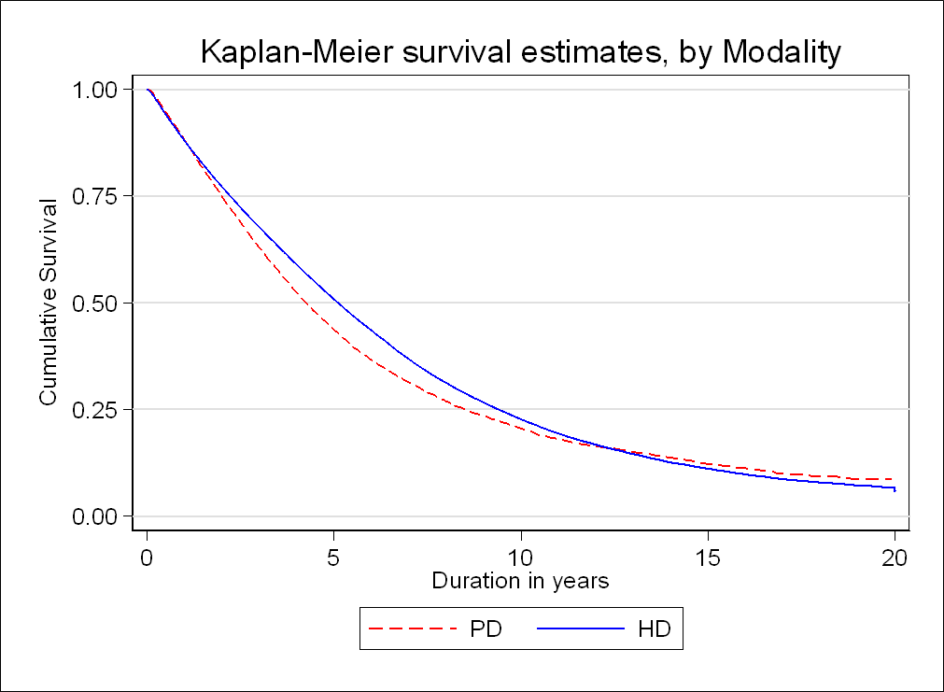
Figure 3.2.1: Patient survival by dialysis modality analysis (not censored for change of modality), 2005-2024

Slide 9
Table 3.2.2: Unadjusted patient survival by age, 2005-2024
Age group (years) Interval (year) | ≤14 |  |  | 15-24 |  |  | 25-34 |  |  | 35-44
 | n | % survival | SE | n | % survival | SE | n | % survival | SE | n | % survival | SE
0 | 1020 | 100 |  | 3669 | 100 |  | 9066 | 100 |  | 16935 | 100
1 | 909 | 94 | 0 | 3240 | 94 | 0 | 7829 | 94 | 0 | 14227 | 92 | 0
2 | 790 | 88 | 0 | 2898 | 90 | 0 | 6670 | 88 | 0 | 11763 | 84 | 0
3 | 704 | 85 | 0 | 2572 | 87 | 0 | 5771 | 84 | 0 | 9802 | 78 | 0
4 | 617 | 79 | 0 | 2290 | 84 | 0 | 5028 | 80 | 0 | 8209 | 72 | 0
5 | 546 | 75 | 0 | 2029 | 80 | 0 | 4345 | 76 | 0 | 6781 | 65 | 0
6 | 455 | 70 | 0 | 1798 | 77 | 0 | 3725 | 72 | 0 | 5513 | 60 | 0
7 | 402 | 66 | 0 | 1592 | 74 | 0 | 3164 | 67 | 0 | 4530 | 54 | 0
8 | 349 | 63 | 0 | 1379 | 71 | 0 | 2683 | 63 | 0 | 3676 | 49 | 0
9 | 305 | 59 | 0 | 1210 | 68 | 0 | 2234 | 59 | 0 | 3001 | 44 | 0
10 | 259 | 55 | 0 | 1049 | 65 | 0 | 1868 | 56 | 0 | 2379 | 40 | 0
11 | 226 | 53 | 0 | 887 | 63 | 0 | 1537 | 52 | 0 | 1880 | 36 | 0
12 | 198 | 52 | 0 | 736 | 61 | 0 | 1236 | 49 | 0 | 1473 | 33 | 0
13 | 169 | 50 | 0 | 607 | 58 | 0 | 980 | 46 | 0 | 1137 | 29 | 0
14 | 138 | 49 | 0 | 501 | 56 | 0 | 779 | 44 | 0 | 859 | 26 | 0
15 | 102 | 46 | 0 | 397 | 54 | 0 | 582 | 41 | 0 | 645 | 24 | 0
16 | 75 | 45 | 0 | 297 | 52 | 0 | 430 | 39 | 0 | 474 | 21 | 0
17 | 51 | 43 | 0 | 207 | 48 | 0 | 299 | 37 | 0 | 311 | 20 | 0
18 | 35 | 43 | 0 | 124 | 45 | 0 | 182 | 35 | 0 | 198 | 18 | 0
19 | 20 | 42 | 0 | 57 | 42 | 0 | 89 | 34 | 0 | 96 | 17 | 0
20 | 1 | 42 | 0 | 2 | 41 | 0 | 4 | 32 | 0 | 2 | 16 | 0

Slide 10
Table 3.2.2: Unadjusted patient survival by age, 2005-2024 (Cont.)
Age group (years) Interval (year) | 45-54 |  |  | 55-64 |  |  | ≥65
 | n | % survival | SE | n | % survival | SE | n | % survival | SE
0 | 33427 | 100 |  | 44005 | 100 |  | 36849 | 100
1 | 27923 | 90 | 0 | 35856 | 88 | 0 | 28164 | 83 | 0
2 | 22933 | 80 | 0 | 28500 | 76 | 0 | 21088 | 68 | 0
3 | 18856 | 71 | 0 | 22506 | 65 | 0 | 15407 | 55 | 0
4 | 15472 | 63 | 0 | 17329 | 55 | 0 | 11000 | 43 | 0
5 | 12489 | 55 | 0 | 13099 | 46 | 0 | 7658 | 33 | 0
6 | 9946 | 48 | 0 | 9726 | 38 | 0 | 5064 | 25 | 0
7 | 7757 | 41 | 0 | 7052 | 30 | 0 | 3311 | 18 | 0
8 | 5989 | 35 | 0 | 5066 | 25 | 0 | 2137 | 13 | 0
9 | 4596 | 30 | 0 | 3593 | 20 | 0 | 1375 | 9 | 0
10 | 3485 | 26 | 0 | 2451 | 15 | 0 | 854 | 7 | 0
11 | 2614 | 22 | 0 | 1620 | 12 | 0 | 523 | 5 | 0
12 | 1929 | 19 | 0 | 1097 | 9 | 0 | 322 | 3 | 0
13 | 1386 | 16 | 0 | 737 | 7 | 0 | 184 | 2 | 0
14 | 967 | 13 | 0 | 446 | 5 | 0 | 99 | 2 | 0
15 | 664 | 11 | 0 | 288 | 4 | 0 | 57 | 1 | 0
16 | 444 | 9 | 0 | 172 | 3 | 0 | 26 | 1 | 0
17 | 277 | 8 | 0 | 90 | 2 | 0 | 4 | 0 | 0
18 | 174 | 7 | 0 | 50 | 2 | 0 | 2 | 0 | 0
19 | 69 | 6 | 0 | 23 | 2 | 0 | 1 | 0 | 0
20 | 1 | 6 | 0 | 1 | 2 | 0 | 1 | 0 | 0

Slide 11
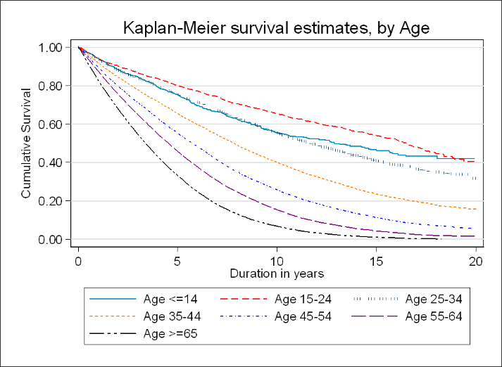
Figure 3.2.2: Unadjusted patient survival by age, 2005-2024

Slide 12
Table 3.2.3: Unadjusted patient survival by diabetes mellitus status, 2005-2024
Diabetes status Interval (year) | Non-diabetic |  |  | Diabetic
 | n | % survival | SE | n | % survival | SE
0 | 58886 | 100 |  | 85653 | 100
1 | 48651 | 90 | 0 | 69158 | 86 | 0
2 | 40157 | 82 | 0 | 54169 | 73 | 0
3 | 32986 | 75 | 0 | 42344 | 62 | 0
4 | 27020 | 68 | 0 | 32658 | 52 | 0
5 | 22054 | 61 | 0 | 24654 | 42 | 0
6 | 17829 | 55 | 0 | 18192 | 34 | 0
7 | 14659 | 50 | 0 | 12980 | 27 | 0
8 | 11975 | 45 | 0 | 9158 | 22 | 0
9 | 9808 | 41 | 0 | 6391 | 17 | 0
10 | 7897 | 37 | 0 | 4356 | 13 | 0
11 | 6329 | 33 | 0 | 2884 | 10 | 0
12 | 5025 | 31 | 0 | 1910 | 8 | 0
13 | 3905 | 28 | 0 | 1256 | 6 | 0
14 | 2981 | 25 | 0 | 779 | 5 | 0
15 | 2221 | 23 | 0 | 489 | 4 | 0
16 | 1627 | 21 | 0 | 275 | 3 | 0
17 | 1091 | 19 | 0 | 132 | 2 | 0
18 | 682 | 18 | 0 | 72 | 2 | 0
19 | 316 | 17 | 0 | 29 | 1 | 0
20 | 6 | 14 | 0 | 1 | 1 | 0

Slide 13
Figure 3.2.3: Unadjusted patient survival by diabetes mellitus status, 2005-2024

Slide 14
Table 3.2.4: Unadjusted patient survival by 4 Era, 2005-2024
Year Interval (year) | 2005-2009 |  |  | 2010-2014 |  |  | 2015-2019 |  |  | 2020-2024
 | n | % survival | SE | n | % survival | SE | n | % survival | SE | n | % survival | SE
0 | 20588 | 100 |  | 32736 | 100 |  | 42434 | 100 |  | 49213 | 100
1 | 18081 | 88 | 0 | 28454 | 87 | 0 | 37324 | 89 | 0 | 34289 | 88 | 0
2 | 15921 | 78 | 0 | 24806 | 76 | 0 | 32259 | 77 | 0 | 21654 | 77 | 0
3 | 14028 | 69 | 0 | 21662 | 67 | 0 | 27750 | 67 | 0 | 12177 | 67 | 0
4 | 12333 | 60 | 0 | 18759 | 58 | 0 | 23623 | 57 | 0 | 5230 | 59 | 0
5 | 10787 | 53 | 0 | 16142 | 50 | 0 | 19911 | 48 | 0 | 106 | 50 | 0
6 | 9441 | 46 | 0 | 13761 | 43 | 0 | 13024 | 41 | 0
7 | 8119 | 40 | 0 | 11673 | 36 | 0 | 8014 | 34 | 0
8 | 6997 | 34 | 0 | 9805 | 31 | 0 | 4474 | 29 | 0
9 | 6121 | 30 | 0 | 8262 | 26 | 0 | 1926 | 24 | 0
10 | 5339 | 26 | 0 | 6920 | 22 | 0 | 80 | 21 | 0
11 | 4629 | 23 | 0 | 4655 | 19 | 0
12 | 4069 | 20 | 0 | 2918 | 16 | 0
13 | 3553 | 18 | 0 | 1642 | 14 | 0
14 | 3086 | 16 | 0 | 699 | 12 | 0
15 | 2721 | 14 | 0 | 9 | 11 | 0
16 | 1912 | 12 | 0
17 | 1232 | 11 | 0
18 | 759 | 10 | 0
19 | 348 | 9 | 0
20 | 6 | 8 | 0

Slide 15
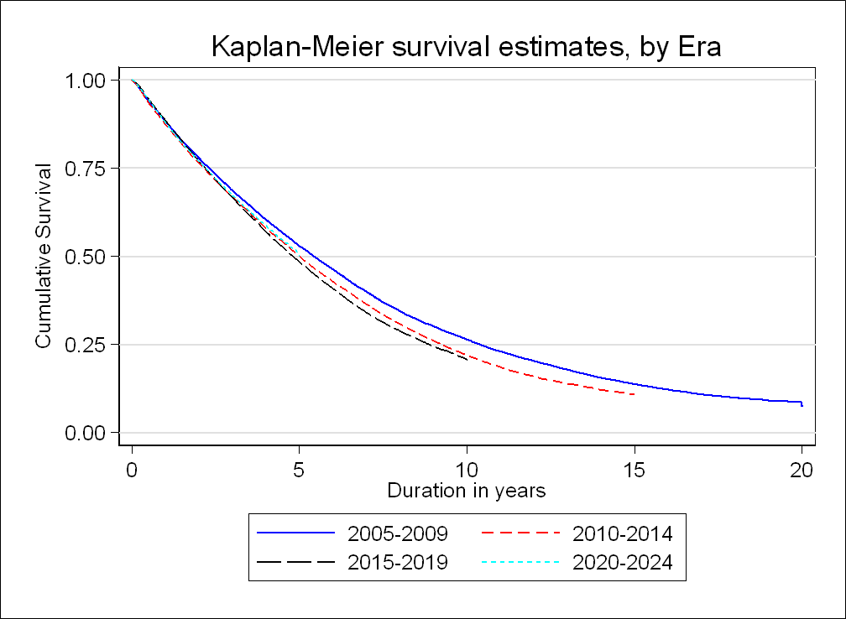
Figure 3.2.4(a): Unadjusted patient survival by 4 Era, 2005-2024

Slide 16
Figure 3.2.4(b): Adjusted for Age and Diabetes patient survival by 4 Era, 2005-2024

Slide 17
Table 3.2.5: Unadjusted HD patient survival by 4 Era, 2005-2024
Year Interval (year) | 2005-2009 |  |  | 2010-2014 |  |  | 2015-2019 |  |  | 2020-2024
 | n | % survival | SE | n | % survival | SE | n | % survival | SE | n | % survival | SE
0 | 18080 | 100 |  | 28921 | 100 |  | 36362 | 100 |  | 40183 | 100
1 | 15903 | 88 | 0 | 25099 | 87 | 0 | 31977 | 89 | 0 | 27988 | 88 | 0
2 | 14037 | 78 | 0 | 21968 | 77 | 0 | 27779 | 77 | 0 | 17861 | 77 | 0
3 | 12404 | 69 | 0 | 19284 | 67 | 0 | 24024 | 67 | 0 | 10199 | 68 | 0
4 | 10947 | 61 | 0 | 16758 | 59 | 0 | 20599 | 58 | 0 | 4444 | 60 | 0
5 | 9604 | 54 | 0 | 14457 | 51 | 0 | 17443 | 49 | 0 | 95 | 51 | 0
6 | 8412 | 47 | 0 | 12333 | 43 | 0 | 11503 | 42 | 0
7 | 7199 | 40 | 0 | 10445 | 37 | 0 | 7075 | 35 | 0
8 | 6191 | 35 | 0 | 8744 | 31 | 0 | 3962 | 29 | 0
9 | 5383 | 30 | 0 | 7343 | 26 | 0 | 1682 | 25 | 0
10 | 4680 | 26 | 0 | 6121 | 22 | 0 | 72 | 21 | 0
11 | 4036 | 23 | 0 | 4112 | 18 | 0
12 | 3524 | 20 | 0 | 2570 | 16 | 0
13 | 3051 | 17 | 0 | 1438 | 14 | 0
14 | 2624 | 15 | 0 | 604 | 12 | 0
15 | 2310 | 13 | 0 | 9 | 11 | 0
16 | 1618 | 12 | 0
17 | 1043 | 10 | 0
18 | 632 | 9 | 0
19 | 282 | 9 | 0
20 | 6 | 7 | 0

Slide 18
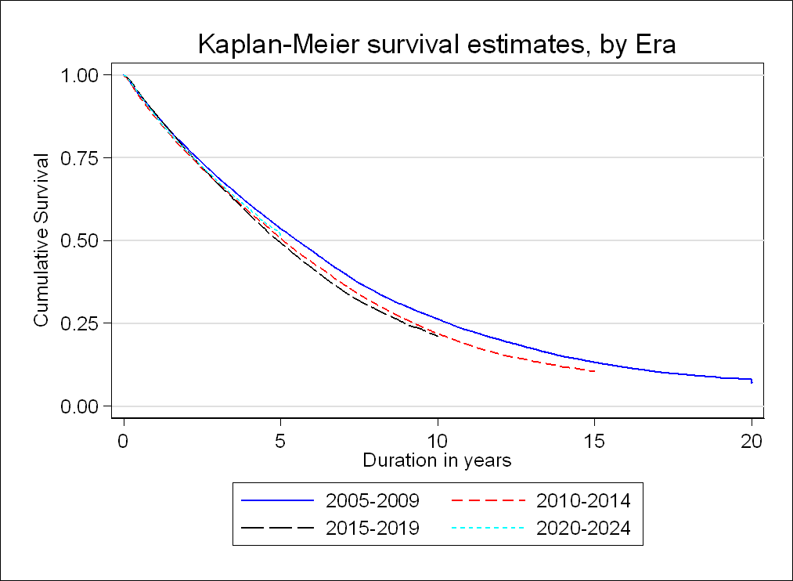
Figure 3.2.5(a): Unadjusted HD patient survival by 4 Era, 2005-2024

Slide 19
Figure 3.2.5(b): Adjusted for Age and Diabetes HD patient survival by 4 Era, 2005-2024

Slide 20
Table 3.2.6: Unadjusted PD patient survival by 4 Era, 2005-2024
Year Interval (year) | 2005-2009 |  |  | 2010-2014 |  |  | 2015-2019 |  |  | 2020-2024
 | n | % survival | SE | n | % survival | SE | n | % survival | SE | n | % survival | SE
0 | 2346 | 100 |  | 3693 | 100 |  | 5940 | 100 |  | 8898 | 100
1 | 2020 | 86 | 0 | 3240 | 88 | 0 | 5226 | 88 | 0 | 6209 | 88 | 0
2 | 1731 | 74 | 0 | 2726 | 74 | 0 | 4368 | 75 | 0 | 3735 | 75 | 0
3 | 1474 | 63 | 0 | 2269 | 62 | 0 | 3621 | 62 | 0 | 1954 | 64 | 0
4 | 1241 | 54 | 0 | 1893 | 52 | 0 | 2923 | 51 | 0 | 778 | 54 | 0
5 | 1040 | 45 | 0 | 1581 | 44 | 0 | 2371 | 42 | 0 | 11 | 44 | 0
6 | 890 | 38 | 0 | 1326 | 37 | 0 | 1454 | 35 | 0
7 | 786 | 34 | 0 | 1130 | 32 | 0 | 889 | 29 | 0
8 | 676 | 29 | 0 | 971 | 27 | 0 | 482 | 24 | 0
9 | 611 | 27 | 0 | 831 | 24 | 0 | 231 | 21 | 0
10 | 537 | 24 | 0 | 715 | 20 | 0 | 12 | 17 | 0
11 | 478 | 21 | 0 | 473 | 18 | 0
12 | 433 | 19 | 0 | 302 | 16 | 0
13 | 398 | 18 | 0 | 175 | 14 | 0
14 | 364 | 16 | 0 | 83 | 13 | 0
15 | 319 | 15 | 0 | 1 | 13 | 0
16 | 222 | 13 | 0
17 | 140 | 12 | 0
18 | 89 | 11 | 0
19 | 41 | 10 | 0
20 | 1 | 10 | 0

Slide 21
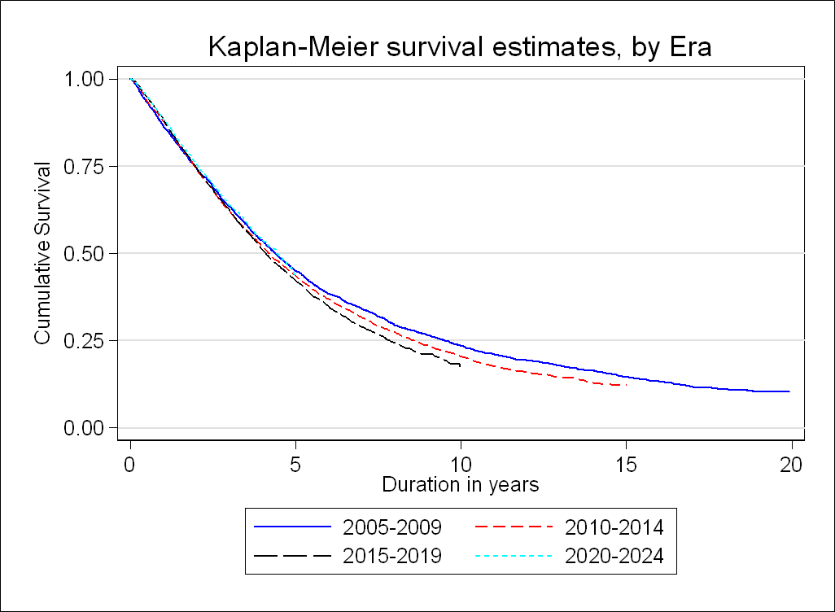
Figure 3.2.6(a): Unadjusted PD patient survival by 4 Era, 2005-2024

Slide 22
Figure 3.2.6(b): Adjusted for Age and Diabetes PD patient survival by 4 Era, 2005-2024

Slide 23
Table 3.3.1: Adjusted hazard ratio for mortality of dialysis patients uncensored for change of modality (2005-2024)
Factors | n | Hazard ratio | 95% CI | P-value
Age (years)
Age 1-14 | 1,013 | 0.55 | (0.43 - 0.71) | < 0.001
Age 15-24 | 3,622 | 0.73 | (0.66 - 0.81) | < 0.001
Age 25-34 ^{(ref*)} | 8,970 | 1.00
Age 35-44 | 16,797 | 1.61 | (1.52 - 1.71) | < 0.001
Age 45-54 | 33,294 | 2.40 | (2.27 - 2.54) | < 0.001
Age 55-64 | 43,904 | 3.36 | (3.17 - 3.55) | < 0.001
Age ≥65 | 36,823 | 4.81 | (4.54 - 5.10) | < 0.001
Gender
Male ^{(ref*)} | 79,261 | 1.00
Female | 65,162 | 0.79 | (0.78 - 0.81) | < 0.001
Primary diagnosis
Unknown primary | 15,404 | 1.11 | (1.03 - 1.20) | 0.007
Diabetes mellitus | 85,521 | 2.13 | (1.98 - 2.29) | < 0.001
GN/SLE ^{(ref*)} | 4,682 | 1.00
Polycystic kidney | 910 | 1.03 | (0.89 - 1.20) | 0.680
Obstructive nephropathy | 1,896 | 1.38 | (1.23 - 1.54) | < 0.001
Toxic nephropathy | 779 | 1.45 | (1.26 - 1.68) | < 0.001
Hypertension | 30,964 | 1.37 | (1.28 - 1.48) | < 0.001
Others | 4,267 | 1.30 | (1.18 - 1.43) | < 0.001

Slide 24
Table 3.3.1: Adjusted hazard ratio for mortality of dialysis patients uncensored for change of modality (2005-2024) (Cont.)
Factors | n | Hazard ratio | 95% CI | P-value
Year start dialysis
2005-2009 ^{(ref*)} | 20,426 | 1.00
2010-2014 | 32,614 | 2.74 | (2.62 - 2.87) | < 0.001
2015-2019 | 42,302 | 6.67 | (6.35 - 7.02) | < 0.001
2020-2024 | 49,081 | 9.10 | (8.60 - 9.62) | < 0.001
Modality
HD ^{(ref*)} | 123,546 | 1.00
PD | 20,877 | 0.92 | (0.89 - 0.95) | < 0.001
BMI
BMI <18.5 | 6,685 | 1.38 | (1.32 - 1.45) | < 0.001
BMI 18.5-25 ^{(ref*)} | 59,192 | 1.00
BMI 25-30 | 40,447 | 0.93 | (0.91 - 0.95) | < 0.001
BMI ≥30 | 19,247 | 0.99 | (0.96 - 1.02) | 0.429
Albumin (g/L)
<25 | 2,976 | 6.88 | (6.46 - 7.33) | < 0.001
25-<30 | 7,031 | 4.10 | (3.92 - 4.28) | < 0.001
30-<35 | 21,263 | 2.36 | (2.29 - 2.44) | < 0.001
35-<40 | 47,695 | 1.39 | (1.35 - 1.43) | < 0.001
≥40 ^{(ref*)} | 30,521 | 1.00

Slide 25
Table 3.3.1: Adjusted hazard ratio for mortality of dialysis patients uncensored for change of modality (2005-2024) (Cont.)
Factors | n | Hazard ratio | 95% CI | P-value
LDL cholesterol (mmol/L)
<1.8 | 23,680 | 1.14 | (1.11 - 1.17) | < 0.001
1.8-<2.6 ^{(ref*)} | 42,898 | 1.00
≥2.6 | 39,625 | 1.09 | (1.06 - 1.11) | < 0.001
Diastolic BP (mmHg)
<70 | 30,694 | 0.88 | (0.85 - 0.91) | < 0.001
70-<80 | 60,257 | 0.87 | (0.85 - 0.90) | < 0.001
80-<90 ^{(ref*)} | 38,267 | 1.00
90-<100 | 8,867 | 1.35 | (1.28 - 1.42) | < 0.001
≥100 | 1,360 | 2.25 | (1.98 - 2.56) | < 0.001
Haemoglobin (g/dL)
<10 | 59,689 | 1.83 | (1.80 - 1.87) | < 0.001
10-<12 ^{(ref*)} | 70,038 | 1.00
≥12 | 8,224 | 0.95 | (0.91 - 1.00) | 0.030
Serum calcium (mmol/L)
<2.1 | 17,418 | 1.02 | (0.99 - 1.04) | 0.316
2.1-≤2.37 ^{(ref*)} | 63,670 | 1.00
>2.37 | 28,184 | 0.94 | (0.92 - 0.96) | < 0.001

Slide 26
Table 3.3.1: Adjusted hazard ratio for mortality of dialysis patients uncensored for change of modality (2005-2024) (Cont.)
Factors | n | Hazard ratio | 95% CI | P-value
Serum phosphate (mmol/L)
<0.8 | 541 | 1.69 | (1.48 - 1.92) | < 0.001
0.8-<1.3 ^{(ref*)} | 13,524 | 1.00
1.3-<1.8 | 48,430 | 0.94 | (0.91 - 0.96) | < 0.001
1.8-<2.2 | 31,241 | 1.01 | (0.98 - 1.05) | 0.524
≥2.2 | 15,702 | 1.25 | (1.20 - 1.30) | < 0.001
HBsAg
Negative ^{(ref*)} | 138,347 | 1.00
Positive | 4,769 | 0.93 | (0.88 - 0.98) | 0.007
Anti-HCV
Negative ^{(ref*)} | 139,935 | 1.00
Positive | 3,181 | 1.05 | (0.98 - 1.12) | 0.144
Cardiovascular disease (CVD)
No CVD ^{(ref*)} | 105,118 | 1.00
CVD | 15,791 | 1.02 | (1.00 - 1.05) | 0.096

Slide 27
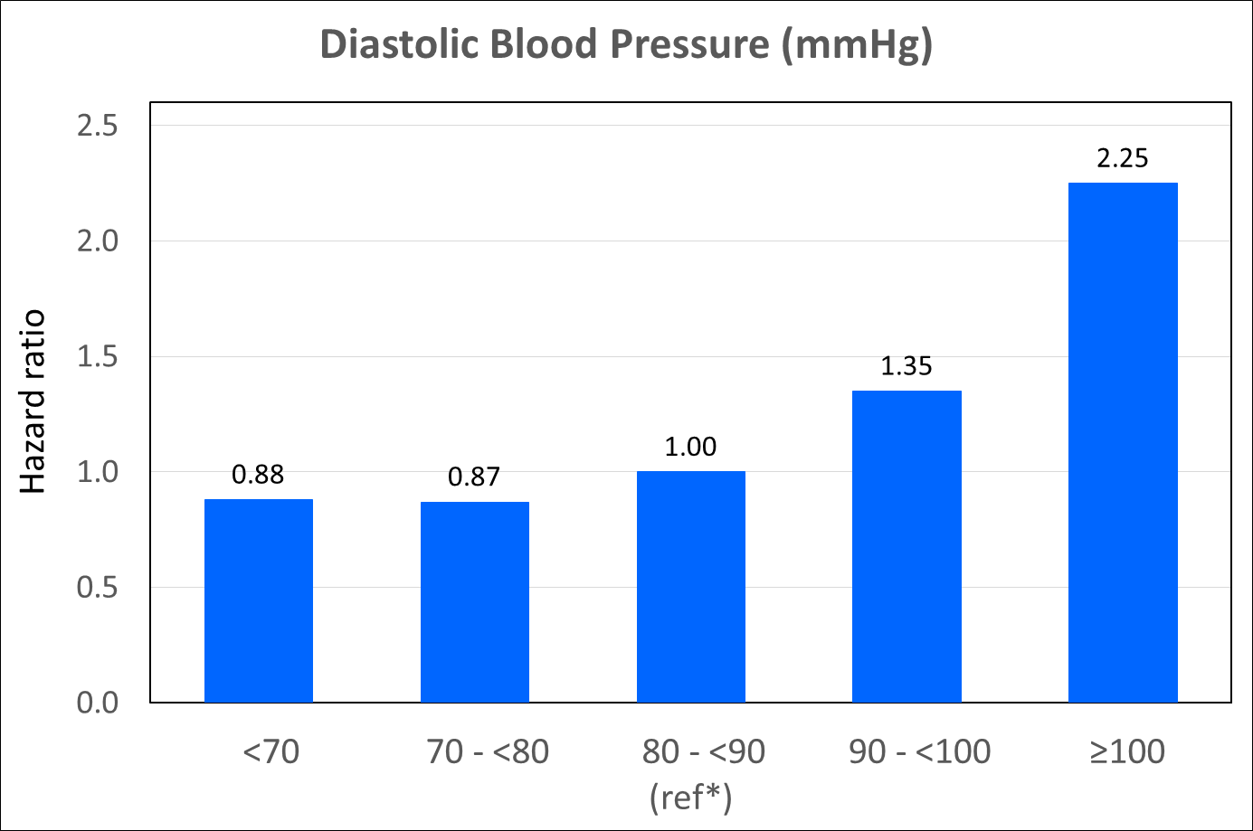
Figure 3.3.1(a): Adjusted hazard ratio for mortality of dialysis patients uncensored for change of modality by diastolic blood pressure (2005-2024 cohort)

Slide 28
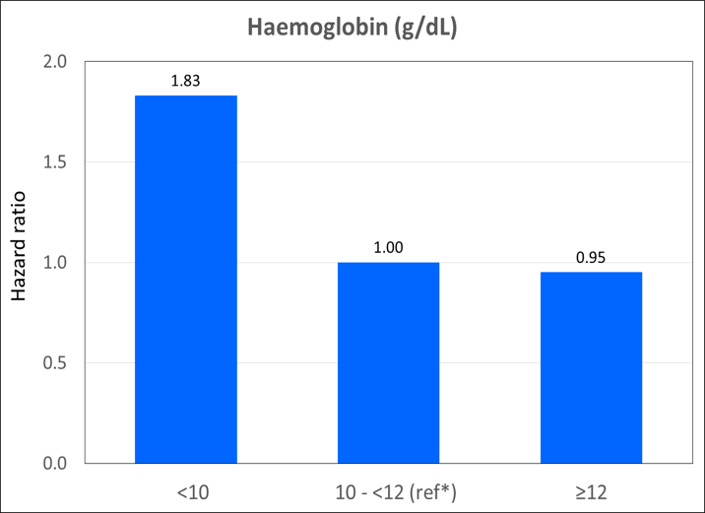
Figure 3.3.1(b): Adjusted hazard ratio for mortality of dialysis patients uncensored for change of modality by haemoglobin (2005-2024 cohort)

Slide 29
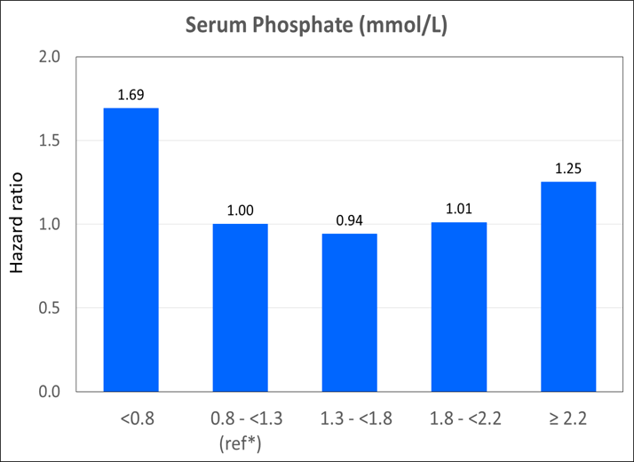
Figure 3.3.1(c): Adjusted hazard ratio for mortality of dialysis patients uncensored for change of modality by serum phosphate (2005-2024 cohort)

Slide 30
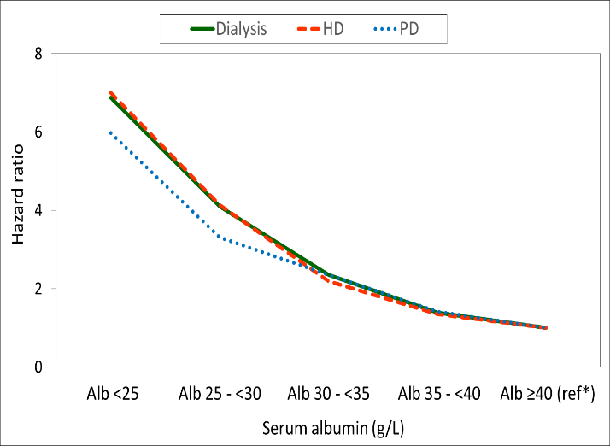
Figure 3.3.1(d): Adjusted hazard ratio for mortality of dialysis patients uncensored for change of modality by serum albumin (2005-2024 cohort)

Slide 31
Table 3.3.2: Adjusted hazard ratio for mortality of HD patients (2005-2024 cohort)
Factors | n | Hazard ratio | 95% CI | P-value
Age (years)
Age 1-14 | 254 | 0.62 | (0.35 - 1.10) | 0.103
Age 15-24 | 2,316 | 0.74 | (0.65 - 0.85) | < 0.001
Age 25-34 ^{(ref*)} | 6,928 | 1.00
Age 35-44 | 13,991 | 1.69 | (1.57 - 1.81) | < 0.001
Age 45-54 | 28,902 | 2.49 | (2.32 - 2.66) | < 0.001
Age 55-64 | 38,365 | 3.52 | (3.28 - 3.77) | < 0.001
Age ≥65 | 32,790 | 5.08 | (4.73 - 5.46) | < 0.001
Gender
Male ^{(ref*)} | 68,255 | 1.00
Female | 55,291 | 0.97 | (0.94 - 0.99) | 0.014
Primary diagnosis
Unknown primary | 13,315 | 1.13 | (1.03 - 1.25) | 0.010
Diabetes mellitus | 74,137 | 2.06 | (1.89 - 2.25) | < 0.001
GN/SLE ^{(ref*)} | 3,242 | 1.00
Polycystic kidney | 809 | 1.05 | (0.89 - 1.25) | 0.550
Obstructive nephropathy | 1,524 | 1.34 | (1.17 - 1.53) | < 0.001
Toxic nephropathy | 643 | 1.47 | (1.23 - 1.76) | < 0.001
Hypertension | 26,554 | 1.37 | (1.25 - 1.50) | < 0.001
Others | 3,322 | 1.28 | (1.13 - 1.44) | < 0.001

Slide 32
Table 3.3.2: Adjusted hazard ratio for mortality of HD patients (2005-2024 cohort) (Cont.)
Factors | n | Hazard ratio | 95% CI | P-value
Year start dialysis
2005-2009 ^{(ref*)} | 18,080 | 1.00
2010-2014 | 28,921 | 2.70 | (2.56 - 2.85) | < 0.001
2015-2019 | 36,362 | 6.43 | (6.07 - 6.80) | < 0.001
2020-2024 | 40,183 | 8.97 | (8.40 - 9.57) | < 0.001
BMI
BMI <18.5 | 5,409 | 1.48 | (1.40 - 1.57) | < 0.001
BMI 18.5-25 ^{(ref*)} | 50,660 | 1.00
BMI 25-30 | 34,602 | 0.84 | (0.81 - 0.86) | < 0.001
BMI ≥30 | 16,844 | 0.77 | (0.74 - 0.80) | < 0.001
Albumin (g/L)
<25 | 1,286 | 7.00 | (6.34 - 7.73) | < 0.001
25-<30 | 3,882 | 4.14 | (3.91 - 4.38) | < 0.001
30-<35 | 15,960 | 2.19 | (2.11 - 2.26) | < 0.001
35-<40 | 42,974 | 1.35 | (1.31 - 1.39) | < 0.001
≥40 ^{(ref*)} | 28,886 | 1.00
LDL cholesterol (mmol/L)
<1.8 | 21,278 | 1.12 | (1.09 - 1.15) | < 0.001
1.8-<2.6 ^{(ref*)} | 37,626 | 1.00
≥2.6 | 31,723 | 1.10 | (1.07 - 1.13) | < 0.001

Slide 33
Table 3.3.2: Adjusted hazard ratio for mortality of HD patients (2005-2024 cohort) (Cont.)
Factors | n | Hazard ratio | 95% CI | P-value
Kt/V
<1 | 3,616 | 2.13 | (2.00 - 2.27) | < 0.001
1-<1.2 | 12,277 | 1.44 | (1.38 - 1.49) | < 0.001
1.2-<1.4 ^{(ref*)} | 27,329 | 1.00
1.4-<1.6 | 24,344 | 0.78 | (0.76 - 0.81) | < 0.001
≥1.6 | 25,556 | 0.64 | (0.61 - 0.66) | < 0.001
Diastolic BP (mmHg)
<70 | 28,377 | 0.91 | (0.88 - 0.94) | < 0.001
70-<80 | 52,087 | 0.90 | (0.87 - 0.92) | < 0.001
80-<90 ^{(ref*)} | 30,141 | 1.00
90-<100 | 7,135 | 1.31 | (1.23 - 1.39) | < 0.001
≥100 | 1,173 | 1.90 | (1.62 - 2.24) | < 0.001
Haemoglobin (g/dL)
<10 | 52,148 | 1.82 | (1.78 - 1.87) | < 0.001
10-<12 ^{(ref*)} | 58,886 | 1.00
≥12 | 6,553 | 0.92 | (0.87 - 0.97) | 0.002
Serum calcium (mmol/L)
<2.1 | 15,728 | 0.98 | (0.95 - 1.02) | 0.304
2.1-≤2.37 ^{(ref*)} | 55,479 | 1.00
>2.37 | 21,670 | 0.95 | (0.92 - 0.97) | < 0.001

Slide 34
Table 3.3.2: Adjusted hazard ratio for mortality of HD patients (2005-2024 cohort) (Cont.)
Factors | n | Hazard ratio | 95% CI | P-value
Serum phosphate (mmol/L)
<0.8 | 436 | 1.62 | (1.38 - 1.89) | < 0.001
0.8-<1.3 ^{(ref*)} | 10,611 | 1.00
1.3-<1.8 | 41,225 | 0.91 | (0.88 - 0.94) | < 0.001
1.8-<2.2 | 27,163 | 0.94 | (0.91 - 0.98) | 0.005
≥2.2 | 13,576 | 1.12 | (1.07 - 1.18) | < 0.001
HBsAg
Negative ^{(ref*)} | 118,585 | 1.00
Positive | 4,062 | 0.94 | (0.89 - 1.00) | 0.047
Anti-HCV
Negative ^{(ref*)} | 119,914 | 1.00
Positive | 2,733 | 1.08 | (1.00 - 1.16) | 0.048
Cardiovascular disease (CVD)
No CVD ^{(ref*)} | 92,066 | 1.00
CVD | 13,032 | 0.99 | (0.96 - 1.02) | 0.560

Slide 35
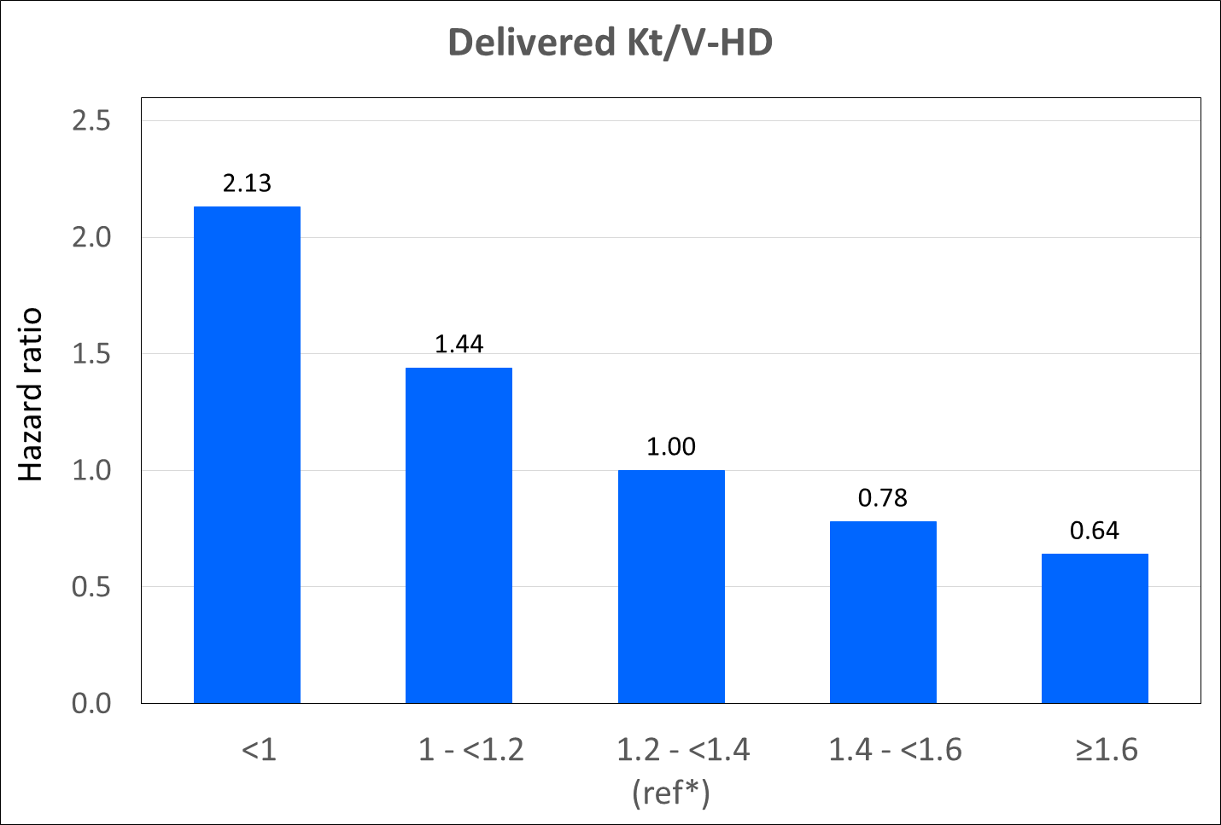
Figure 3.3.2: Adjusted hazard ratio for mortality of HD patients uncensored for change of modality by Kt/V (2005-2024 cohort)

Slide 36
Table 3.3.3: Adjusted hazard ratio for mortality of PD patients (2005-2024 cohort)
Factors | n | Hazard ratio | 95% CI | P-value
Age (years)
Age 1-14 | 759 | 0.44 | (0.32 - 0.60) | < 0.001
Age 15-24 | 1,306 | 0.72 | (0.60 - 0.86) | < 0.001
Age 25-34 ^{(ref*)} | 2,042 | 1.00
Age 35-44 | 2,806 | 1.31 | (1.14 - 1.49) | < 0.001
Age 45-54 | 4,392 | 1.89 | (1.66 - 2.14) | < 0.001
Age 55-64 | 5,539 | 2.59 | (2.28 - 2.95) | < 0.001
Age ≥65 | 4,033 | 3.69 | (3.21 - 4.24) | < 0.001
Gender
Male ^{(ref*)} | 11,006 | 1.00
Female | 9,871 | 0.83 | (0.79 - 0.88) | < 0.001
Primary diagnosis
Unknown primary | 2,089 | 1.06 | (0.88 - 1.26) | 0.545
Diabetes mellitus | 11,384 | 2.32 | (1.99 - 2.69) | < 0.001
GN/SLE ^{(ref*)} | 1,440 | 1.00
Polycystic kidney | 101 | 0.90 | (0.56 - 1.44) | 0.656
Obstructive nephropathy | 372 | 1.58 | (1.24 - 2.02) | < 0.001
Toxic nephropathy | 136 | 1.32 | (0.95 - 1.84) | 0.100
Hypertension | 4,410 | 1.32 | (1.14 - 1.54) | < 0.001
Others | 945 | 1.35 | (1.08 - 1.70) | 0.009

Slide 37
Table 3.3.3: Adjusted hazard ratio for mortality of PD patients (2005-2024 cohort) (Cont.)
Factors | n | Hazard ratio | 95% CI | P-value
Year start dialysis
2005-2009 ^{(ref*)} | 2,346 | 1.00
2010-2014 | 3,693 | 2.86 | (2.42 - 3.37) | < 0.001
2015-2019 | 5,940 | 6.97 | (5.86 - 8.29) | < 0.001
2020-2024 | 8,898 | 8.06 | (6.70 - 9.70) | < 0.001
BMI
BMI <18.5 | 1,276 | 1.41 | (1.24 - 1.61) | < 0.001
BMI 18.5-25 ^{(ref*)} | 8,532 | 1.00
BMI 25-30 | 5,845 | 1.00 | (0.94 - 1.06) | 0.910
BMI ≥30 | 2,403 | 1.11 | (1.02 - 1.21) | 0.016
Albumin (g/L)
<25 | 1,690 | 5.97 | (5.16 - 6.91) | < 0.001
25-<30 | 3,149 | 3.31 | (2.90 - 3.78) | < 0.001
30-<35 | 5,303 | 2.35 | (2.07 - 2.66) | < 0.001
35-<40 | 4,721 | 1.42 | (1.25 - 1.62) | < 0.001
≥40 ^{(ref*)} | 1,635 | 1.00
LDL cholesterol (mmol/L)
<1.8 | 2,402 | 1.11 | (1.03 - 1.20) | 0.009
1.8-<2.6 ^{(ref*)} | 5,272 | 1.00
≥2.6 | 7,902 | 1.13 | (1.07 - 1.20) | < 0.001

Slide 38
Table 3.3.3: Adjusted hazard ratio for mortality of PD patients (2005-2024 cohort) (Cont.)
Factors | n | Hazard ratio | 95% CI | P-value
Diastolic BP (mmHg)
<70 | 2,317 | 1.03 | (0.93 - 1.13) | 0.612
70-<80 | 8,170 | 0.87 | (0.82 - 0.93) | < 0.001
80-<90 ^{(ref*)} | 8,126 | 1.00
90-<100 | 1,732 | 1.28 | (1.13 - 1.46) | < 0.001
≥100 | 187 | 2.38 | (1.61 - 3.52) | < 0.001
Haemoglobin (g/dL)
<10 | 7,541 | 1.40 | (1.31 - 1.49) | < 0.001
10-<12 ^{(ref*)} | 11,152 | 1.00
≥12 | 1,671 | 1.18 | (1.06 - 1.32) | 0.004
Serum calcium (mmol/L)
<2.1 | 1,690 | 1.05 | (0.95 - 1.17) | 0.325
2.1-≤2.37 ^{(ref*)} | 8,191 | 1.00
>2.37 | 6,514 | 0.94 | (0.89 - 1.00) | 0.042
Serum phosphate (mmol/L)
<0.8 | 105 | 2.00 | (1.46 - 2.74) | < 0.001
0.8-<1.3 ^{(ref*)} | 2,913 | 1.00
1.3-<1.8 | 7,205 | 0.85 | (0.79 - 0.92) | < 0.001
1.8-<2.2 | 4,078 | 0.92 | (0.84 - 1.00) | 0.057
≥2.2 | 2,126 | 1.10 | (0.98 - 1.22) | 0.097

Slide 39
Table 3.3.3: Adjusted hazard ratio for mortality of PD patients (2005-2024 cohort) (Cont.)
Factors | n | Hazard ratio | 95% CI | P-value
HBsAg
Negative ^{(ref*)} | 19,762 | 1.00
Positive | 707 | 0.96 | (0.83 - 1.12) | 0.633
Anti-HCV
Negative ^{(ref*)} | 20,021 | 1.00
Positive | 448 | 1.08 | (0.90 - 1.29) | 0.404
Cardiovascular disease (CVD)
No CVD ^{(ref*)} | 13,052 | 1.00
CVD | 2,759 | 1.08 | (1.01 - 1.16) | 0.031

